Slide 1
SASS Reference Groups
ERN Student Enquiry
Identifying and Providing Quality Professional Learning Activities

Slide 2
Acknowledgement of Country
I would like to acknowledge the traditional custodians of the land on which we meet today and pay my respects to Elders past and present, and any Aboriginal people here today.
I would also like to recognise our Aboriginal youth as future leaders.

Slide 3
Housekeeping
Sign on sheets
Restroom
Evacuation Procedures
Lockdown Procedures
Morning tea/lunch tea breaks
Mobile Phones
Emails
Evaluations
Special Needs

Slide 4
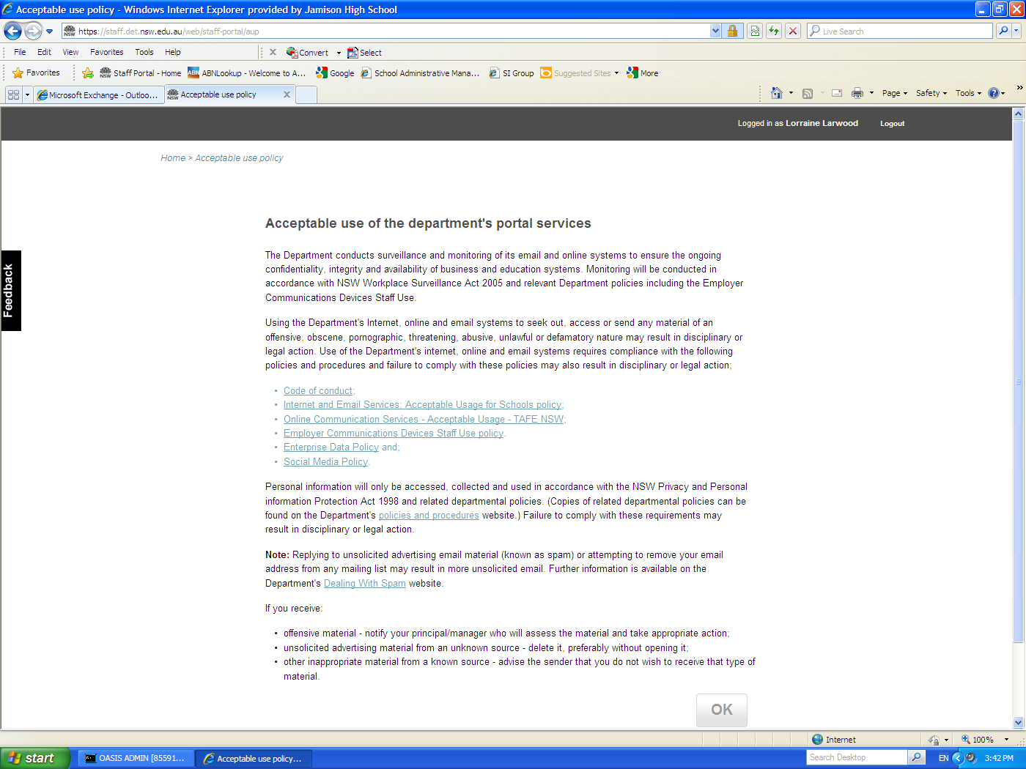
Privacy and Code of Conduct
Remember:
You have the ability to access confidential information – you are bound by the DoE Code of Conduct
and other policies mentioned on the Acceptable Use of the Department’s Portal Services
By clicking “OK” you agree with these conditions
Tip: Lock your computer when you leave the room. Press the Windows flag key + L key to lock your computer

Slide 5
Outcomes: ERN Student Enquiry
On completion of this course participants will be able to:
Locate a student registered at your school
List students enrolled in a particular cohort
Recognise the status of a student
Locate a family of students enrolled at your school
Maintain details of a student at your school

