Slide 1
Excellence in School Administration framework – Relationships
Aspect: Communicate effectively
Focus: 1.2 Written communication
Module: (b) Digital content - emails
Sessions in this module
DoE email policy and procedures
Storing school emails
Structuring emails [this session]
Notes:
Note to presenter
Before commencing this module please read the separate Presenter notes which outline all preparation required to successfully present each session.
Welcome to the third session on Digital Content - Email module supporting the Written Communication focus area of the Excellence in School Administration Framework.
This module is one of a series of modules which have been developed to support the implementation of the Framework and contains notes for the presenter and identifies resources for the participants.

Slide 2
Structure of the module
This module contains 3 sessions and has a total delivery time of 2 hours 15 minutes. Resources for this module include:
PowerPoint presentation session
session 1 – DoE email policy and procedures – 55 minutes
session 2 – Storing school emails – 45 minutes
session 3 – Structuring emails – 35 minutes
presenter notes with pre-reading and guidelines to successfully deliver sessions
handouts and activities.
Purpose
This module is one of a series of modules which have been developed to support the implementation of the Excellence in School Administration Framework
Notes:
Presenter to give an overview as per slide

Slide 3
Delivery
This module can be completed in the following manner:
presentation style – facilitator follows notes/slides and works through activities in a group setting
independently – individual follows slides, notes and works through learning tasks and activities.
To ensure the delivery meets the needs of your audience presenter should consider the following:
for internal presentations (to own staff) prior to presenting the session assess your knowledge of each participant’s experience in this topic, adjust notes and resources where necessary
for external presentations at the commencement of the session ask participants to introduce themselves and briefly explain their reasons for attending, adjust notes and resources where necessary.
Audience
Key audience is the front office administration staff, however it is a useful resource for all non-teaching staff in schools.
Notes:
Presenter to give an overview as per slide

Slide 4
Outcome of the module – digital content - email
At the completion of this module, participants should be able to:
describe the characteristics of well structured, easy to follow written communication and apply these to produce writing in the following forms:
general correspondence
permission notes and newsletters
digital content and email.
Notes:
At the completion of this module you should be able to describe the characteristics of well structured, easy to follow written communication and apply these to produce writing in the following forms:
general correspondence
permission notes and newsletters
digital content and email

Slide 5
Outcome of this session – structuring emails
At the completion of this session, participants should be able to:
write well-constructed, clear, and concise emails.
Notes:
At the completion of this session you should be able to:
write well-constructed, clear and concise emails.

Slide 6
Writing emails
audience
subject
Consider
word count
call to action
Notes:
Emails are increasingly becoming the normal method of communication in school.
Some simple guidelines to think about before you put your hands on the keyboard are:
Click to transition point on slide
Consider your audience
who will be receiving/reading this email?
is the language relevant to them?
Click to transition point on slide
What is the main subject of the email?
some people will not read emails if they don’t have a clear understanding of the content from the subject heading
keep your subject heading clear and short
Click to transition point on slide
How long should your email be?
most of us will only read what is on the screen in front of us and not scroll down further
keep your email clear and succinct
Click to transition point on slide
What is the call to action for this email?
what do you want the reader to do?
when do you want them to do it by?
is there a deadline?
Q: How many words do you consider would be appropriate in a subject heading and can you give examples?
A: 1-6 words, e.g.: K1 excursion 26 July - permission note

Slide 7
Writing emails
Structure
greeting
message
Recipient can’t see you or hear your voice
Choose words carefully to avoid being misconstrued
Listen to your own voice as you write the email
DO NOT WRITE IN CAPITALS – YOU ARE YELLING!
When asking for something give a reason
Notes:
It is basic etiquette to say hello in some way to another person even in emails. Would you start a conversation in person or on the phone by launching directly into what you want to say without saying hello?
Business emails should not be too informal and if you know the person not too formal.
Some good ways to start are:
Dear
Hello
Good morning or good afternoon name
Q: Does anyone else have any suggestions for suitable greetings for emails?
Some points to remember when constructing emails:
imagine you are having a face-to-face conversation when you are writing the email
remember the person receiving the email cannot see you or your body language or hear your voice when you are writing the email so choose your words carefully as they can be misconstrued
sometimes when we are in a rush or under pressure we focus on the sending and not the message and we don’t consider the feelings of the person receiving the email
take your hands off the keyboard and read it again before sending the email
never write an email in capitals to drive your point home, you are actually yelling at the person receiving the email
when you are asking for something give a reason, don’t just ask. Have you ever been asked for something and not been told why? It sounds like an order and not a request.
Q:
Have you ever received an email with insufficient information, asking something of you?
How did you respond?

Slide 8
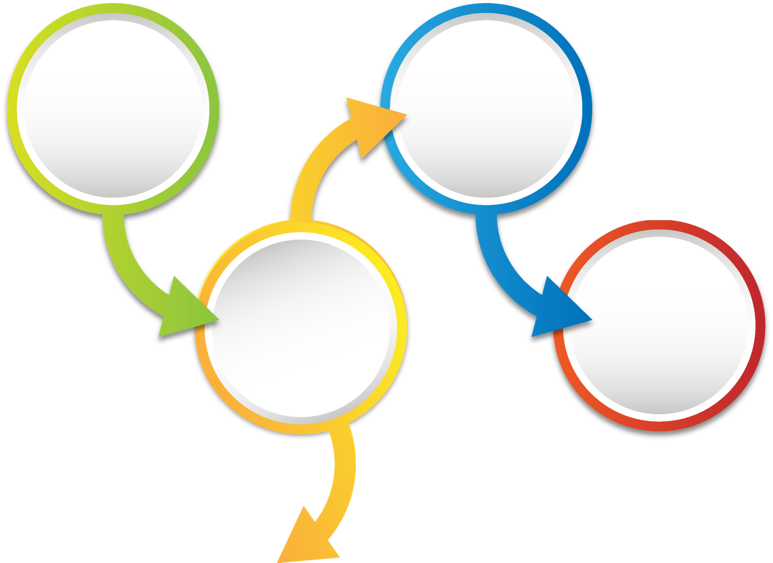
Writing emails
Structure
Don’t use jargon, emojis, symbols, slang
cc
Read it before you hit send
Sign off
Susan Smith, School Administration Officer
Little Valley Primary School
564 Nuton Road
Tahmoor NSW 2167
E: susan.smith@det.nsw.edu.au
Notes:
Other points to consider in the body of the email:
don’t use jargon or slang that the reader might not understand. Your reader may have English as a second language and not understand some words and misconstrue the message
never use emoji's in business emails
sign off your email professionally and with your full title
examples are ‘Thank you‘ or ‘Regards‘
Do you have any other examples of professional sign offs suitable for emails?
Has your school a standard way of signing off your emails?
Ask your principal what they would like to see as a standard sign off for school emails. If everyone in the school who sends emails has a standard way of signing off, it would look extremely professional and send the message that this school is organised.
For example
Susan Smith, School Administration Officer
Little Valley Primary School
564 Nuton Road
Tahmoor NSW 2167
E: susan.smith@det.nsw.edu.au
Q: What do the letters ‘cc’ stand for?
A: Old term ‘carbon copy’ meaning to send a copy of the email to another person with all recipients of the email seeing who is in the conversation.
Q: What then do the letters ‘bcc’ mean?
A: Old term ‘blind carbon copy’ meaning to send a copy of the email to another person and no other recipients of the email can see who is in the conversation or their email address.
Think before adding someone into the conversation. Check that it is appropriate or necessary to have someone else see what the email is about. Sometimes it is necessary that your supervisor knows the action has happened, or they know what was said in the email so you can’t be misquoted. In other situations, it’s awkward or potentially rude to have someone cc’ed into an email that was not intended for a broader audience.
Q: When do you think it would not be appropriate to cc someone else into the email trail?
A: Private conversations
Q: When do you think it would be appropriate to use bcc?
A: Don’t want to reveal other email addresses e.g. emailing out newsletters to parents.
Once you have setup your email sit back and read it, out loud or get someone else to read it before you send it. Emails once sent cannot be retrieved no matter how much you scream at the computer to stop. If you need to, put it in ‘drafts’ overnight and come back to it tomorrow and read it with a fresh mind.

Slide 9
Activity – Writing emails
Notes:
Activity (7 minutes)
Handout Sample Emails (2 pages) activity sheets refer pre-reading
Let’s look at some sample emails.
Read through sample emails 1 to 4 and in pairs and mark how you think these emails could be improved.
Some items to consider:
is the subject heading too long, too short, too detailed
has the email been sent to the right audience, or copied to relevant staff
is the greeting that is used too informal for the audience
does the signoff used in each email accurately reflect who the writer is
Q: Would anyone like to give some feedback on these samples?

Slide 10
Reflecting on this session – structuring emails
Has this session given you an understanding of:
how to write well-constructed, clear, and concise emails.
Notes:
Ask participants to reflect on what they have learned in this session.
Has this session given you an understanding of
how to write well-constructed, clear and concise emails?
Ask participants to reflect individually and then share with the person next to them.

Slide 11
ESA relationship modules
Framework focus area | Module | Session
1.1 Oral communication | a. Face-to-face communication | Quality communication Create a positive image Develop a customer service statement
1.1 Oral communication | b. Telephone communication | Telephone communication Telephone communication procedures
1.2 Written communication | a. Communication guidelines | DoE Style Guide Written communication
1.2 Written communication | b. Digital content – email | DoE email policy and procedures Storing school emails Structuring emails
1.2 Written communication | c. Digital content – website | Keeping your website current School website team
1.3 Building relationships | a. Students as customers | Supporting students Student wellbeing
1.3 Building relationships | b. Connecting with customers | Cultural diversity Aboriginal & Torres Strait Islander customers Welcoming customers with disability Customer complaints - role of SAS staff
1.3 Building relationships | c. Customer feedback | Customer feedback
1.4 Teamwork | a. Keeping staff informed | Keeping staff informed
1.5 Promoting the school and its vision | a. School plan and school culture | School plan and school culture
Professional Learning for Non-Teaching Staff (PLNTS) website
Notes:
This module is one of a series of developed resources to support the Excellence in school administration customer relationships framework.
These are all located on the DoE professional learning website, School Administrative and Support webpage which can be accessed via the portal, Inside the department A-Z.
https://education.nsw.gov.au/teaching-and-learning/professional-learning/professional-learning-for-non-teaching-staff

Slide 12
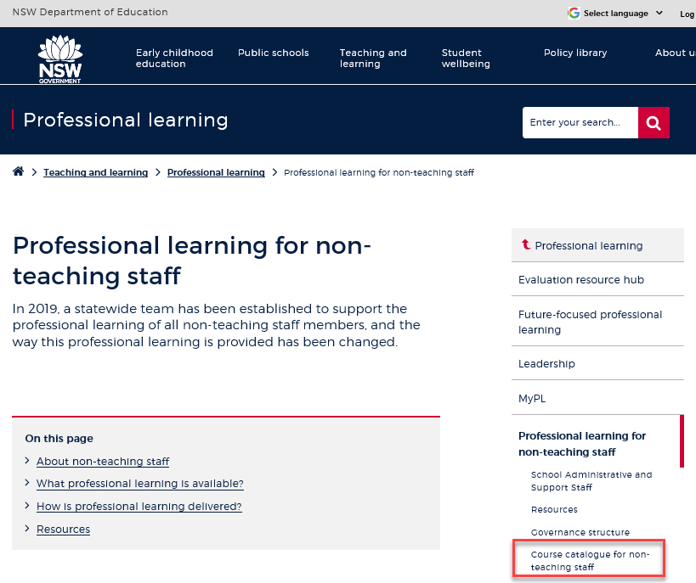
Professional learning information, resources and course catalogue for non-teaching staff
Information about professional learning for non-teaching staff including links to a course catalogue and resources, can be found on the professional learning site of the intranet.
From the Inside the department A-Z tab select:
Professional learning
Professional learning for non-teaching staff
Course catalogue
Notes:
Professional learning information, resources and course catalogue for non-teaching staff.
Professional learning for non-teaching staff
Information about professional learning for non-teaching staff including links to a course catalogue and resources, can be found on the professional learning site of the intranet.
From the Inside the department A-Z tab select:
Professional learning
Professional learning for non-teaching staff
Course catalogue
Our course catalogue has a large range of professional learning events available for non-teaching staff in your area and are a great resource to keep you up to date so you don’t miss out.
https://education.nsw.gov.au/teaching-and-learning/professional-learning/professional-learning-for-non-teaching-staff
https://education.nsw.gov.au/teaching-and-learning/professional-learning/professional-learning-for-non-teaching-staff/course-catalogue-for-non-teaching-staff

Slide 13
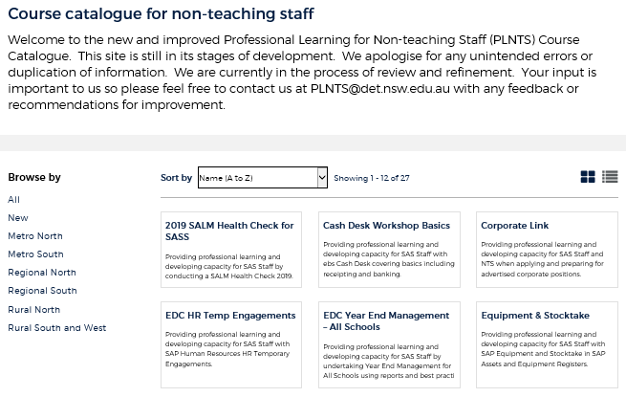
Professional learning for non-teaching staff (PLNTS) catalogue
New and improved layout and features!
Display as a grid or a list
Browse options
Click a course for details, dates, location and MyPL reference
PLNTS catalogue
Notes:
The Professional Learning for Non-Teaching Staff (PLNTS) team’s schedule of professional learning caters for all categories of non-teaching staff in schools across the state.
Please refer to the professional learning catalogue for events that build your skills.
The catalogue is easy to use to find the course you need:
you can display as a grid or as a list
you can also browse by your region or
simply focus on new courses
Once you select a course, you will see
the course details and location
the dates the course is being presented and
the MyPL reference code.
https://education.nsw.gov.au/teaching-and-learning/professional-learning/professional-learning-for-non-teaching-staff/course-catalogue-for-non-teaching-staff

