Slide 1
Musical theatre

Slide 2
What is musical theatre?
Discuss each question below as a class.
What is musical theatre?
What elements does musical theatre incorporate?
What is the difference between a stage production and a musical on film? Explore examples of what came first?
Musical theatre is the most complex of theatre artforms, requiring the performer to be a “triple threat”.
Within musicals, a story is told through song and dance.
Elements of production enhance the musical: props, set, lighting and costumes.
What musicals have you seen or do you know of? List these and their adaptions in your book!
Notes:
Image one: http://www.mtdemocrat.com/prospecting/national-tours-punctuate-sixth-harris-center-season/

Slide 3
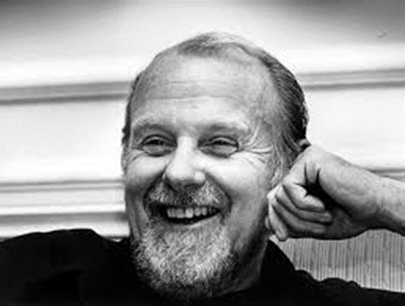
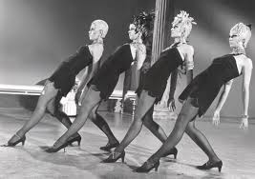
1950’s: Bob Fosse
Born in 1927 – 1987.
Fosse was a musical theatre choreographer and director.
Fosse developed a jazz style that was immediately recognizable.
Watch the following clip and state three themes about the style of jazz.
Bob Fosse: Rich Man’s Frug
Discuss if Fosse’s style of dance reminds you of any current performers style?
Current artist inspired by Fosse
Notes:
Image one: http://www.latimes.com/local/obituaries/archives/la-me-bob-fosse-19870924-20160622-snap-story.html
Image two: https://www.pinterest.com.au/pin/136515432430189887/?lp=true

Slide 4
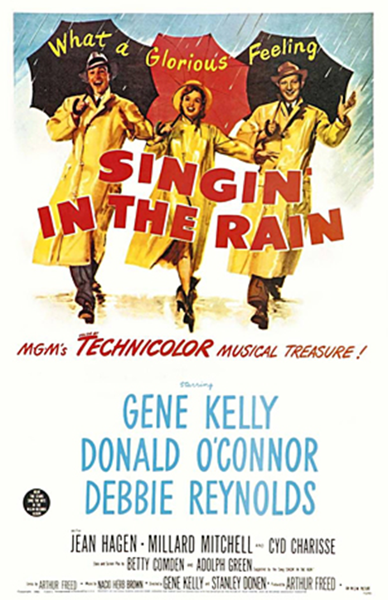
1950’s: Singin’ in the Rain
Summarise the following information:
Singin’ in the Rain was made in 1952, depicting Hollywood in the 1920’s. The musical explores how films went from silent movies to ‘talkies’ or started using sound.
It is frequently regarded as one of the best musicals ever made.
In 2007 it ranked the 5th greatest motion picture of all time.
Singin’ in the Rain was then adapted for an onstage production years after the motion picture.
Notes:
Image one: https://www.google.com.au/search?q=singin+in+the+rain&safe=strict&dcr=0&tbm=isch&tbas=0&source=lnt&sa=X&ved=0ahUKEwirq6XtNPXAhUIabwKHQ1HBB8QpwUIHg&biw=1280&bih=604&dpr=1.5#imgrc=asnBcAox5KhEIM:

Slide 5
Singin’ in the Rain: Scene Analysis
Write three arguments about the following scenes and discuss their success in conveying the intent:
Make ‘Em Laugh
Broadway Melody.
Notes:
Image one: https://vintagehandbook.files.wordpress.com/2013/02/cyd-5.jpg

Slide 6
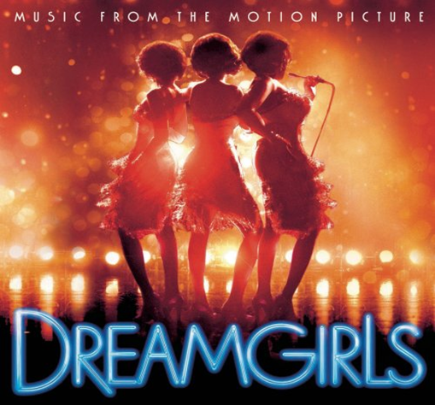
1970’s: Dreamgirls
Set in the 1960’s, a young female trio from Chicago get their big break at a singing contest, and begin singing back up vocals for the famous Jimmy Early.
This was originally a stage production in the 70’s, which was then re-made for film in 2006. This film stars Beyonce, Jennifer Hudson, Jamie Foxx and Eddie Murphy.
View the trailer and write a TEEEC paragraph describing the social themes explored in the 1960’s:
Dreamgirls Trailer
Watch the following clip and discuss the success of this scene. Use examples from the piece in your analysis:
Dreamgirls: It’s All Over
Notes:
Image one: https://www.bing.com/images/search?view=detailV2&ccid=adE4PylM&id=3F55DA7947569A18A914896DB03A2F7C9A4C6063&thid=OIP.adE4PylMFm8cqgvWjHZdgAEsEq&q=dreamgirls&simid=608032805413258363&selectedIndex=4&ajaxhist=0

Slide 7
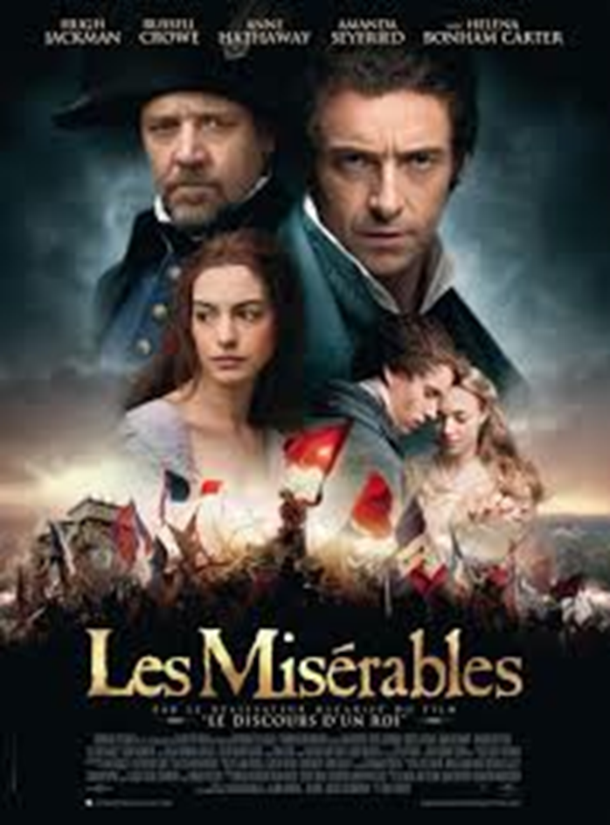
1980’s: Les Misérables
Summarise the following information:
Les Misérables was originally a novel set in 1832, about a French uprising, of the poor and downtrodden.
Synopsis: A desperate man commits a petty crime of stealing a loaf of bread. He is then released from prison but brakes his parole. The story follows this man, Val Jean, through his life of becoming a good respectable citizen, while still hiding from the law. The musical follows his life through the French uprising in 1832.
Les Misérables has been popularized from the many stage adaptions and recent film adaption.
The first stage production was in 1985, and has been running all over the world since then. It is currently showing in Australia.
Watch the following clips and describe how this musical has created such powerful performance pieces:
Do You Hear the People Sing
One Day More
Notes:
Image one: https://www.google.com.au/search?q=les+miserable&safe=strict&dcr=0&tbm=isch&tbas=0&source=lnt&sa=X&ved=0ahUKEwivuIaE0NPXAhUGVLwKHWEtCIQQpwUIHg&biw=1280&bih=604&dpr=1.5#imgrc=E_XznHTP9v1jWM:

Slide 8
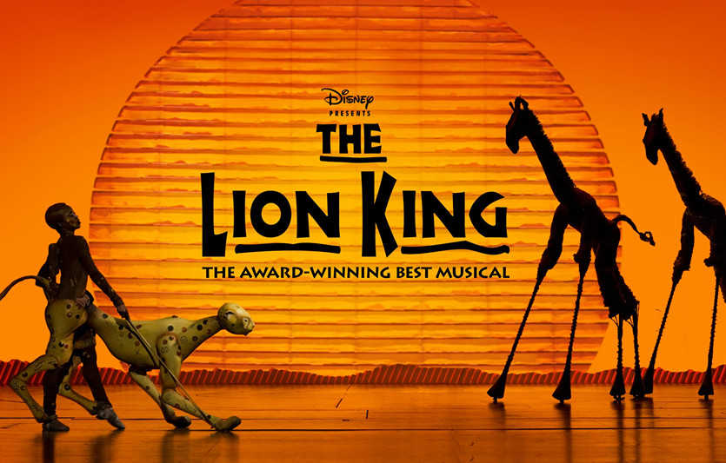
1990’s: The Lion King
Summarise and write a TEEEC paragraph with the following information:
The Lion King is a 1994 American animated musical by Walt Disney. It is the 32nd animated feature in the Walt Disney animated series.
The story takes place in a kingdom of lions in Africa. It tells the story of Simba, a young lion who is to succeed his father Mufasa as king.
The film was the highest grossing release of 1994.
As of 2011, the film has earned over US $987 million, worldwide.
It is the highest grossing 2D animation in the United States;
The third highest grossing animated film of all time;
The 23rd highest grossing film of all time.
Notes:
Image one: https://www.google.com.au/search?safe=strict&dcr=0&biw=1280&bih=604&tbm=isch&sa=1&ei=vS8WWuKOFoiC8wXIuYugCg&q=the+lion+king+musical&oq=the+lion+king+musical&gs_l=psy-ab.3..0l10.9650.10496.0.10595.8.6.0.1.1.0.278.278.2-1.1.0....0...1c.1.64.psy-ab..6.2.303....0.1jiI9L520vo#imgrc=VyrPVJoRRA9HYM:

Slide 9
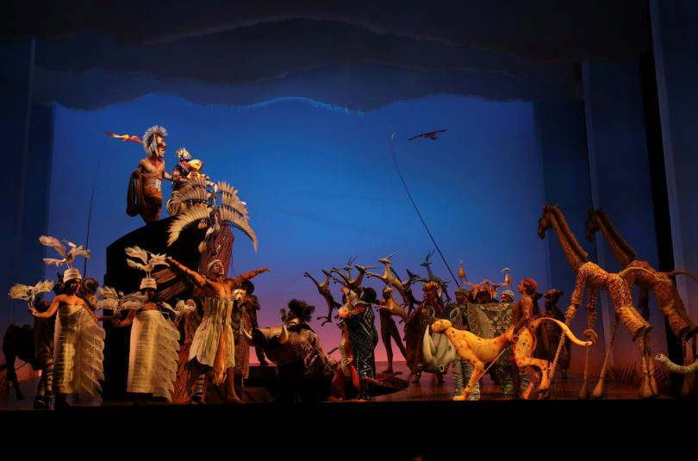
The Lion King: Analysis
Watch the following clip and describe how the elements of production add to the performance.
The Lion King stage production
Discuss the movement quality and costuming.
Notes:
Image one: http://amppob.com/lion-king-musical-coming-little-rock/

