Slide 1
Learning and Wellbeing
Issue 2 – October 2016
Introduction to the National Disability Insurance Scheme and its interface with school education

Slide 2
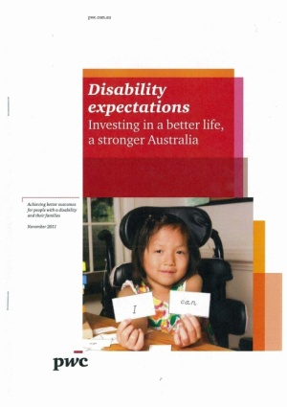
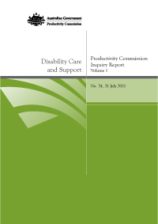
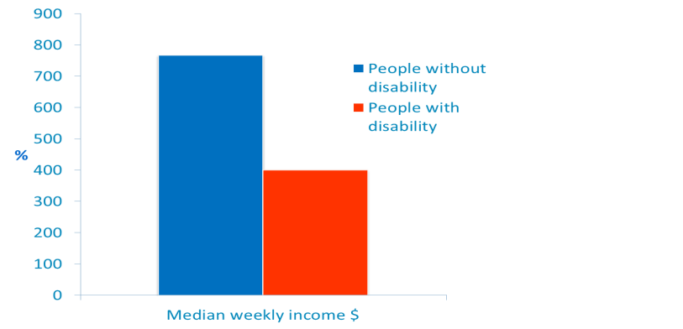
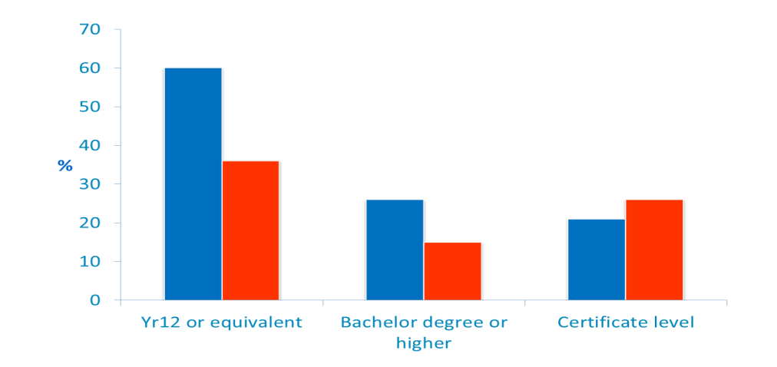
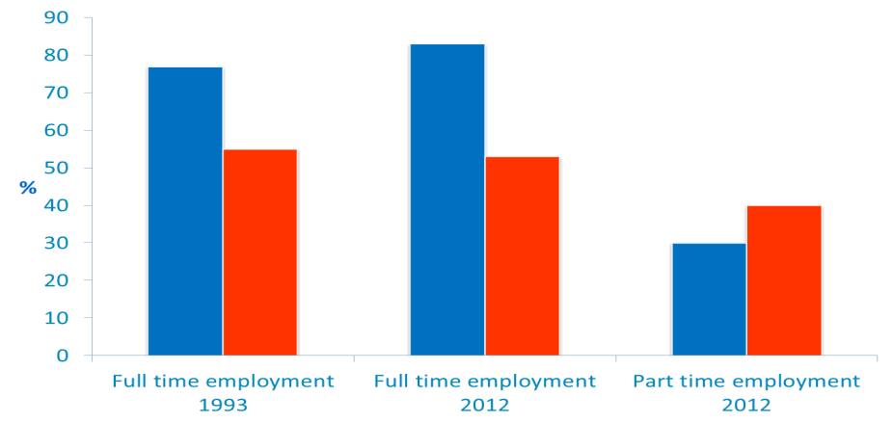
The Context – disability Experiences and expectations

Slide 3

What IS The NDIS?
    Generational reform of the disability support system across Australia.
    A new way of providing support for people with disability to achieve their personal goals and aspirations and enable their participation.
    Personalised, lifetime support for participants.
    Demand driven system of support, tailored to need.
    Choice and control for participants over their disability supports.
    Focus on early intervention.
    Administered by the National Disability Insurance Agency or the NDIA.

Slide 4








NDIS reform
Personalised packages of support for people with significant and permanent disability
Will support:
About 140,000 people in NSW
About 400,000 people nationally
Information, linkages and capacity building – referrals, web based services and community engagement
Will Support
About 1.5 million people in NSW
About 4 million nationally
Community awareness and improved access to mainstream services for people with disability

Slide 5
Who is eligible for personalised disability supports through NDIS?
NDIS eligibility criteria includes:
permanent impairment or disability
impairment resulting in substantially reduced functional capacity that affects participation
impairment requiring lifetime support
0-65 years.
Additional criteria apply for early intervention supports, relating to:
children under 6 years old with a developmental delay
people with a likely permanent impairment or condition where there is evidence that supports will improve or reduce deterioration in functional capacity, or will strengthen informal supports.
Notes:
The National Disability Insurance Agency has developed an online access checker which can provide quick feedback on the likelihood of a person being eligible for and NDIS funding package.
The NDIS has a pool of funding for early intervention where application of funding may reduce or remove the need for lifetime support.
Services currently provided by Ageing Disability and Homecare to students who are found not to be eligible for the NDIS will no longer be available to those students.

Slide 6
Features of THE NDIS
Person-centred and based on functional disability needs.
Packages of support through a personalised plan to achieve personal goals and aspirations.
Individuals and their carers empowered to be the decision makers about what disability support is accessed.
Does not replace mainstream service obligations to people with disability and requirements to provide reasonable adjustments, including schools.
Reshaping the disability workforce and broader human service sectors.
Transition of funding and disability services currently provided or funded by Ageing, Disability and Home Care (ADHC) in NSW.
Notes:
The NDIS will reshape the disability workforce by altering the relationship between people with disability and service providers. The Government will move out of general disability service provision and disability services will become more market based. The Productive Commission estimated that there will need to be an extra 25,000 workers in the disability sector nationally when the NDIS rolls out. In NSW it is likely that many of these will be former staff of Ageing Disability and Home Care.

Slide 7
NDIS Framework
NDIS Act 2013
NDIS Rules 2013
Agreed principles for implementation guide the responsibilities between the scheme and other service systems, including school education.
Applied Principles
Rules covering a range of issues guide how the scheme works for people with disability, their families, carers and service providers.
Working Arrangements
Agreed ways of putting the Applied Principles into practice in NSW through NDIS transition.
The Act establishes the framework for a national scheme and sets out the objects and principles under which the scheme will operate.
LEGISLATION
Principles for responsibility of the NDIS and other service systems: http://www.coag.gov.au/node/497
Notes:
Rules cover issues such as:
Becoming a participant of the scheme
Supports for participants
Special rules for children
Registration of providers
Plan management
Protection and disclosure of information
Government agreements
Applied principles were agreed by COAG and are reflected in the Rules.

Slide 8
Applied Principles – School Education
Allocation of responsibilities between the NDIS and education systems will be consistent with legal obligations of schools and government policy objectives for education.
Schools Responsibility
Schools will be responsible for personalising learning and support for students that primarily relates to their educational attainment.
NDIS Responsibility
The NDIS will fund supports that the student would require which are associated with the functional impact of the student’s disability on their daily living activities.
Education systems and schools will continue to support students with disability in accordance with current obligations. This creates some areas of overlap. The way these areas are funded and managed is the subject of national negotiations.

Slide 9
The interface between the NDIS and school education
School Education
DDA and Disability Standards for Education 2005
Personalised learning and support
Supports that relate to educational attainment
National Disability Insurance Scheme
NDIS Act and Rules
Personalised plans and packages
Supports that are associated with the functional impact of disability on daily living activities
Around 100,000 (15%) students in NSW public schools whose learning is impacted by disability (as defined by the Disability Discrimination Act and Disability Standards for Education)
Around 140,000 people in NSW aged 0-65, including
about 40,000 children and young people, are expected to be NDIS participants
Around 30,000 (3-4%) students in NSW public schools with disability are anticipated to be eligible for NDIS personalised support

Slide 10

from trial to full implementation in NSW
2013
Trial - Hunter Newcastle
2014
Trial - Hunter Lake Macquarie
2015
2016
Trial - Hunter Maitland
Early transition to full scheme - Nepean Blue Mountains
0-17 year olds
2017
2018
Fully in place across NSW
Transition to full scheme
Hunter New England, Southern NSW, Central Coast, Northern Sydney, SW Sydney, Western Sydney, Nepean Blue Mountains
Transition to full scheme
Northern NSW, Mid North Coast, Sydney,
SE Sydney, Illawarra - Shoalhaven, Murrumbidge, Western NSW,
Far West NSW
By 2018, the NDIS is estimated to support 140,000 individuals (0-65 years) across NSW

Slide 11
NDIS Transition Schedule
People will be able to access the NDIS from 1 July 2016, if they live in:
Central Coast
Hunter New England
Nepean Blue Mountains
Northern Sydney
From 1 July 2016
People will be able to access the NDIS from 1 July 2017, if they live in:
Illawarra Shoalhaven
Mid North Coast
Murrumbidgee
Northern NSW
South Western Sydney
Southern NSW
Western Sydney
From 1 July 2017
South Eastern Sydney
Sydney
Western NSW
Far West
From 1 July 2016
From 1 July 2017
* The geographical approach to the rollout is based on existing districts used by the Department of Family and Community Services and NSW Health.
Notes:
Key points:
The transition will occur in two stages.
When clients transition will depend on two factors: where they live, and what types of services, if any, they currently receive.
Year 1 local areas can access the NDIS between 1 July 2016 and 30 June 3017.
Year 2 local areas can access the NDIS between 1 July 2017 and 30 June 3018.

Slide 12
Transition to the NDIS – a phased approach
The National Disability Insurance Agency (NDIA) and NSW Family and Community Services (FACS) holds primary responsibility for managing the transition of people with disability into the NDIS.
People currently receiving support from Ageing Disability and Home Care (ADHC) or ADHC-funded services will have a streamlined transition through the phasing schedule.
These people transitioning to the NDIS will be contacted directly by the NDIA and FACS. They will not need to make an Access Request to the NDIA.

Slide 13
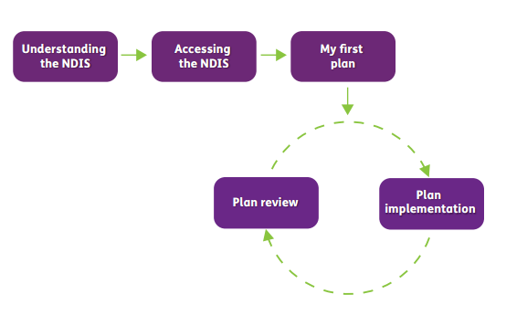
NDIS Planning Process

Slide 14
Transition by cohort
Cohort | Expected timeframe Year 1 Year 2
People living in large and small residential centres and group homes and people accessing hostels | July - September 2016 | July - September 2017
People receiving attendant care, in-home support or alternative family placement
People who attend day, recreation and life skills programs | July - December 2016 | July - December 2017
People receiving support from therapy, early or behaviour intervention programs or use case management services
People accessing centre-based and flexible respite services | From January 2017 (subject to evidence of disability as part of NDIS access request) | From January 2018 (subject to evidence of disability as part of NDIS access request)
People accessing domestic or personal care assistance, personal care, meal services, home modifications and transport services

Slide 15
Transition to the NDIS – Referral of ‘new participants’
People not currently receiving ADHC disability supports can have their eligibility for an NDIS package assessed by the NDIA when the Scheme starts in their local area.
The NDIA will make decisions around access for new participants, in a way that will minimise the impact on the transition of existing disability clients. This may mean a waiting period for some new participants.
In Year 1 areas, families who do not currently receive specialist disability supports will need to directly contact the NDIA.
In Year 2 areas, from July 2016 to June 2017, ADHC will continue to operate and provide services to families in need of specialist disability supports.
From July 2017, families in Year 2 areas who do not currently receive specialist disability supports will need to directly contact the NDIA.

Slide 16
Transition to the NDIS – Impact on Schools
Legal obligations to students with disability under the Disability Discrimination Act 1992 and the Disability Standards for Education 2005 continue to apply in all Australian schools.
Schools will continue to have obligations towards ALL students with disability, not just those students with NDIS packages.
The NDIS will not fundamentally change the way NSW Public schools operate day-to-day in NSW:
      Around 100,000 students in NSW public schools receive personalised learning and support adjustments for disability consistent with obligations under the Disability Discrimination Act 1992 and the Disability Standards for Education 2005.
      Of these, around 30,000 are expected to be eligible for an NDIS-funded individual package.
      This means that a maximum of 4% of all NSW Public School students are likely to receive an NDIS-funded individual package.
      These and other students may also receive supports and assistance from services funded under the NDIS ‘Information, linkages and capacity building’ stream.

Slide 17
NDIS – the benefits for children and young people
All children and young people who are eligible for the NDIS will receive support through the specialist disability service system according to their needs (that is, the level of support is no longer limited to available program funding).
This means that some children and young people and their families will receive specialist disability supports for the first time.
NDIS supports are more tailored to the individual needs of children and young people and are directly aligned to their personal goals and aspirations.
The provision of more appropriate, tailored specialist disability supports is likely to increase engagement in learning and increase opportunities for children and young people to participate fully in school and beyond.
Opportunities to align a student’s personalised education planning with supports provided in their NDIS plan.
Opportunity to strengthen engagement and collaboration between schools and families.

Slide 18
Opportunities and challenges for schools
Engaging school staff in understanding the NDIS, the potential benefits for children with disability and their families, and a new service environment.
Supporting and reassuring parents and carers about continuing support at school.
Managing responsibilities and expectations.
Knowing and understanding obligations under the Disability Standards for Education 2005.
Supporting children and families with information from school to inform NDIA planning meetings.
Supporting students with disability who are deemed ineligible for an NDIS package.
Working with external providers funded by the NDIS

Slide 19
NDIS issues resolution – internal support arrangements
The Department has established field-based NDIS Coordinators to provide advice and support to NSW Public Schools and help resolve issues during the transition to NDIS:
Wendy English, Wagga Wagga Operational District (Dubbo)
Roz Jennings, Wagga Wagga Operational District (Wollongong)
Steve Pilon, Ultimo Operational District
Fran Tinley, Macquarie Park Operational District
Tracey Winfer, Tamworth Operational District
NDIS Coordinators will help resolve issues in NSW Public Schools related to the roll out of the NDIS

Slide 20
Information and communications
As a major new reform, knowing the sources of accurate information can help minimise misunderstandings and build confidence about the changes.
Key sources of information about the NDIS:
National NDIS/NDIA website: www.ndis.gov.au
Whole of NSW Government website: www.ndis.nsw.gov.au
Information and support materials for school communities linked to the Department of Education website
Additional information and materials for schools will progressively developed in line with whole of government plans and agreements.

Slide 21
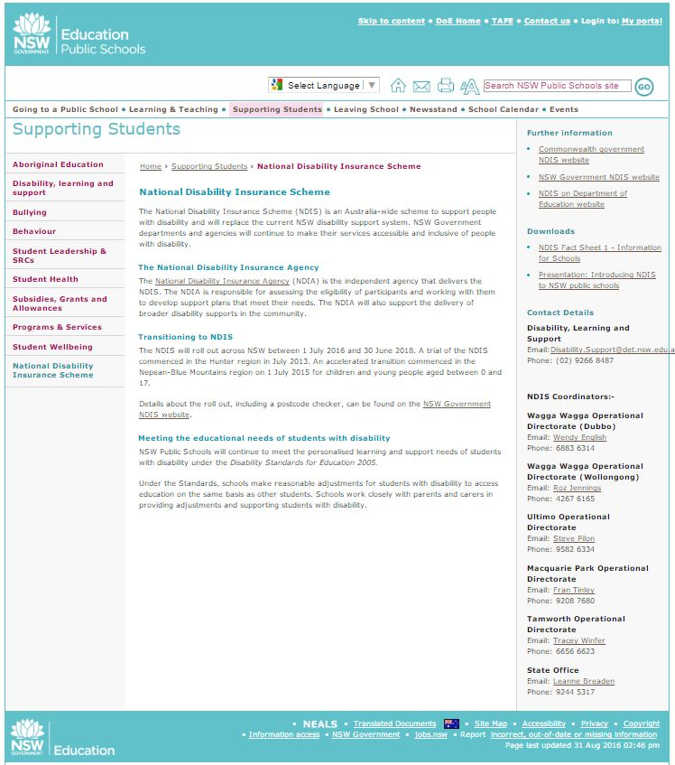
http://www.schools.nsw.edu.au/studentsupport/ndis/index.php
Links to external websites
Materials for schools
Contacts

