Slide 1
Excellence in School Administration framework – Relationships
Sessions in this module
Keeping your website current
School website team
Aspect: Communicate effectively focus: 1.2 written communication
Module: 1.2(c) Digital Content - Website
Notes:
Note to presenter
Before commencing this module please read the separate Presenter Notes which outline all preparation required to successfully present each session.
Welcome to the second session of the Digital content – Website module supporting the written communication focus of the Excellence in School Administration Framework.
This module is one of a series of modules which have been developed to support the implementation of the Framework and contains notes for the presenter and identifies resources for the participants.

Slide 2
Structure of the module
Purpose
This module is one of a series of modules which have been developed to support the implementation of the Excellence in School Administration Framework
This module contains 2 sessions and has a total delivery time of 1 hour and 25 minutes. Resources for this module include:
PowerPoint presentation session
Session 1 – Keeping your website current – 35 minutes
Session 2 – School website team – 50 minutes
Presenter notes with pre-reading and guidelines to successfully deliver sessions
Handouts and activities
Notes:
Presenter to give an overview as per slide

Slide 3
delivery
Audience
Key audience is the front office administration staff, however it is a useful resource for all non-teaching staff in schools.
This module can be completed in the following manner:
Presentation style – facilitator follows notes/slides and works through activities in a group setting
Independently – individual follows slides, notes and works through learning tasks and activities.
To ensure the delivery meets the needs of your audience presenter should consider the following:
For internal presentations (to own staff) prior to presenting the session assess your knowledge of each participant’s experience in this topic, adjust notes and resources where necessary
For external presentations at the commencement of the session ask participants to introduce themselves and briefly explain their reasons for attending, adjust notes and resources where necessary
Notes:
Presenter to give an overview as per slide

Slide 4
Outcome of the module – Digital content website
At the completion of this module, participants should be able to:
describe the characteristics of well structured, easy to follow written communication and apply these to produce writing in the following forms:
general correspondence
permission notes and newsletters
digital content and email
Notes:
At the completion of this module you should be able to describe the characteristics of well structured, easy to follow written communication and apply these to produce writing in the following forms:
general correspondence
permission notes and newsletters
digital content and email

Slide 5
Outcome of this session – School Website team
At the completion of this session, participants should be able to:
express an interest in becoming a member of the school website team
assess school website content to ensure it is current and suited to the audience
Notes:
At the completion of this session you should be able to:
express an interest in becoming a member of the school website team
assess your school website content to ensure it is current and suited to your audience

Slide 6
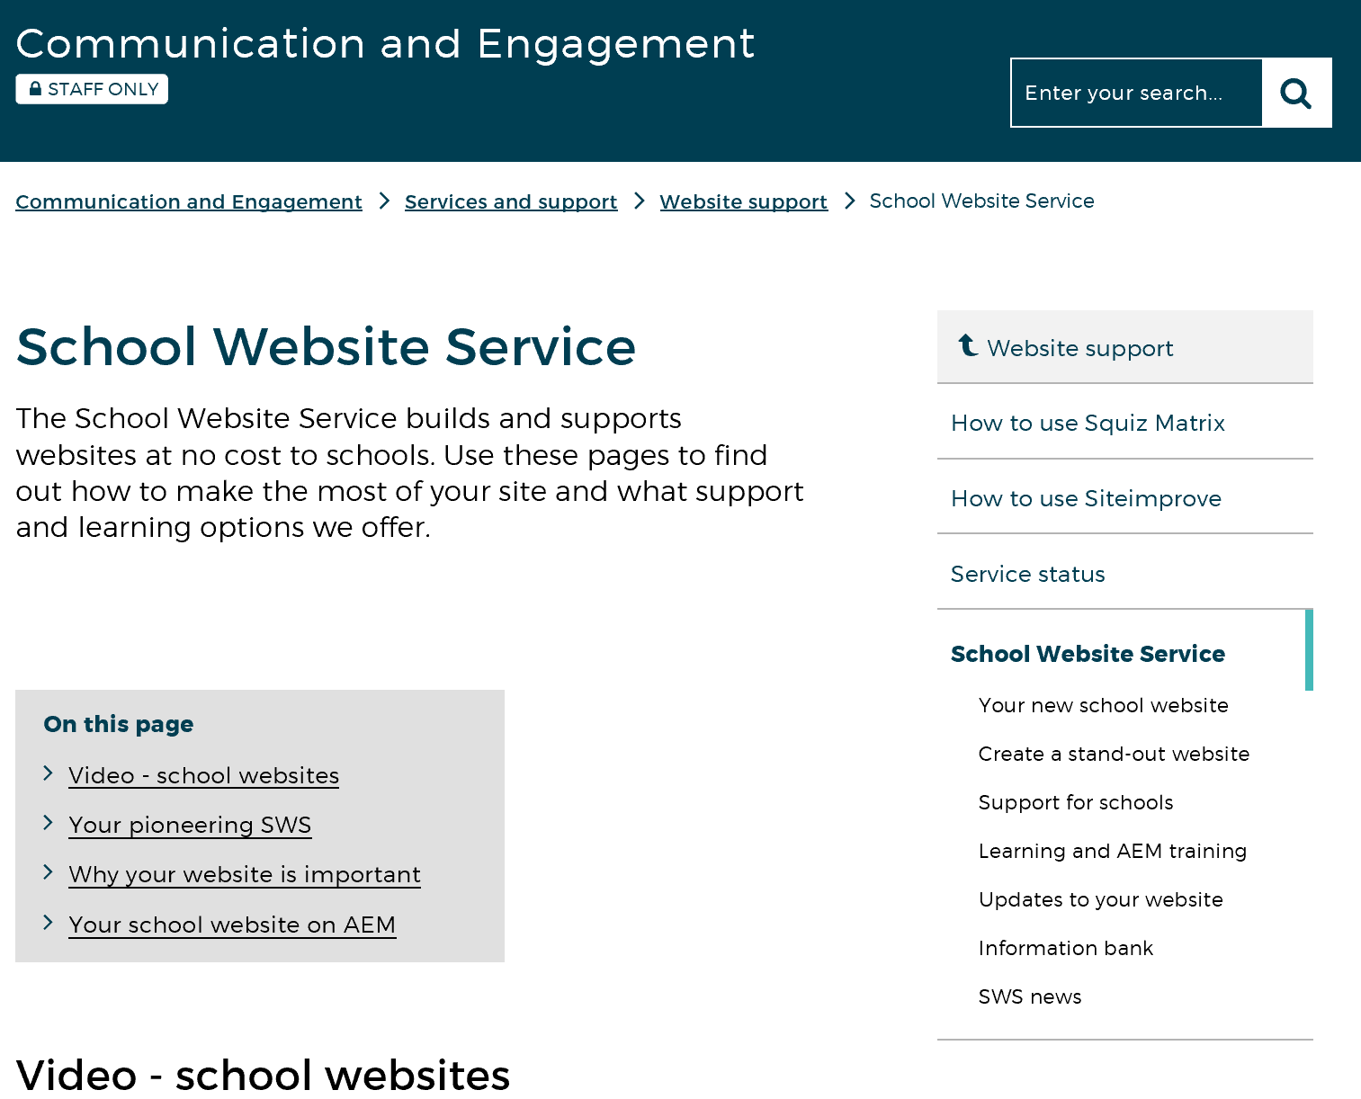
School website service
Click here for School website service
Notes:
This is the support site for the School Website Service. This site is extensive and provides links to essential information related to creating and maintaining your school website.
Q: Does your school have a website? If yes, continue with the following questions. If your school does not have a website, you can follow the instructions on the school website index to ensure that when you design your website, it meets the DoE standards.
Q: Do you have a website team?
A: If yes, are you a member of this team or would you like to join it? Speak with your SAM, principal or IT team.
If no, would you consider leading a team or offering support to the team with approval from your principal?
Q: How would you go about this?
A: Make a time with your SAM to discuss what you believe should be your website team’s priorities and goals.
https://education.nsw.gov.au/inside-the-department/communication-and-engagement/services-and-support/website-support/school-website-service

Slide 7
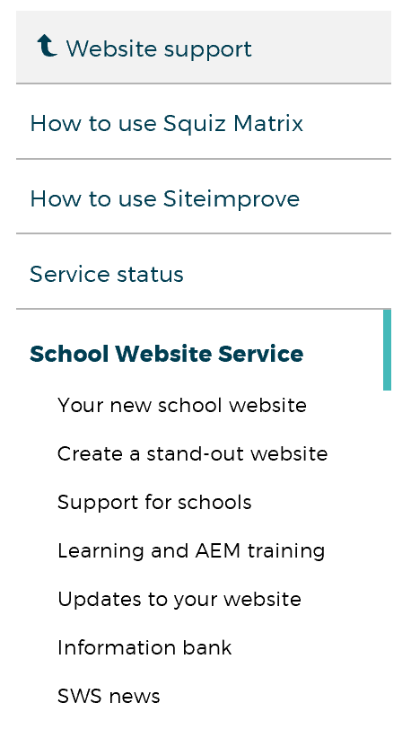
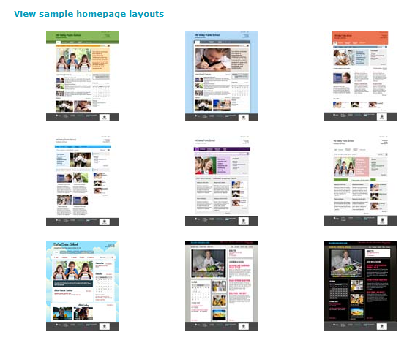
School website service
Sample website layouts
Notes:
The School Website Service is an opt-in service which enables schools to set up and maintain their own website using easy-to-use tools . This includes a 2 step set-up process and a content management system to maintain the website.
The design of the service has involved extensive user experience research to ensure the service meets the needs, goals and expectations of school communities.
It includes centrally maintained content of high relevance to parents and school communities which is updated automatically as information changes.
You can choose from a variety of sample homepages, including different colours and layouts, to suit your school.

Slide 8
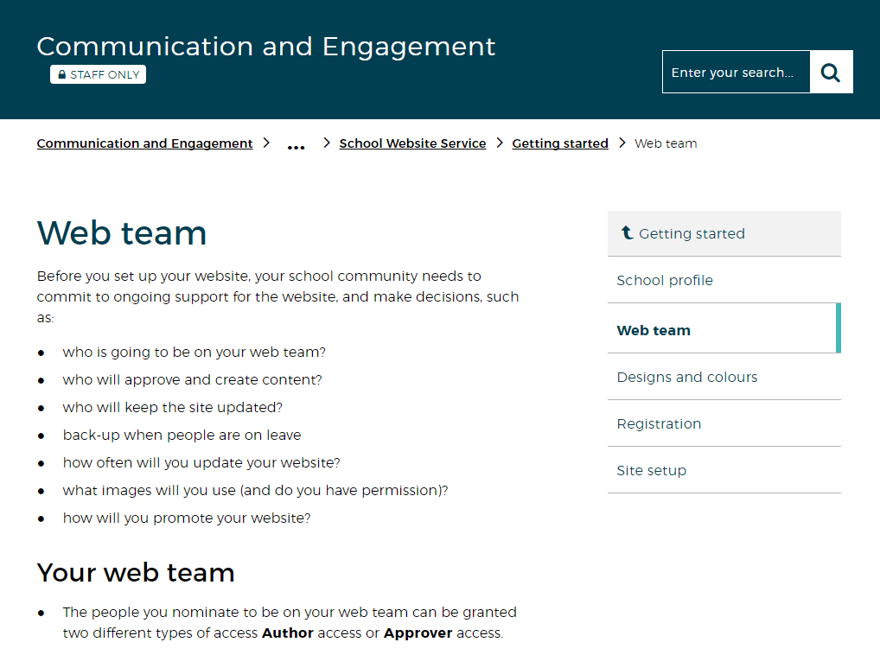
Your web team
Click here for Getting started – Web team
Notes:
Q: Do you know if any of your staff has an interest in web publishing?
Who on your staff has an interest in maintaining the website?
Can these staff members be on the website team?
When a staff member shows an interest in being on the school website team, they can access professional development to increase their knowledge and skills. Professional development courses will be discussed later in this session.
The next slide looks at the power of using professional photos.
Click here for Getting started – Web team
https://education.nsw.gov.au/inside-the-department/communication-and-engagement/services-and-support/website-support/school-website-service/getting-started/web-team

Slide 9
Pro photographs
Why your website needs them
Click here for Taking photos guidelines for your website
Notes:
The best way to put your best image forward and add personality to your website is with high quality photos. Professional standard photos are a necessity to show that your school is a professional place to be. Professional photos can show the pride that is taken in every aspect of your school. Photos should not be generic, but should be full of colour and action.
Tell your school story with photos
Q: Who on your staff team can take great photos? If they become part of the website team, they can use their expertise or they could be offered professional development.
Tips and tricks on taking great photos
Communication and Engagement - School Website Service - Taking photos

Slide 10
activity
What is the first thing you notice?
Are the colours bright (school colours)?
Is it easy to navigate?
Is it up-to-date?
Are the photos current?
Is the calendar up-to-date?
Notes:
Activity (10 minutes)
Open your school website and write down your thoughts on the following:
what is the first thing you notice?
are the colours bright (school colours)?
is it easy to navigate?
is it up-to-date?
are the photos current?
is the calendar up-to-date?
What suggestions would your website team take to the principal following this activity?

Slide 11
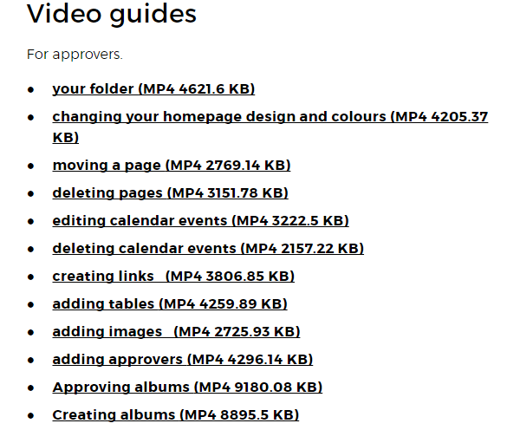
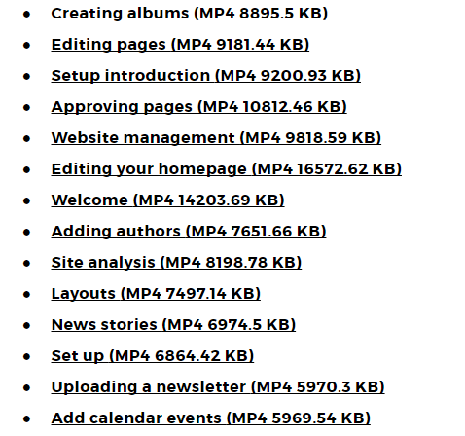
School website service
Click here for - How to use the school website service
Notes:
There are a number of tutorials, on the School Website Service, for authors to learn about completing various tasks on their website.
Click on the link on this slide and select one of the tutorials (refer to pre-reading link).

Slide 12
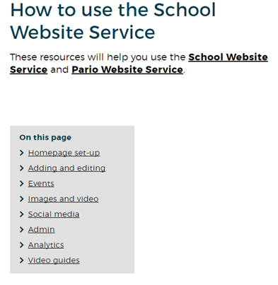
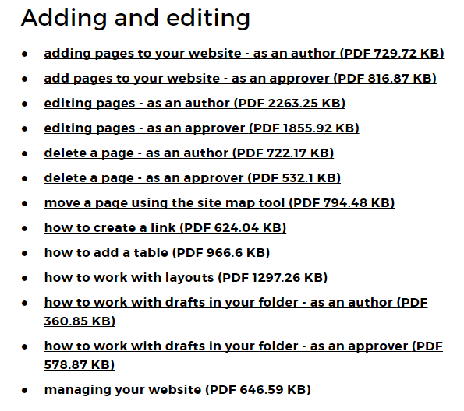
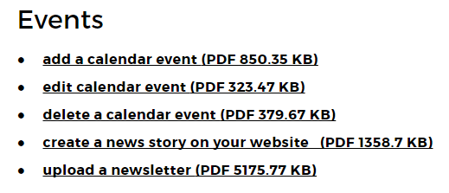
School website service
Reference sheets
Click here for - How to use the school website service
Notes:
The school website learning link has reference sheets to assist when making changes to your school website.
When you open the reference sheets you will see User Guides for tasks such as adding pages, editing your homepage and creating photo albums.
Click on the link on this slide and select one of the author reference sheets (refer to pre-reading link).
You can work online and step-by-step with these user guides.
Note: there are two key roles in maintaining school websites.
an author is someone who can create pages and content on your website, however, they must send their changes to an approver to review and publish in order to see it on the website.
an approver can create pages and content on your website. They also have additional permission to approve authors’ changes on the website, set up users, change colours and designs and move pages on the website.

Slide 13
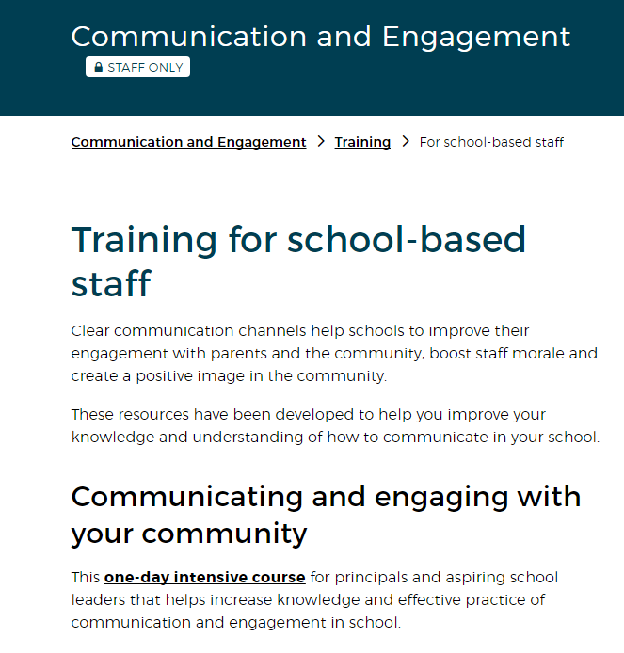
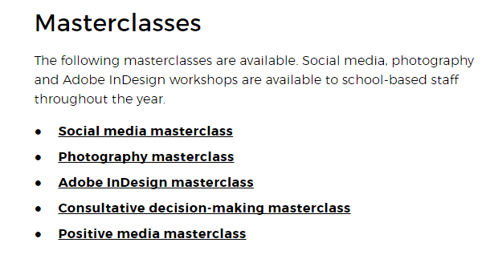
Schools communication and engagement
Click here for – Training for school-based staff
Notes:
C&E directorate facilitate professional learning in face-to-face training and e-learning courses.
The training courses and current training calendar can be found on the C&E website.
https://education.nsw.gov.au/inside-the-department/communication-and-engagement/training/for-school-based-staff
Click here for – Training for school-based staff

Slide 14
Reflecting on this session – school website team
Has this session given you:
the confidence to express interest in becoming a member of the school website team?
an understanding of how to asses your school website content to ensure it is current and suited to your audience?
Notes:
Ask participants to reflect on what they have learned in this session.
Has this session given you:
the confidence to express interest in becoming a member of the school website team
an understanding of how to assess your school website content to ensure it is current and suited to your audience?
Ask participants to reflect individually and then share with the person next to them.

Slide 15
Esa relationship modules
Click here for the Professional learning website
1.1 Oral communication |  |  | 1.2 Written communication | 1.3 Building relationships | 1.4 Teamwork
Face-to-face communication |  |  | Communication guidelines | Students as customers | Keeping staff informed
1. Quality communication |  |  | 1. DoE style guide | 1. Supporting students | 1. Keeping staff informed
2. Create a positive image |  |  | 2. Written communication | 2. Student wellbeing
3. Develop a customer service statement |  |  | Digital content - email | Connecting with customers
Telephone communication |  |  | 1. DoE email policy and procedures | 1. Cultural diversity | 1.5 Promoting the school and its vision
1. Telephone communication |  |  | 2. Storing school emails | 2. Aboriginal & Torres Strait Islander customers | School plan and school culture
2. Telephone communication procedures |  |  | 3. Structuring emails | 3. Welcoming customers with disability | 1. School plan and school culture
Key to modules table |  |  | Digital content - website | 4. Customer complaints – role of SAS staff
Framework focus area | Name of module | Name of session | 1. Keeping your website current | Customer feedback
 |  |  | 2. School website team | 1. Customer feedback
Notes:
This module is one of a series of developed resources to support the Excellence in school administration customer relationships framework.
These are all located on the DoE Professional learning website, School Administrative and Support webpage which can be accessed via the portal, Inside the department A-Z.
Click here for the Professional learning website

Slide 16
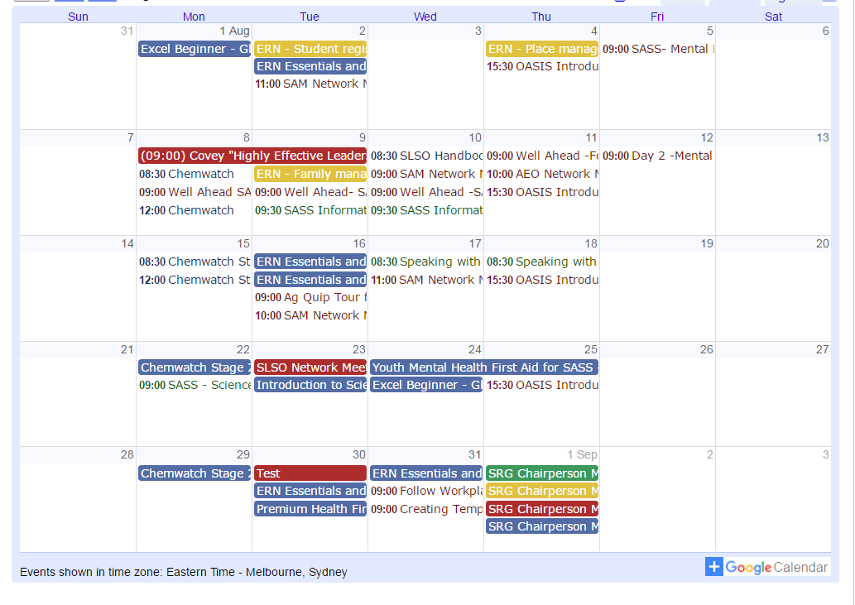
Professional development
SAS staff Reference Group (SRG)
Professional learning calendar
Thank you
for participating in this session
Notes:
The SAS staff Reference Groups (SRGs) schedule professional learning that caters for all categories of non-teaching staff in schools across the state. Please refer to the professional learning calendar for events that may assist to build your skills.
The calendar and SRG committee contact details are available for all SAS staff and can be found on the School Administrative and Support Staff webpage on the DoE Professional Learning website which can be accessed via the portal, Inside the department A-Z.
Thank you for participating in this session.

