Slide 1
SASS Reference Groups
ERN Family Manager
Identifying and Providing Quality Professional Learning Activities

Slide 2
Acknowledgement of Country
I would like to acknowledge the traditional custodians of the land on which we meet today and pay my respects to Elders past and present, and any Aboriginal people here today.
I would also like to recognise our Aboriginal youth as future leaders.

Slide 3
Housekeeping
Sign on sheets
Restroom
Evacuation procedures
Lockdown procedures
Morning tea/lunch breaks
Mobile phones
Emails
Evaluations
Special needs

Slide 4
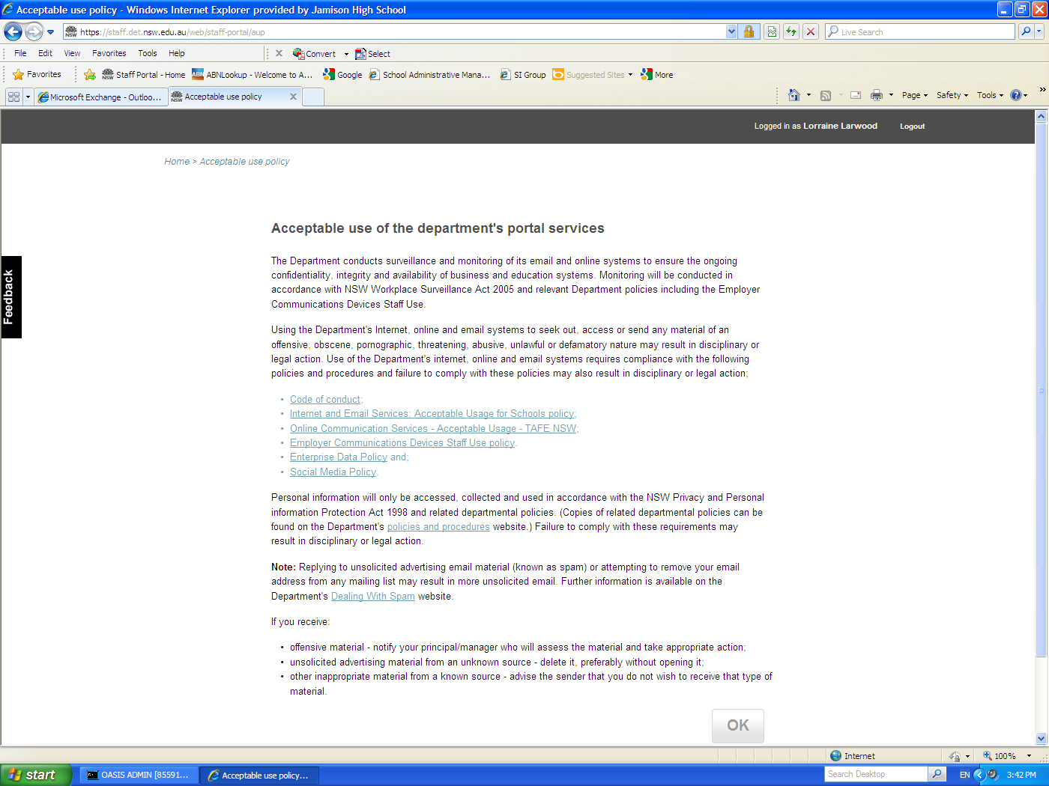
Privacy and Code of Conduct
Remember:
You have the ability to access confidential information – you are bound by the NSW DoE Code of Conduct
and other policies mentioned on the Acceptable Use of the Department’s Portal Services
By clicking “OK” you agree with these conditions
Tip: Lock your computer when you leave the room. Press the Windows flag key + L key to lock your computer

Slide 5
Outcomes: ERN Family Manager
On completion of this course participants will be able to:
Understand the importance of family management (family tree) to ERN
Understand and be able to use the functions of Family Manager
Understand the implications of making changes – to other schools with student’s siblings and to student invoicing
Check the accuracies of the family tree and make changes where necessary
Run merge reports to check for duplication of families in ERN

