Slide 1
Excellence in School Administration framework – Relationships
Aspect: Commit to customer service
Focus: 1.3 Building relationships
Module: (b) Connecting with Customers
Sessions in this module
Cultural diversity
Aboriginal & Torres Strait Islander customers [this session]
Welcoming customers with a disability
Customer complaints and role of the SAS staff
Notes:
Note to presenter
Before commencing this module please read the separate Presenter notes which outline all preparation required to successfully present each session
Welcome to the second session of the Connecting with Customers module Supporting the Building Relationships focus area of the Excellence in School Administration Framework.
This module is one of a series of modules which have been developed to support the implementation of the framework and contains notes for the presenter and identifies resources for the participants.

Slide 2
Structure of the module
This module contains 4 sessions and has a total delivery time of
3 hours 10 minutes. Resources for this module include:
PowerPoint presentation sessions
Session 1 - Cultural Diversity – 1 hour and 10 minutes
Session 2 - Aboriginal & Torres Strait Islander customers – 35 minutes
Session 3 - Welcoming customers with a disability – 45 minutes
Session 4 - Customer complaints role of SAS staff – 40 minutes
Presenter notes with pre-reading and guidelines to successfully deliver sessions
Handouts and activities.
Purpose
This module is one of a series of modules which have been developed to support the implementation of the Excellence in School Administration Framework
Notes:
Presenter to give an overview as per slide

Slide 3
Delivery
This module can be completed in the following manner:
presentation style – facilitator follows notes/slides and works through activities in a group setting
independently – individual follows slides, notes and works through learning tasks and activities.
To ensure the delivery meets the needs of your audience presenter should consider the following:
for internal presentations (to own staff) prior to presenting the session assess your knowledge of each participant’s experience in this topic, adjust notes and resources where necessary
for external presentations at the commencement of the session ask participants to introduce themselves and briefly explain their reasons for attending, adjust notes and resources where necessary.
Audience
Key audience is the front office administration staff, however it is a useful resource for all non-teaching staff in schools.
Notes:
Presenter to give an overview as per slide

Slide 4
Outcome of the module – connecting with customers
At the completion of this module, participants should be able to:
describe strategies which build positive relationships with customers and apply these to develop relationships that are authentic and supportive.
Notes:
On completion of this module, participants should be able to:
describe strategies which build positive relationships with customers and apply these to develop relationships that are authentic and supportive

Slide 5
Outcome of this session – Aboriginal & Torres Strait Islander customers
At the completion of this session, participants should be able to:
customers from Aboriginal and Torres Strait Islander backgrounds
have strategies to build a deeper understanding of Aboriginal culture.
Notes:
At the completion of this session you should:
understand delivery of service to customers from Aboriginal and Torres Strait Islander backgrounds
have strategies to build a deeper understanding of Aboriginal culture.

Slide 6
Aboriginal and Torres strait islanders
An Aboriginal/Torres Strait Islander is a person who:
is of Aboriginal or Torres Strait Island descent
identifies themselves as an Aboriginal or Torres Strait Islander
is accepted by the Aboriginal or Torres Strait Islander community as an Aboriginal or Torres Strait Islander person.
© Australian Human Rights Commission 2014
Face the Facts: Aboriginal and Torres Strait Islander Peoples 2014
Notes:
The Department of Education recognises that quality teaching & learning in the classroom is critical to student success. It is implementing strategies to make schools more responsive to the goals and aspirations of their Aboriginal students. These include: new funding models that better support Aboriginal students; working more closely with local Aboriginal communities; and putting more focus on student wellbeing.
In referring to Aboriginal people, the DoE Aboriginal Education and Training Policy refers inclusively to all Aboriginal Australians and Torres Strait Islander people.
Aboriginal parents, caregivers and communities want a good education for their children. Strong & respectful partnerships are fundamental to improving educational outcomes for Aboriginal students and it is critical that schools engage with Aboriginal parents and communities to provide opportunities for local decision making about school planning and practices to achieve positive outcomes for Aboriginal students.
Since the early 1980s the Federal Government has used a definition identifying Aboriginal or Torres Strait Islanders as a person who:
is of Aboriginal or Torres Strait Island descent
identifies themselves as an Aboriginal or Torres Strait Islander
is accepted by the Aboriginal or Torres Strait Island community as an Aboriginal or Torres Strait Islander person
© Australian Human Rights Commission 2014
https://www.humanrights.gov.au/human-rights-education-and-training
Face the Facts: Aboriginal and Torres Strait Islander Peoples 2014
https://www.humanrights.gov.au/education/face-facts/face-facts-aboriginal-and-torres-strait-islander-peoples

Slide 7
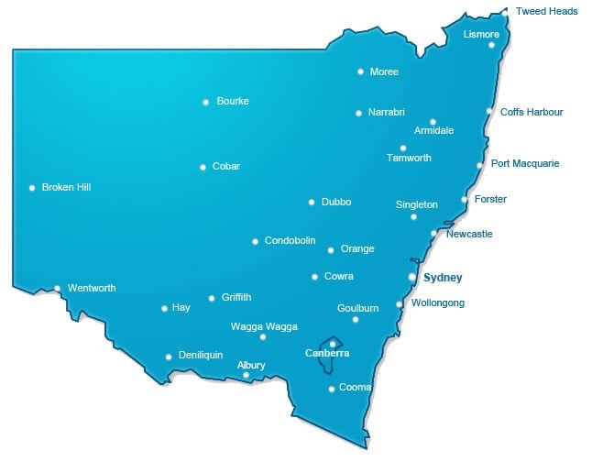
Aboriginal and Torres strait islanders
Total enrolments in NSW Public Schools 54,145
Centre for Education Statistics and Evaluation (CESE) – website
Notes:
According to 2015 DoE records the number of Aboriginal and Torres Strait islander student enrolments in NSW public schools across the state was:
Ultimo Operational Directorate – 6,425
Macquarie Park Operational Directorate – 9,320
Tamworth Operational Directorate – 20,488
Wagga Wagga Operational Directorate – 17,912
A total of 54,145.
Centre for Education Statistics and Evaluation - CESE website
http://www.cese.nsw.gov.au/

Slide 8
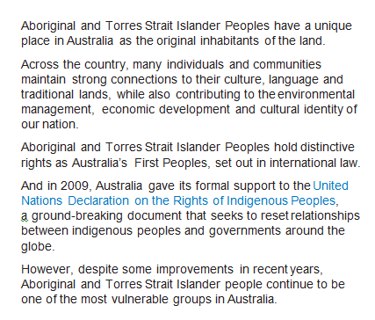
Aboriginal and Torres strait islanders
© Australian Human Rights Commission 2014
Face the Facts: Aboriginal and Torres Strait Islander Peoples 2014
Notes:
Click on link in slide
Let’s look at some of the facts around Aboriginal and Torres Strait Islander peoples. This document on the Human Rights website has some valuable information for dealing with customers from Aboriginal and Torres Strait Island backgrounds.
© Australian Human Rights Commission 2014
https://www.humanrights.gov.au/human-rights-education-and-training
Face the Facts: Aboriginal and Torres Strait Islander Peoples 2014
https://www.humanrights.gov.au/education/face-facts/face-facts-aboriginal-and-torres-strait-islander-peoples

Slide 9
Cultural understanding – what you can do
people skills
concept of family
empathy
patience
no direct eye contact
general talk and interaction
respect and understand silence
Aboriginal access and Aboriginal resources AEC
Notes:
The DoE website contains resources for schools to assist with developing cultural understanding.
Having a cultural understanding of Aboriginal and Torres Strait Islander people includes skills such as:
people skills. It is important to remember names and the relationships between people to help you engage, earn trust and be viewed as credible
broadening your concept of family - many Aboriginal people base their decisions on a consensus of extended family and kin (community), rather than just the immediate family group
being empathic without being overly-familiar and accept that unless you are Aboriginal, it may be difficult to fully understand the person's opinions or situation. Ask genuine, but non-intrusive questions about family and culture
being patient. Aboriginal people may mistrust mainstream agencies and it can take time to earn their trust. Ask family members if they would be more comfortable speaking about personal issues with a support person present
understanding that for many Aboriginal people, direct eye contact may be inappropriate. This may be due to shyness or unfamiliarity with the person speaking to them
recognising that, like other cultures, Aboriginal people often begin with general talk and interaction, before getting down to business
respecting and understanding silence. Silence may mean people are not ready to express an opinion yet or they are listening and reflecting on what has been said.
Aboriginal access and Aboriginal resources AEC
https://education.nsw.gov.au/teaching-and-learning/aec/aboriginal-education-consultative-group-partnership-agreement
DoE Our Services - Aboriginal Resources
https://education.nsw.gov.au/teaching-and-learning/aec

Slide 10
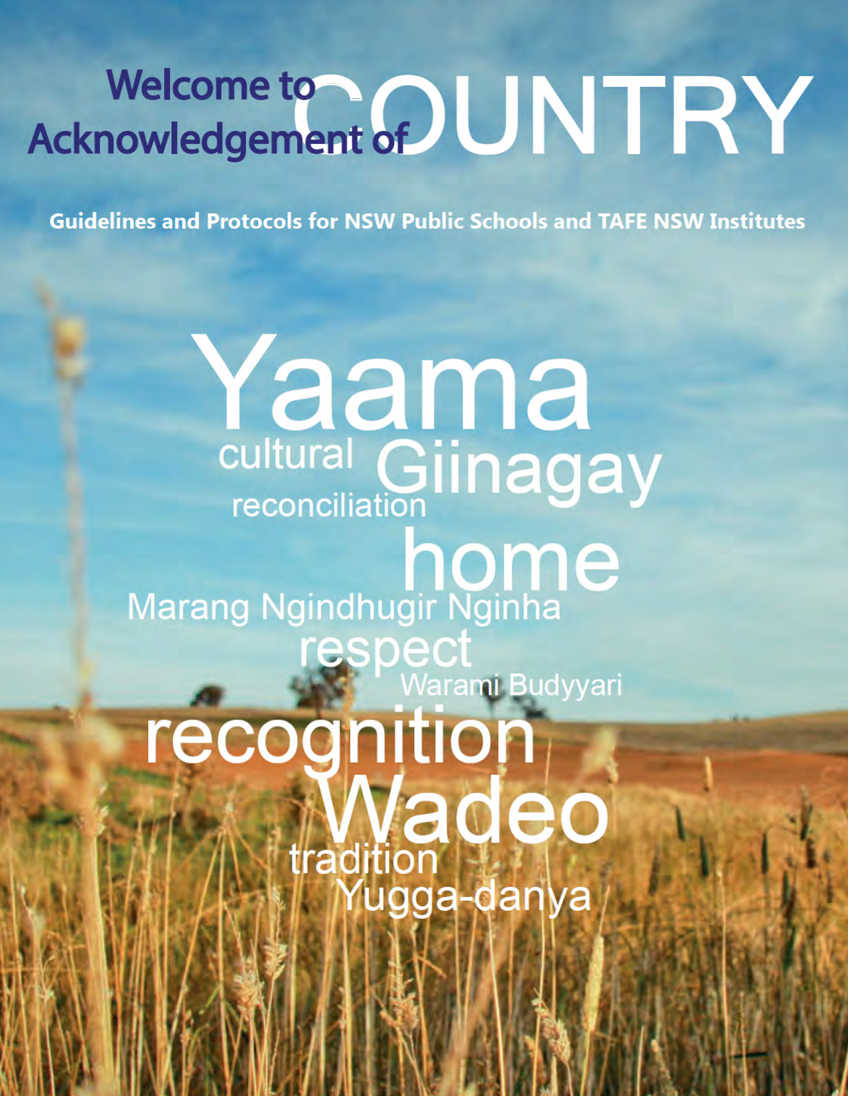
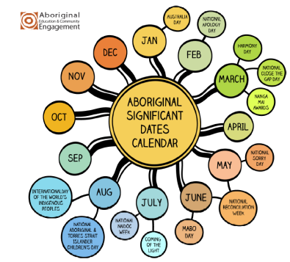
Cultural understanding – what you can do
Significant dates calendar
Guidelines for ceremonies
Aboriginal Education and Communities
Calendar for cultural diversity
Winanggaay welcome to country and acknowledgement of country
Notes:
Acknowledging and celebrating Aboriginal culture in schools is a good way to connect with your Aboriginal community and build understanding of Aboriginal culture.
The DoE Aboriginal Education and Community Engagement website provides information to support schools in their planning to meet the needs of Aboriginal students.
Resources such as the Aboriginal Significant Dates Calendar can be downloaded and used as a resource for schools to engage with their Aboriginal students.
Hand out the Aboriginal Significant Dates Calendar (1 page link in pre-reading)
Q:
Can you name any Aboriginal events that are celebrated in NSW public schools?
A:
National Sorry Day – 26 May each year
Reconciliation Week – (generally the last week of May)
Mabo Day – 3 June every year
NAIDOC Week – first full week in July each year
National Aboriginal and Islander Children's Day – 4 August every year.
The department and the NSW AECG Inc. advocate the promotion of greater understanding of Aboriginal cultures in the wider community and endorses the use of appropriate Aboriginal protocols in schools, formal and informal meetings, public meetings and ceremonies. Event guidelines for Welcome to Country and flying Aboriginal flags are available through the DoE Communications and Engagement website.
Q:
Can anyone describe the difference between a Welcome to Country and An Acknowledgement of Country?
A:
A Welcome to Country is where the Traditional Aboriginal Custodians (in most cases the Elders) welcome people to their Land. This is a significant recognition and is made through a formal process.
An Acknowledgement of Country is a way that all people can show respect for Aboriginal culture and heritage and the ongoing relationship the traditional custodians have over the Land. At the beginning of a meeting or function, a Chair or Speaker begins by acknowledging that the event is taking place in the Country of the Traditional Custodians. Acknowledgement of Country can be performed by both Aboriginal and non-Aboriginal people.
Presenter to hand out a copy of Protocols document (3 pages) and give participants time to read through this document (link in pre reading)
Presenter leads discussion on what participants have learned
Cultural and Diversity website page
https://education.nsw.gov.au/teaching-and-learning/curriculum/multicultural-education/culture-and-diversity
Calendar for cultural diversity
https://education.nsw.gov.au/teaching-and-learning/curriculum/multicultural-education/culture-and-diversity/calendar-for-cultural-diversity
Winanggaay welcome to Acknowledgement of country
https://my.education.nsw.gov.au/human-resources/media/documents/winanggaay/welcomecountry.pdf

Slide 11
Reflecting on this session – Aboriginal & Torres Strait Islander customers
Has this session given you an understanding of how to:
deliver service to customers from Aboriginal and Torres Strait Islander backgrounds
build a deeper understanding of Aboriginal culture.
Notes:
Ask participants to reflect on what they have learned in this session
Has this session given you an understanding of:
deliver service to customers from Aboriginal and Torres Strait Islander backgrounds
build a deeper understanding of Aboriginal culture
Ask participants to reflect individually and then share with the person next to them

Slide 12
ESA relationship modules
Framework focus area | Module | Session
1.1 Oral communication | a. Face-to-face communication | Quality communication Create a positive image Develop a customer service statement
1.1 Oral communication | b. Telephone communication | Telephone communication Telephone communication procedures
1.2 Written communication | a. Communication guidelines | DoE Style Guide Written communication
1.2 Written communication | b. Digital content – email | DoE email policy and procedures Storing school emails Structuring emails
1.2 Written communication | c. Digital content – website | Keeping your website current School website team
1.3 Building relationships | a. Students as customers | Supporting students Student wellbeing
1.3 Building relationships | b. Connecting with customers | Cultural diversity Aboriginal & Torres Strait Islander customers Welcoming customers with disability Customer complaints - role of SAS staff
1.3 Building relationships | c. Customer feedback | Customer feedback
1.4 Teamwork | a. Keeping staff informed | Keeping staff informed
1.5 Promoting the school and its vision | a. School plan and school culture | School plan and school culture
Professional Learning for Non-Teaching Staff (PLNTS) website
Notes:
This module is one of a series of developed resources to support the Excellence in school administration customer relationships framework.
These are all located on the DoE professional learning website, School Administrative and Support webpage which can be accessed via the portal, Inside the department A-Z.
https://education.nsw.gov.au/teaching-and-learning/professional-learning/professional-learning-for-non-teaching-staff

Slide 13
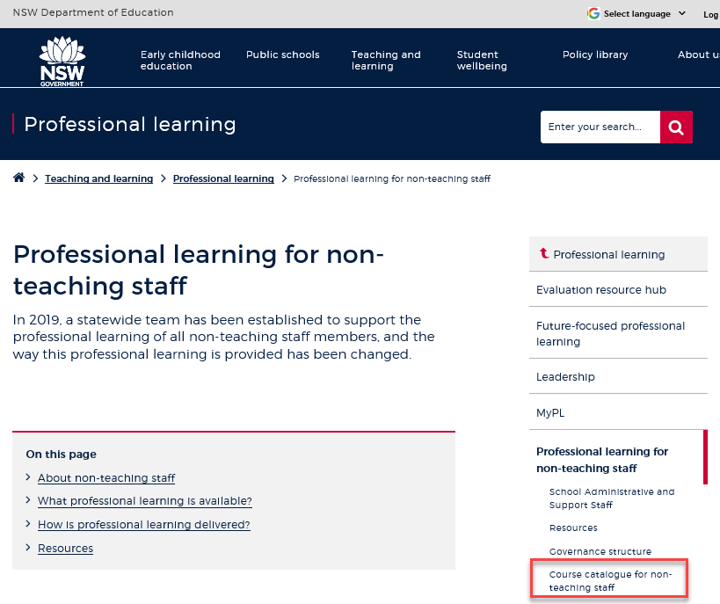
Professional learning information, resources and course catalogue for non-teaching staff
Information about professional learning for non-teaching staff including links to a course catalogue and resources, can be found on the professional learning site of the intranet.
From the Inside the department A-Z tab select:
Professional learning
Professional learning for non-teaching staff
Course catalogue
Notes:
Professional learning information, resources and course catalogue for non-teaching staff.
Professional learning for non-teaching staff
Information about professional learning for non-teaching staff including links to a course catalogue and resources, can be found on the professional learning site of the intranet.
From the Inside the department A-Z tab select:
Professional learning
Professional learning for non-teaching staff
Course catalogue
Our course catalogue has a large range of professional learning events available for non-teaching staff in your area and are a great resource to keep you up to date so you don’t miss out.
https://education.nsw.gov.au/teaching-and-learning/professional-learning/professional-learning-for-non-teaching-staff
https://education.nsw.gov.au/teaching-and-learning/professional-learning/professional-learning-for-non-teaching-staff/course-catalogue-for-non-teaching-staff

Slide 14
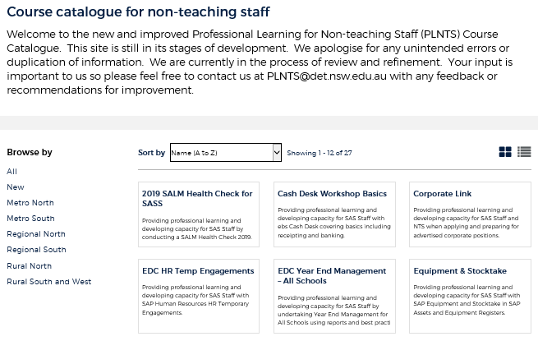
Professional learning for non-teaching staff (PLNTS) catalogue
New and improved layout and features!
Display as a grid or a list
Browse options
Click a course for details, dates, location and MyPL reference
PLNTS catalogue
Notes:
The Professional Learning for Non-Teaching Staff (PLNTS) team’s schedule of professional learning caters for all categories of non-teaching staff in schools across the state.
Please refer to the professional learning catalogue for events that build your skills.
The catalogue is easy to use to find the course you need:
you can display as a grid or as a list
you can also browse by your region or
simply focus on new courses
Once you select a course, you will see
the course details and location
the dates the course is being presented and
the MyPL reference code.
https://education.nsw.gov.au/teaching-and-learning/professional-learning/professional-learning-for-non-teaching-staff/course-catalogue-for-non-teaching-staff

