Slide 1
Excellence in School Administration framework – Administrative Practices
Aspect: Plan, Prioritise and Deliver Results Focus: 2.4 Supporting Change
Module: (a) Change in the Workplace
Session in this module
Change in the Workplace
Notes:
Note to presenter
Before commencing this module please read the separate Presenter Notes which outline all preparation required to successfully present this module.
Welcome to the Change in the Workplace module supporting the Supporting Change focus area of the Excellence in School Administration (ESA) Framework.
This module is one of a series of modules which have been developed to support the implementation of the Framework and contains notes for the presenter and identifies resources for the participants.

Slide 2
Structure of the module
This module contains 1 session and has a total delivery time of 47 minutes. Resources for this module include:
PowerPoint presentation session
Session 1 – Change in the Workplace – 47 minutes
presenter notes with pre-reading and guidelines to successfully deliver sessions
handouts and activities.
Purpose
This module is one of a series of modules which have been developed to support the implementation of the Excellence in School Administration Framework
Notes:
Presenter to give an overview as per slide

Slide 3
Delivery
This module can be completed in the following manner:
presentation style – facilitator follows notes/slides and works through activities in a group setting
independently – individual follows slides, notes and works through learning tasks and activities.
To ensure the delivery meets the needs of your audience presenter should consider the following:
for internal presentations (to own staff) prior to presenting the session assess your knowledge of each participant’s experience in this topic, adjust notes and resources where necessary
for external presentations at the commencement of the session ask participants to introduce themselves and briefly explain their reasons for attending, adjust notes and resources where necessary.
Audience
Key audience is the front office administration staff, however it is a useful resource for all non-teaching staff in schools.
Notes:
Presenter to give an overview as per slide

Slide 4
Outcome of this module – Change in the Workplace
At the completion of this module, participants should be able to:
engage in change with a positive mindset
support improvement by participating in professional learning
act on feedback.
Notes:
At the completion of this module you should be able to:
engage in change with a positive mindset
support improvement by participating in professional learning
act on feedback.

Slide 5
Why do changes happen in schools?
department initiatives
school planning priorities
new technologies
reviews of current programs, practices and procedures
introduction of new systems and procedures
changes to staff and leadership
community consultation
staff suggestions for improvements in work practices
Notes:
Why do changes happen in schools?
Schools undergo continuous improvement with:
department initiatives and school planning priorities such as the implementation of Local Schools Local Decisions, SAP/SALM, School Plans, and PDP’s for non-teaching staff
new technologies, for example the library system Oliver, introduction of Google docs, and the new SAP/SALM systems
reviews of current programs, practices and procedures, for example SAS staff induction, staff induction into school Health and Safety procedures regularly reviewed and emergency evacuations etc.
introduction of new systems and procedures, for example new procurement systems and procedures and approvals processes.
staff and leadership changes such as a new principal, deputy principal or school administrative manager (SAM)
community consultation including P&C feedback on school uniform
staff suggesting different ways of working such as streamlining front office procedures.
Most of the changes relate back to the Department of Education philosophy of seeking continuous improvement in order to improve learning outcomes for students.

Slide 6
Responses to change can be
Answer
Positive
excitement
happiness
positivity
enthusiasm
Negative
denial
anger
resistance
Notes:
People may respond to change in a positive and/or negative manner.
When a change is first introduced some people’s reactions may be excitement and happiness and they approach it with positivity and enthusiasm.
It is normal for staff to feel some anxiety around change.
Others may fear the change so much that they react with denial or resistance and be angry about the change.
While there is a large range of different emotions that a staff member may display in response to changes in the workplace there are strategies to manage the impact of change on staff.
Staff who demonstrate a positive response can be utilised to engage other staff to:
participate in professional development opportunities
participate in giving, receiving and acting on feedback
contribute to and promote the changes within the team
work collaboratively to support the team to understand and manage the changes

Slide 7
Engaging in change is about
contribution and feedback
recognition of progress
communication
Notes:
NSW public schools are continuously improving the services they offer students and families.
Successful implementation of these improvements will depend on how they are planned, managed and communicated to the school community.
One of the best methods is to provide open and clear communication on the proposed improvements.
When someone explains clearly the reason for change, the importance of the proposal to the school community and details of plans for implementation people are more likely to come on board and participate in the changes.
QUESTION: Can you provide an example of change/s or improvements that have recently been implemented in your school?
ANSWER: SAP HR Payroll
QUESTION: Can you think of different effective methods of communication about changes that have been used to let you know?
ANSWER: Finance bulletins, staff meeting minutes, SchoolBiz, meeting with SAM/principal before the change is introduced
Being involved in the continuous improvement process, is an opportunity to contribute, provide input and feedback.
When schools act on feedback they are letting everyone know their ideas matter.
Everyone when encouraged to contribute to change and improvement processes develops a sense of ownership and responsibility.
Recognising progress with changes provides opportunities for both giving and receiving ongoing feedback, into the next phase.
It assists in maintaining motivation and builds confidence in achieving the longer term goal.
Having a school culture where there is continuous and open communication about change will ensure it is embraced by school staff.
Most importantly to ensure change is welcome and embraced by staff everyone needs to communicate, communicate and communicate.
When there is not enough communication, people will often assume and fear the worst about the changes being implemented.
QUESTION: Can you provide examples of ways you could respond positively to communications about change?
ANSWER: Read the bulletins without being asked, attend meetings where changes are being discussed, talk to colleagues and supervisor and offer ideas or suggestions.

Slide 8
Activity
Discuss ways you could be involved in the continuous improvement in your school.
Activity
Notes:
Activity
(3 minutes)
In small groups discuss some of the ways you could be involved in the continuous improvement in your school.
For example, you nominate to be on the improvement committee for student reports by attending meetings and offering input from an administrative viewpoint.
QUESTION: Would anyone like to share their ideas with the group?

Slide 9
Professional development
professional development
contribute to team goals
work collaboratively
feedback
identify what professional learning is required
actively participate in professional learning opportunities
identify what development opportunities, career advice, mentoring or coaching
non-teaching staff in schools webpage
Notes:
When change occurs in the workplace it should always be with the view of continuous improvement. It is important to have a clear understanding of your role and responsibilities, and how to support yourself and others through the changes these improvements will bring.
work with your professional development plan (PDP) supervisor in identifying what professional learning is required in order for the improvements to progress to the next phase and what you need to do your job well
actively participate in professional learning opportunities being provided
identify what development opportunities, career advice, mentoring or coaching will be of benefit to ensure smooth transition to the changed or new role
prioritise with your supervisor to allocate adequate time in the performance of your role to learn new processes, procedures and skills.
Everyone needs time to adjust to new ways of working.
The performance and development plan (PDP) is an excellent tool to help identify professional development requirements.
The process will help to identify what future development is required to be able to undertake the new way of doing things.
Refer to the DoE Human resources staff only website, for resources on Performance and development plans for non-teaching staff.
https://education.nsw.gov.au/human-resources/performance/non-teaching-staff-in-schools

Slide 10
Activity
Discuss the new SAP/SALM procedures and what professional development would be of benefit.
Discuss how you can support yourself and others developing and improving SAP/SALM skills.
Activity
Notes:
Activity
(5 minutes)
Presenter note: This activity is dependent on participants in the session.
In small groups discuss the new SAP/SALM procedures and what professional development would be of benefit in cash receipting or student rolls. For example: QRG’s for cash receipting or Excel training with a focus on sorting and filtering.
In small groups discuss how you can support yourself and others in the team in developing and improving SAP/SALM skills (any aspect), for example by being given the time and opportunity in the work day to co-pilot or work in teams of two through relevant QRGs, keeping in mind that time/resources are not unlimited in schools.

Slide 11
Feedback
professional development
contribute to team goals
work collaboratively
feedback
Receiving feedback provides opportunity for:
developing strengths
acknowledgement of achievements
clear expectations
growth
Notes:
Focus on feedback as a two-way conversation.
Feedback is vital when acknowledging progress, informing decision makers of problems and providing guidance by giving information that is constructive and supportive.
It can be an opportunity for you to receive acknowledgement of your work or progress. Feedback given constructively gives you the opportunity to act on the feedback.
Feedback also provides opportunity for you to communicate changes affecting your role, discuss progress and identify areas for growth.
To be effective in our work and workplace relationships, we need to be aware of both our strengths and areas that could be further developed.
This is especially important when going through changes brought about by continuous improvement within the school.
If we are to accomplish the dual goals of developing our best selves and contributing our best, then each of us must seek out genuine authentic feedback and be open to responding to the information that we get in return.

Slide 12
Feedback
professional development
contribute to team goals
work collaboratively
feedback
Giving feedback provides opportunity for:
contribution to team goals
clear expectations
focus on the task
balance
Notes:
Giving feedback provides opportunity for you to:
contribute to the team goals
ensure that you understand the expectations and that they are clear. Ask questions to clarify your understanding of the change and what is needed from you
focus on the task that you have to complete to help achieve the team goals
provide the team with a balance of positive and negative feedback
have input with constructive criticism whilst supporting team goals.

Slide 13
Feedback
professional development
contribute to team goals
work collaboratively
feedback
Acting on feedback provides opportunity to:
develop and keep an open mind
discuss next steps
give it a go
Notes:
Acting on feedback provides opportunity for you to:
Develop and keep an open mind about the changes that are being implemented
Discuss with colleagues or supervisor what the next steps are
Give it a go, what have you got to lose by acting on feedback?

Slide 14
Contribute to team goals
professional development
contribute to team goals
work collaboratively
feedback
understand work in the context of the team
become more committed to the team’s success
be less troubled by short term difficulties
Notes:
When individuals contribute to team goals they can:
understand how their work contributes to the team goals
become more committed to the team’s success
become less troubled and distracted by short term difficulties.
When as a team member you contribute to team goals you will understand deadlines and how your work impacts on the rest of the team.
QUESTION: Think of a situation in your school where you have contributed to achieving a team goal.
QUESTION: Would anyone like to share their experience?

Slide 15
Work collaboratively
professional development
contribute to team goals
work collaboratively
feedback
brainstorm
work together
share
learn
listen
Notes:
Collaborative workplace relationships work best when staff feel appreciated and valued.
If colleagues understand how to work well together, continuous improvements introduced in the school are implemented more effectively and successfully.
Staff need to learn how to:
brainstorm and work together to ensure the team goals are met
share ideas, skills and learning with the team
demonstrate an openness to suggestions and willingness to learn and to make compromises with changes and new ideas
listen to new ideas and to what colleagues are saying and acknowledge that it was heard and act on it
give constructive feedback that supports the colleague and team goals.
QUESTION: Can anyone provide a practical example of working collaboratively in the school?
ANSWER: Urgent mailouts to parents, where one staff member edits the note, another staff photocopy the notes and the team put them in the envelopes to be mailed out.

Slide 16
Activity
Activity 1
Brainstorm and think of a situation where you have worked collaboratively to bring about change.
Activity 2
Brainstorm how the staff could manage the changes
in the following scenario:
The school has an increase in students which brings
about the following changes:
the administrative staff will increase by two days per week
some staff may have to move their desk/location
equipment is required for the new staff
some roles may have to be reassigned to accommodate new staff.
Activity
Notes:
Activity
(5 minutes)
In small groups brainstorm and think of a situation where you have worked collaboratively to bring about change.
Did you share your learning with other colleagues?
QUESTION: Would anyone like to share their ideas?
Activity
(3 minutes)
In the same small groups brainstorm the following scenario:
The school has an increase in students which brings about the following changes:
the administrative staff will increase by two days per week
some staff may have to move their desk/location
equipment is required for the new staff
some roles may have to be reassigned to accommodate new staff
QUESTION: How could the changes be managed and communicated so they are accepted by the staff?
QUESTION: Would anyone like to share their answers?

Slide 17
Change
The only way to make sense out of change is to plunge into it, move with it, and join the dance’
Alan Watts, English philosopher, (1915 to 1973)
Notes:
Change is never really over but there will be a time when most objectives of change being implemented have been achieved.
It is important to keep looking at the way we work and keep monitoring our approach to change to ensure we are continuing to improve.
Alan Watts an English philosopher once said ‘the only way to make sense out of change is to plunge into it, move with it, and join the dance’.
Alan Watts
English philosopher (1915 to 1973)

Slide 18
Reflecting on this session – Change in the Workplace
Has this session given you an understanding of how to:
engage in change with a positive mindset
support improvement by participating in professional learning
act on feedback?
Notes:
Ask participants to reflect on what they have learned.
Has this module given you an understanding of how to:
engage in change with a positive mindset
support improvement by participating in professional learning
act on feedback?
Ask participants to reflect individually and then share with the person next to them.

Slide 19
ESA administrative practices modules
Framework focus area | Module
2.1 Applying DoE policies and processes | Policy and Procedures in Administrative Practices Risk management in the Workplace
2.2 Financial literacy and compliance | School Finance Financial Terminology Procurement
2.3 Achieving team objectives | Team Objectives
2.4 Supporting change | Change in the Workplace
2.5 Systems improvement | Technology and Systems
Professional Learning for Non-Teaching Staff (PLNTS) website
Notes:
This module is one of a series of developed resources to support the excellence in school administration framework for administrative practices.
These are all located on the DoE professional learning website, School Administrative and Support webpage which can be accessed via the portal, through Inside the department A-Z.
https://education.nsw.gov.au/teaching-and-learning/professional-learning/professional-learning-for-non-teaching-staff

Slide 20
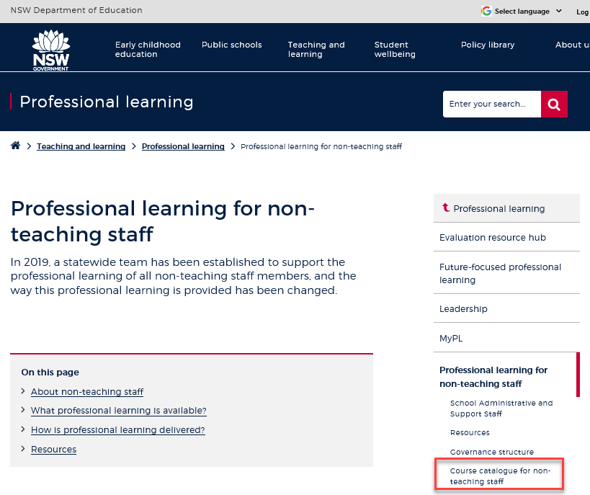
Professional learning information, resources and course catalogue for non-teaching staff
Information about professional learning for non-teaching staff including links to a course catalogue and resources, can be found on the professional learning site of the intranet.
From the Inside the department A-Z tab select:
Professional learning
Professional learning for non-teaching staff
Course catalogue
Notes:
Professional learning information, resources and course catalogue for non-teaching staff.
Professional learning for non-teaching staff
Information about professional learning for non-teaching staff including links to a course catalogue and resources, can be found on the professional learning site of the intranet.
From the Inside the department A-Z tab select:
Professional learning
Professional learning for non-teaching staff
Course catalogue
Our course catalogue has a large range of professional learning events available for non-teaching staff in your area and are a great resource to keep you up to date so you don’t miss out.
https://education.nsw.gov.au/teaching-and-learning/professional-learning/professional-learning-for-non-teaching-staff
https://education.nsw.gov.au/teaching-and-learning/professional-learning/professional-learning-for-non-teaching-staff/course-catalogue-for-non-teaching-staff

Slide 21
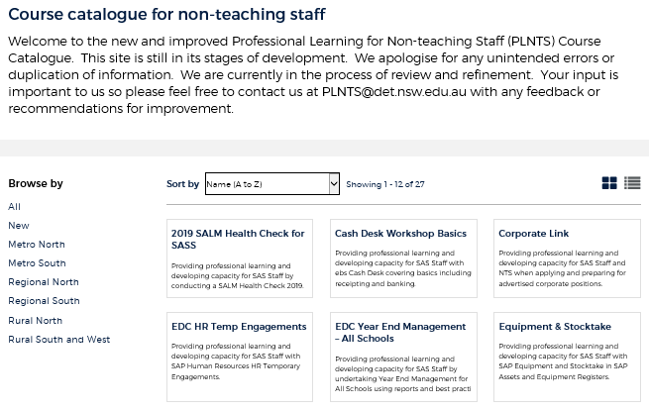
Professional learning for non-teaching staff (PLNTS) catalogue
New and improved layout and features!
Display as a grid or a list
Browse options
Click a course for details, dates, location and MyPL reference
PLNTS catalogue
Notes:
The Professional Learning for Non-Teaching Staff (PLNTS) team’s schedule of professional learning caters for all categories of non-teaching staff in schools across the state.
Please refer to the professional learning catalogue for events that build your skills.
The catalogue is easy to use to find the course you need:
you can display as a grid or as a list
you can also browse by your region or
simply focus on new courses
Once you select a course, you will see
the course details and location
the dates the course is being presented and
the MyPL reference code.
https://education.nsw.gov.au/teaching-and-learning/professional-learning/professional-learning-for-non-teaching-staff/course-catalogue-for-non-teaching-staff

