Slide 1
Excellence in School Administration framework – Relationships
Aspect: Communicate effectively
Focus: 1.1 Oral communication
Module: (a) Face-to-Face Communication
Sessions in this module
Quality communication
Create a positive image
Develop a customer service statement [this session]
Notes:
Note to presenter
Before commencing this module please read the separate Presenter Notes which outline all preparation required to successfully present each session
Welcome to the third session of the Face-to-Face Communication module supporting the Oral Communication focus of the Excellence in School Administration Framework.
This module is one of a series of modules which have been developed to support the implementation of the Framework and contains notes for the presenter and identifies resources for the participant.

Slide 2
Structure of the module
This module contains 3 sessions and has a total delivery time of 2 hours 20 minutes.
Resources for this module include:
PowerPoint presentation session
Session 1 – Quality Communication – 60 minutes
Session 2 – Create a Positive image – 45 minutes
Session 3 – Develop a Customer Service Statement – 35 minutes
presenter notes with pre-reading and guidelines to successfully deliver sessions
handouts and activities.
Purpose
This module is one of a series of modules which have been developed to support the implementation of the Excellence in School Administration Framework
Notes:
Presenter to give an overview as per slide

Slide 3
Delivery
This module can be completed in the following manner:
presentation style – facilitator follows notes/slides and works through activities in a group setting
independently – individual follows slides, notes and works through learning tasks and activities.
To ensure the delivery meets the needs of your audience presenter should consider the following:
for internal presentations (to own staff) prior to presenting the session assess your knowledge of each participant’s experience in this topic, adjust notes and resources where necessary
for external presentations at the commencement of the session ask participants to introduce themselves and briefly explain their reasons for attending, adjust notes and resources where necessary.
Audience
Key audience is the front office administration staff, however it is a useful resource for all non-teaching staff in schools.
Notes:
Presenter to give an overview as per slide

Slide 4
Outcome of the module – face-to-face Communication
At the completion of this module, participants should be able to:
describe the skills necessary to deliver oral communication and demonstrate these skills in a professional manner to meet the needs of all customers including those from diverse language, cultural, religious, and socio-economic backgrounds.
Notes:
At the completion of this module you should be able to:
describe the skills necessary to deliver oral communication and demonstrate these skills in a professional manner to meet the needs of all customers including those from diverse language, cultural, religious and socio-economic backgrounds.

Slide 5
Outcome of this session – develop a customer service statement
At the completion of this session, participants should be able to:
assist in the development of a school customer service vision
understand the skills required to deliver excellent face-to-face customer service
describe the school’s customer service vision.
Notes:
At the completion of this session you should be able to:
assist in the development of a school customer service vision
deliver excellent face-to-face customer service
describe the school’s customer service vision.

Slide 6
What is a customer service vision?
It is a statement that clearly defines the type of customer service employees are expected to provide
Notes:
What is a customer service vision?
It is a statement that clearly defines the type of customer service employees are expected to provide.

Slide 7
Customer service vision
What do our customers want from us?
Notes:
Let’s discuss what our vision of customer service in NSW public schools should be?
Q:
What do school customers want from us?
Stay on this slide during the group discussion
Make a list of responses from participants
Move to the next slide

Slide 8
What are our customers wanting?
To be given:
reliable information
trust and confidentiality
respect
efficient service
a positive experience
Notes:
Did the participants’ answers match?
The answers you just gave and these answers will assist us when we are developing our customer service vision.
We should ask ourselves these questions when developing our customer service vision:
Group discussion
Q: Why are we here?
A: Quality education for all students
Q: What are our expectations for quality customer service?
A: Customer satisfaction
Q: What do we want our customers to be saying about us?
A: That our school is welcoming and efficient
Q: How would we promote our excellent customer service?
A: By developing a customer service vision and displaying it in our foyer, articles in the newsletter, acknowledging positive feedback and responding to negative feedback

Slide 9
Developing a customer service vision
Trustworthy staff
Informative & efficient
Respectful & polite
Customers seen as partners
ABC Public School is a welcoming school working hand in hand with our community
Reliable & consistent
Notes:
Here is a sample of how you would develop a customer service vision for your school.
Hand out customer service vision (refer pre-reading )
Stay on this slide during activity
Activity (10 minutes)
We will now be working in pairs to work on a customer service vision.
From our previous activity and discussion fill in the bubbles prioritising the expectations of our customers.
Build a picture of what you feel are the customer service priorities for your school.
Once you have identified ‘what you feel’ customer service priorities are for your school, as the leader you need to step back from the decision making when you return to your school and empower your staff to decide. Your staff will then buy in, take ownership and implement the customer service priorities.
The vision statement should outline these priorities and come together to make it a strong statement which all staff support.
New staff members should be inducted and introduced to the vision statement with the expectation they too will embrace the priorities.
Now draft a strong statement to outline your priorities. Read it a number of times to ensure that it is really what you believe!!
If working with your school group
Once your staff and you have drafted the customer service statement, ask your principal if this is suitable to display in the school administration office?
The principal may also like to share it with all staff.
QUESTION: Who would like to share what they have produced?

Slide 10
Reflecting on this session – develop a customer service statement
Has this session given you an understanding of how to:
the development of a school customer service vision
the skills required to deliver excellent face-to-face customer service
the school’s customer service vision?
Notes:
Ask participants to reflect on what they have learned in this session
Has this session given you an understanding of:
the development of a school customer service vision
the skills required to deliver excellent face-to-face customer service
the school’s customer service vision?
Ask participants to reflect individually and then share with the person next to them.

Slide 11
ESA relationship modules
Framework focus area | Module | Session
1.1 Oral communication | a. Face-to-face communication | Quality communication Create a positive image Develop a customer service statement
1.1 Oral communication | b. Telephone communication | Telephone communication Telephone communication procedures
1.2 Written communication | a. Communication guidelines | DoE Style Guide Written communication
1.2 Written communication | b. Digital content – email | DoE email policy and procedures Storing school emails Structuring emails
1.2 Written communication | c. Digital content – website | Keeping your website current School website team
1.3 Building relationships | a. Students as customers | Supporting students Student wellbeing
1.3 Building relationships | b. Connecting with customers | Cultural diversity Aboriginal & Torres Strait Islander customers Welcoming customers with disability Customer complaints - role of SAS staff
1.3 Building relationships | c. Customer feedback | Customer feedback
1.4 Teamwork | a. Keeping staff informed | Keeping staff informed
1.5 Promoting the school and its vision | a. School plan and school culture | School plan and school culture
Professional Learning for Non-Teaching Staff (PLNTS) website
Notes:
This module is one of a series of developed resources to support the Excellence in school administration customer relationships framework.
These are all located on the DoE professional learning website, School Administrative and Support webpage which can be accessed via the portal, Inside the department A-Z.
https://education.nsw.gov.au/teaching-and-learning/professional-learning/professional-learning-for-non-teaching-staff

Slide 12
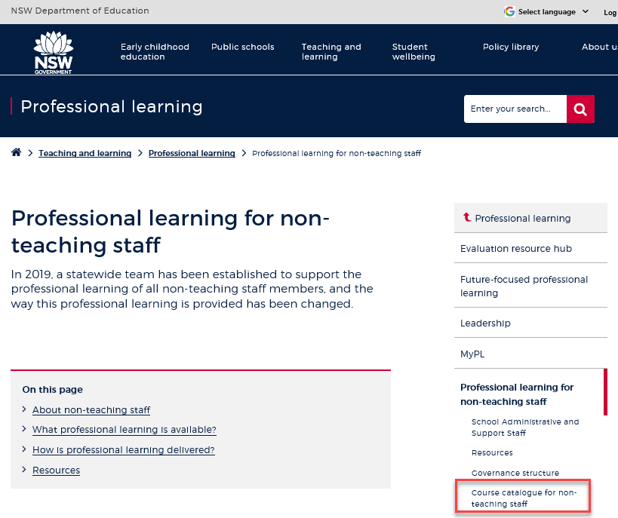
Professional learning information, resources and course catalogue for non-teaching staff
Information about professional learning for non-teaching staff including links to a course catalogue and resources, can be found on the professional learning site of the intranet.
From the Inside the department A-Z tab select:
Professional learning
Professional learning for non-teaching staff
Course catalogue
Notes:
Professional learning information, resources and course catalogue for non-teaching staff.
Professional learning for non-teaching staff
Information about professional learning for non-teaching staff including links to a course catalogue and resources, can be found on the professional learning site of the intranet.
From the Inside the department A-Z tab select:
Professional learning
Professional learning for non-teaching staff
Course catalogue
Our course catalogue has a large range of professional learning events available for non-teaching staff in your area and are a great resource to keep you up to date so you don’t miss out.
https://education.nsw.gov.au/teaching-and-learning/professional-learning/professional-learning-for-non-teaching-staff
https://education.nsw.gov.au/teaching-and-learning/professional-learning/professional-learning-for-non-teaching-staff/course-catalogue-for-non-teaching-staff

Slide 13
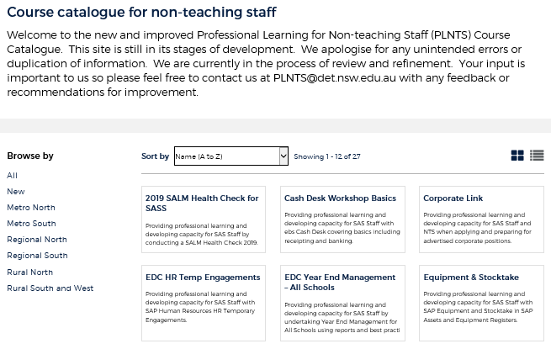
Professional learning for non-teaching staff (PLNTS) catalogue
New and improved layout and features!
Display as a grid or a list
Browse options
Click a course for details, dates, location and MyPL reference
PLNTS catalogue
Notes:
The Professional Learning for Non-Teaching Staff (PLNTS) team’s schedule of professional learning caters for all categories of non-teaching staff in schools across the state.
Please refer to the professional learning catalogue for events that build your skills.
The catalogue is easy to use to find the course you need:
you can display as a grid or as a list
you can also browse by your region or
simply focus on new courses
Once you select a course, you will see
the course details and location
the dates the course is being presented and
the MyPL reference code.
https://education.nsw.gov.au/teaching-and-learning/professional-learning/professional-learning-for-non-teaching-staff/course-catalogue-for-non-teaching-staff

