Slide 1
Excellence in School Administration framework – Relationships
Sessions in this module
Telephone communication
Telephone communication procedures
Aspect: Communicate effectively
Focus: oral communication
Module: 1.1(b) Telephone Communication
Notes:
Note to presenter
Before commencing this module please read the separate Presenter Notes which outline all preparation required to successfully present each session
Welcome to the second session on Telephone Communication module supporting the Oral Communication focus area of the Excellence in School Administration Framework.
This module is one of a series of modules which have been developed to support the implementation of the Framework and contains notes for the presenter and identifies resources for the participants.

Slide 2
Structure of the module
Purpose
This module is one of a series of modules which have been developed to support the implementation of the Excellence in School Administration Framework
This module contains 2 sessions and has a total delivery time of 1 hour and 30 minutes. Resources for this module include:
PowerPoint presentation session
Session 1 – Telephone Communication – 55 minutes
Session 2 – Telephone Communication procedures – 35 minutes
presenter notes with pre-reading and guidelines to successfully deliver sessions
handouts and activities
Notes:
Presenter to give an overview as per slide

Slide 3
delivery
Audience
Key audience is the front office administration staff, however it is a useful resource for all non-teaching staff in schools.
This module can be completed in the following manner:
presentation style – facilitator follows notes/slides and works through activities in a group setting
independently – individual follows slides, notes and works through learning tasks and activities.
To ensure the delivery meets the needs of your audience presenter should consider the following:
for internal presentations (to own staff) prior to presenting the session assess your knowledge of each participant’s experience in this topic, adjust notes and resources where necessary
for external presentations at the commencement of the session ask participants to introduce themselves and briefly explain their reasons for attending, adjust notes and resources where necessary
Notes:
Presenter to give an overview as per slide

Slide 4
Outcome of the module – telephone communication
At the completion of this module, participants should be able to:
describe the skills necessary to deliver oral communication and demonstrate these skills in a professional manner to meet the needs of all customers including those of diverse language, cultural, religious, and socio-economic backgrounds.
Notes:
At the completion of this module you should be able to:
describe the skills necessary to deliver oral communication and demonstrate these skills in a professional manner to meet the needs of all customers including those from diverse language, cultural, religious and socio-economic backgrounds.

Slide 5
Outcome of this session – telephone communication procedures
At the completion of this session, participants should be able to:
develop school telephone communication procedures
Notes:
At the completion of this session you should be able to:
develop school telephone communication procedures.

Slide 6
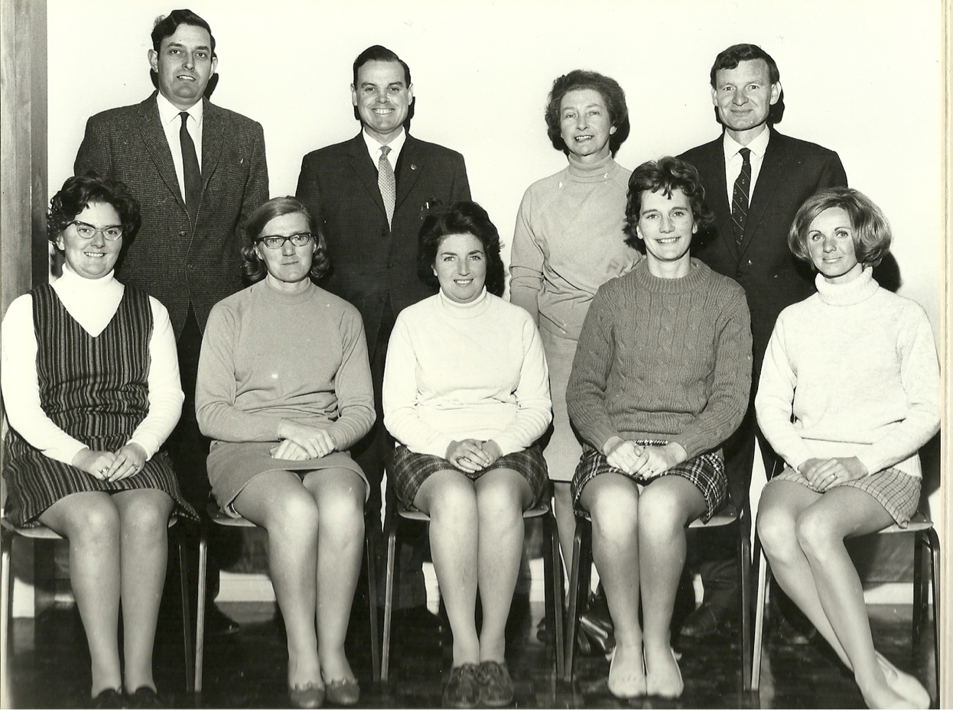
Telephone list
Notes:
Good telephone communication procedures will clearly explain the acceptable practice in your school for answering and dealing with customers over the phone.
They should be clear, specific and contain step-by-step instructions or information for staff in effectively answering the phones.
Every school should have a telephone list of all staff, whether full time or part time, who work in that school. This list can be printed or stored electronically.
Points to consider for a user friendly telephone list:
is it printed or stored securely online
is it easily accessible for all staff
is it in alphabetical order: last name, faculty, room
how often should it be updated – once a term, semester, year or as staff changes are made?
Activity (3 minutes)
Ask participants to discuss in pairs what details you think should be included in a school telephone list.
Q: Would anyone like to share their list of details to include in a telephone list?
A:
full name of staff member (including other names i.e. married name)
title e.g. head teacher, deputy principal
extension number they can be contacted on
other activities they are responsible for e.g. sport coordinator, student wellbeing officer

Slide 7
procedures
answering incoming calls
greeting
taking messages
transferring calls
confidentiality
outgoing calls
Notes:
The items we are going to discuss now are standard procedures that will be a good guide for all staff in what is expected in telephone communication at your school.
Click to transition slide to next point
As we discussed in the last session, there will be an agreed number of rings before a phone is answered by anyone nearby.
Click to transition slide to next point
The greeting should be agreed upon in consultation with the administrative team, the SAM and principal and included in these procedures.
Click to transition slide to next point
When answering telephone calls staff should take messages and assure the caller they will relay the message to the relevant person asap via an agreed method:
discuss with your principal and/or other staff the preferred method of delivering telephone messages
write down the message and keep all message formats standard
repeating back the caller’s message demonstrates understanding
the purpose of repeating back the message is either to get additional information or to verify with the person what they said. If you repeat the information accurately, the person can confirm that you do understand. If you restate inaccurately or miss important details, the person can add information you need to relay
deliver the message as soon as practical via the agreed method
keep a trail of any history of the message
if the staff member is unavailable for any length of time, offer an alternative contact.
Q:
What do you think should be the standard details to include in a message?
A:
caller name
date of call
time of call
person requested
brief description of what the caller wanted
best contact phone number for caller
name of person taking message
Click to transition slide to next point
What are the protocols for transferring calls at your school?
Do staff take responsibility for the calls that they answer or forward to someone else?
Include in the procedures what staff are expected to do with calls.
Some examples are:
do not transfer calls if you can help the caller to find a resolution to their problem in an effective and efficient manner. Where necessary ask the caller if you can place them on hold while you find the answer to their question or ask them for a number where you can call them back
try to help the person by looking up a phone number, transferring the call to the right person, or find out the correct information
advise the caller that you are putting them on hold. Place the caller on hold while you place calls to get necessary information to assist the caller
if the transferred call is not answered promptly return to the caller and explain the situation and take a message.
Click to transition slide to next point
Ensure staff are aware of their obligations in regard to not giving out any personal information about students or staff as we discussed in the previous session.
Click to transition slide to next point
Include outgoing calls and what staff need to know when making outgoing calls:
should they leave the main office number if they have to leave a message
can they let the office know if someone is going to call them back?
These are all good points to include in your procedures.

Slide 8
School telephone procedures
Telephone communication procedures for
1. Answering calls
2. Taking messages
3. Transferring calls
4. Confidentiality
5. Outgoing calls
6. Sharing information
Notes:
Activity (10 minutes)
Hand out blank sample school telephone procedures (refer to pre-reading)
Ask participants in groups of 3-4 to develop procedures for their school.
Using all the points we discussed in the previous slide, develop some procedures for your school staff in answering the phones
Q:
Would anyone like to share their draft procedures?

Slide 9
Reflecting on this session – telephone communication procedures
Has this session given you an understanding of how to:
develop school telephone communication procedures?
Notes:
Ask participants to reflect on what they have learned in this session
Has this session given you an understanding of how to:
develop school telephone communication procedures?
Ask participant's to reflect individually and then share with the person next to them

Slide 10
Esa relationship modules
Click here for the Professional Learning website
1.1 Oral communication |  |  | 1.2 Written communication | 1.3 Building relationships | 1.4 Teamwork
Face-to-face communication |  |  | Communication guidelines | Students as customers | Keeping staff informed
1. Quality communication |  |  | 1. DoE style guide | 1. Supporting students | 1. Keeping staff informed
2. Create a positive image |  |  | 2. Written communication | 2. Student wellbeing
3. Develop a customer service statement |  |  | Digital content - email | Connecting with customers
Telephone communication |  |  | 1. DoE email policy and procedures | 1. Cultural diversity | 1.5 Promoting the school and its vision
1. Telephone communication |  |  | 2. Storing school emails | 2. Aboriginal & Torres Strait Islander customers | School plan and school culture
2. Telephone communication procedures |  |  | 3. Structuring emails | 3. Welcoming customers with disability | 1. School plan and school culture
Key to modules table |  |  | Digital content - website | 4. Customer complaints – role of SAS staff
Framework focus area | Name of module | Name of session | 1. Keeping your website current | Customer feedback
 |  |  | 2. School website team | 1. Customer feedback
Notes:
This module is one of a series of developed resources to support the Excellence in school administration customer relationships framework.
These are all located on the DoE Professional learning website, School Administrative and Support webpage which can be accessed via the portal, Inside the department A-Z.
Click here for the Professional Learning website

Slide 11
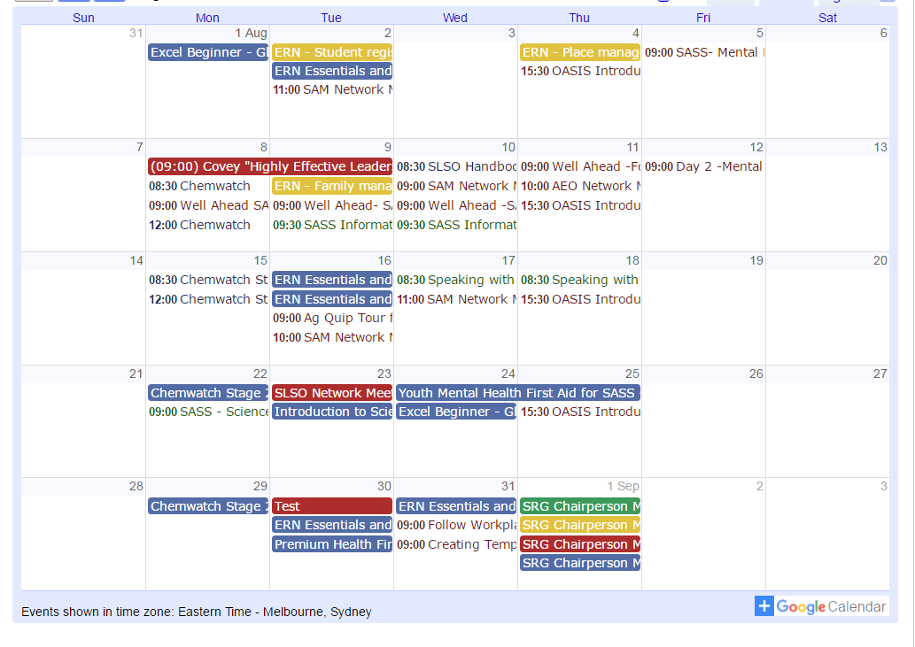
Professional development
SAS staff Reference Group (SRG)
Professional learning calendar
Thank you
for participating in this session
Notes:
The SAS staff Reference Groups (SRGs) schedule professional learning that caters for all categories of non-teaching staff in schools across the state. Please refer to the professional learning calendar for events that may assist to build your skills.
The calendar and SRG committee contact details are available for all SAS staff and can be found on the School Administrative and Support Staff webpage on the DoE Professional Learning website which can be accessed via the portal, Inside the department A-Z.
Thank you for participating in this session.

