Slide 1
Excellence in School Administration framework – Relationships
Sessions in this module
Cultural diversity
Aboriginal & Torres Straight Islander customers
Welcoming customers with a disability
Customer complaints and role of the SAS staff
aspect: Commit to customer service focus: 1.3 building relationships
Module: 1.3(b) Connecting with Customers
Notes:
Note to presenter: before commencing this module please read the separate Presenter Notes which outline all preparation required to successfully present each session
Welcome to the first session of the Connecting with Customers module. Supporting the Building Relationships focus area of the Excellence in School Administration Framework.
This module is one of a series of modules which have been developed to support the implementation of the framework and contains notes for the presenter and identifies resources for the participants.

Slide 2
Structure of the module
Purpose
This module is one of a series of modules which have been developed to support the implementation of the Excellence in School Administration Framework
This module contains 4 sessions and has a total delivery time of 2 hours 45 minutes. Resources for this module include:
PowerPoint presentation sessions
Session 1 - Cultural Diversity – 60 minutes
Session 2 - Aboriginal & Torres Strait Islander customers – 30 minutes
Session 3 - Welcoming customers with a disability – 40 minutes
Session 4 - Customer complaints role of SAS staff – 35 minutes
Presenter notes with pre-reading and guidelines to successfully deliver sessions
Handouts and activities
Notes:
Presenter to give an overview as per slide

Slide 3
delivery
Audience
Key audience is the front office administration staff, however it is a useful resource for all non-teaching staff in schools.
This module can be completed in the following manner:
Presentation style – facilitator follows notes/slides and works through activities in a group setting
Independently – individual follows slides, notes and works through learning tasks and activities.
To ensure the delivery meets the needs of your audience presenter should consider the following:
For internal presentations (to own staff) prior to presenting the session assess your knowledge of each participant’s experience in this topic, adjust notes and resources where necessary
For external presentations at the commencement of the session ask participants to introduce themselves and briefly explain their reasons for attending, adjust notes and resources where necessary
Notes:
Presenter to give an overview as per slide

Slide 4
Outcome of the module – connecting with customers
At the completion of this module, participants should be able to:
describe strategies which build positive relationships with customers and apply these to develop relationships that are authentic and supportive.
Notes:
On completion of this module, participants should be able to:
describe strategies which build positive relationships with customers and apply these to develop relationships that are authentic and supportive

Slide 5
Outcome of this session – cultural diversity
At the completion of this session participants should be able to:
understand the challenges and barriers faced by people of diverse language and cultural background
understand delivery of service to customers from diverse languages and cultural backgrounds
build the capacity to make adjustments to their communication styles.
Notes:
At the completion of this session participants should be able to:
understand the challenges and barriers faced by people of diverse language and cultural backgrounds
understand delivery of service to customers from diverse language and cultural backgrounds
build their capacity to make adjustments to their communication styles

Slide 6
Communication challenges in schools
Click here for the DoE multicultural education policy
Notes:
The DoE Multicultural Education Policy states that schools promote positive community relations through effective communication with parents and community members from diverse cultural, linguistic and religious backgrounds and by providing opportunities for their active engagement in the life of the school.
Q:
Looking at this picture used in this context what do you think it represents?
A:
talking about one thing but the customer is hearing something different or not able to understand your language
discussion is at cross purposes due to language barrier
NSW public schools reflect the diverse language, cultural, religious and socio-economic backgrounds of the state. In such a diverse society NSW public schools have an important role to play in building community harmony through acknowledging and respecting the cultural diversity of their school communities and developing students’ intercultural understanding and sense of identity as Australians. Schools fulfil this role by reflecting and teaching the core values of our community of integrity, excellence, respect, responsibility, cooperation, participation, care, fairness and democracy set out in Values in NSW Public Schools Policy.
Despite this strong desire to build connections with culturally diverse communities, schools can often find it difficult to engage parents from diverse cultural and language backgrounds. Factors which may impede successful engagement with families include:
how parents interact with schools will often reflect their own experiences of schooling
some parents may be used to a more strict separation between home and school life, where parents are not expected to have much of a role in the school unless a problem arises
young people may be more confident in English and take on the role as advocate for the family, providing assistance with interpreting communication from the school and parents may feel dependent and powerless and less confident in approaching the school directly, feeling uncertain and concerned that their English language skills are not adequate
expectations of school involvement from families from other countries can be quite different
Schools should implement a range of practical strategies to support their customers who present communication challenges of different cultures, language or those with disabilities.
https://education.nsw.gov.au/policy-library/policies/multicultural-education-policy
https://education.nsw.gov.au/policy-library/policies/values-in-nsw-public-schools

Slide 7
Communication barriers
Notes:
Schools need effective communication strategies to assist with communication challenges which if not properly addressed can create barriers to parent/carer engagement, student learning and have an adverse impact on the school's reputation.
Q: What are some of the communication barriers or challenges that schools may be presented with?
A:
cultural beliefs and customs
special interest groups
physical barriers
language
hearing impaired
sight impaired
negative past experiences in other schools
experienced trauma

Slide 8
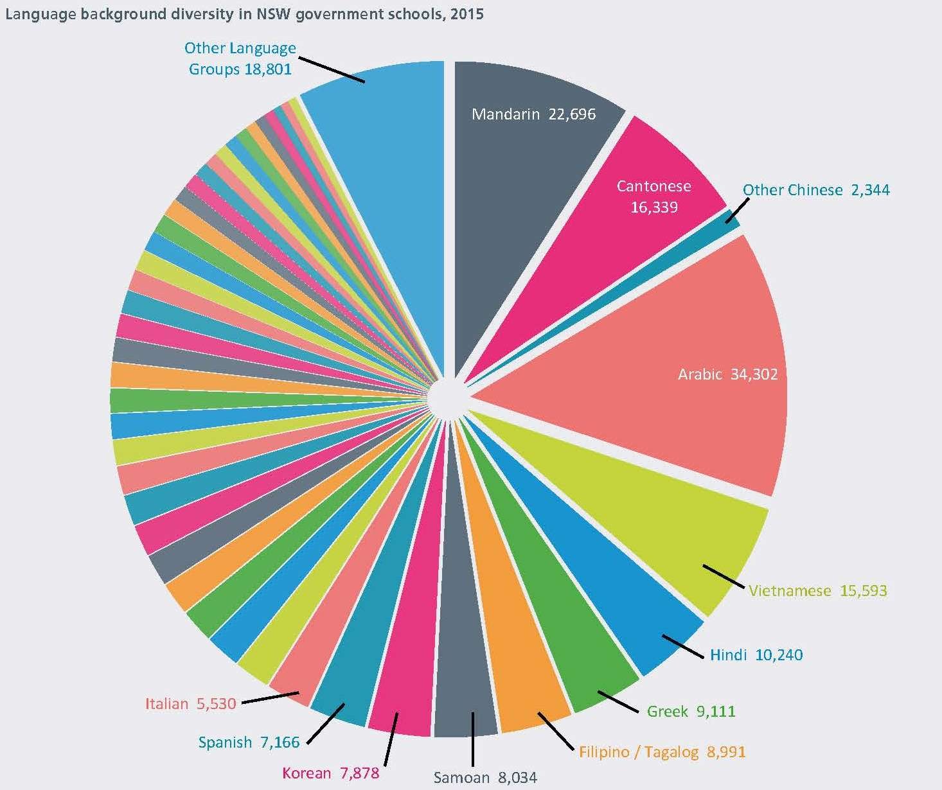
Cultural & language diversity in NSW public schools
32.3% enrolments LBOTE
57% enrolments in Sydney with >50% LBOTE
Sydney West highest LBOTE 64.1%
North West NSW lowest LBOTE 4.1%
231 different language backgrounds
With 43 spoken by more than 1,000 students
Click here for Centre for Education Statistics and Evaluation - CESE website
Notes:
The Centre for Education Statistics and Evaluation (CESE) Bulletin No 14 summarised the diversity of students with a language background other than English (LBOTE) enrolled in NSW public schools in 2015.
Did you know:
In 2015 32.3% of students enrolled in NSW public schools had a language background other than English
57% of all students enrolled in NSW public schools are in the Sydney metropolitan area and in these schools over 50% of the students have a language background other than English
Sydney-West has the highest LBOTE student enrolment with 64.1% of all students enrolled
North West NSW has the lowest LBOTE student enrolment with 4.1% of all students enrolled
This diagram shows the top 10 languages represented in NSW public schools with the largest single language group in 2015 Arabic.
The highest combined language group is Chinese which comprises Mandarin, Cantonese and other Chinese languages.
There are 231 different language backgrounds at NSW public schools but of this there are only 43 languages having more than 1000 LBOTE students.
http://www.cese.nsw.gov.au
Click here for Centre for Education Statistics and Evaluation - CESE website

Slide 9
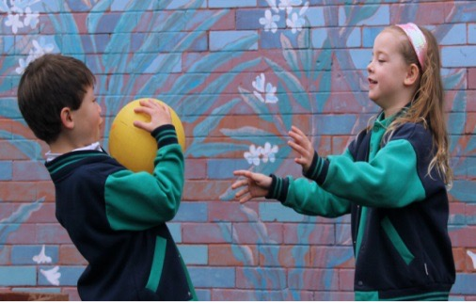
Cultural & language diversity in NSW public schools
20 Largest language groups LBOTE 2015
Chinese | 40,529
Mandarin | 21,360
Cantonese | 16,977
Other Chinese | 2,192
Arabic | 32,628
Vietnamese | 15,543
Hindi | 9,783
Greek | 9,275
Filipino/Tagalog | 8,641
Samoan | 7,915
Korean | 7,685
Spanish | 6,916
Italian | 5,697
Tamil | 4,163
Tongan | 4,063
Macedonian | 3,993
Urdu | 3,968
Indonesian | 3,903
Turkish | 3,803
Bengali | 3,631
Punjabi | 3,293
Japanese | 3,042
Assyrian & Chaldean | 2,960
Notes:
The Centre for Education Statistics and Evaluation Bulletin No 14 summarised the diversity of students with a language background other than English (LBOTE) enrolled in NSW public schools in 2015.
The 20 largest language LBOTE student groups in NSW are:
Chinese, grouped together from Mandarin, Cantonese and other Chinese languages
Arabic
Vietnamese
Hindi
Greek
Filipino/Tagalog
Samoan
Korean
Spanish
Italian
Tamil
Tongan
Macedonian
Urdu
Indonesian
Turkish
Bengali
Punjabi
Japanese
Assyrian & Chaldean
According to the study conducted by CESE in March 2015 there were 251,336 NSW public schools, primary and secondary students identified as having a language background other than English which comprises 32.3% of the 778,508 students enrolled overall.

Slide 10
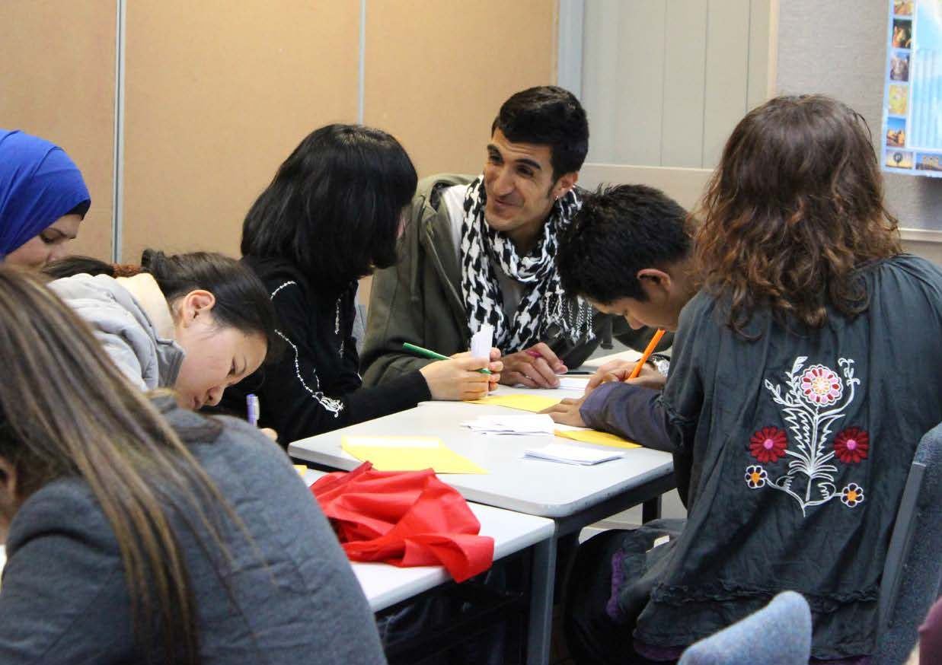
Engaging parents/carers
What you can do:
Involve all staff in creating a targeted family engagement policy and related strategies
Support staff through professional development
Use existing models and resources to support a whole-school approach to engaging migrant and refugee communities.
Appoint a coordination and/or group of staff to assist with engaging migrant or refugee families
Inform all staff about the strategies the school is using
Delegate key staff, including CLOs, to make contact with family members.
Click here for Cultural inclusion
Notes:
https://education.nsw.gov.au/curriculum/multicultural-education/culture-and-diversity/cultural-inclusion
The document produced by DoE in 2006 ‘Opening the School Gate' provides teachers and school staff with a range of strategies to specifically encourage parents/carers from diverse cultural and language backgrounds to engage in their children’s learning. This document forms a part of the DoE Multicultural Education Plan which is the department’s strategic plan to ensure the whole school community’s requirements are met.
We are going to look at some strategies of effective communication and discuss how they can be implemented in schools to help parents/carers engage in their child’s education and bridge any cultural or language barriers.
Schools need to provide support to staff as this is crucial for the success of the communication strategies. Professional development may be required to allow staff to reach a shared understanding about the needs from diverse cultural and language backgrounds.
What schools can do is:
involve staff in creating a targeted family engagement policy and related strategies – look at what the current practices are for engaging parents/carers from diverse cultural and language backgrounds
provide staff with relevant professional development – the DoE Multicultural Education intranet has resources to assist schools in developing practices to support a whole-school approach to engaging migrant and refugee communities and engage parents/carers in their children’s education which we will look at later in this session
appoint a coordinator and/or group of staff to assist with engaging migrant or refugee families
inform staff about the strategies the school is using
Q:
Can you think of ways these strategies can be implemented in schools?
A:
At staff meetings informing staff of strategies.
Through professional development on language and cultural issues specific to that school.

Slide 11
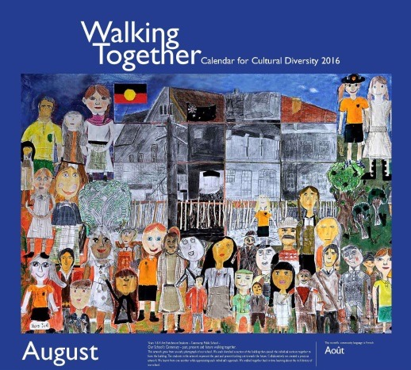
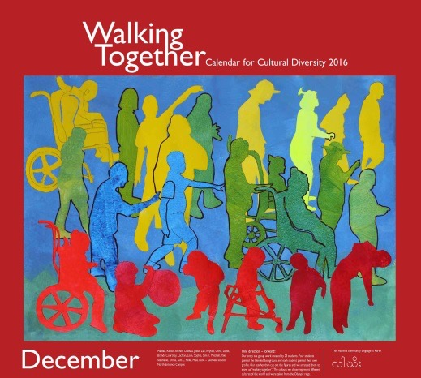
Creating a welcoming environment
What you can do:
Value
Learn
Relate
Understand
Click here for Planning and reporting and access to the Calendar for cultural diversity
Notes:
Schools that are welcoming, positive, respectful and supportive of all parents and carers, including those with disabilities or from all cultural, language and socio-economic backgrounds, are more likely to experience the successful engagement of these families in school activities and achieve positive outcomes for students.
Schools that have ‘welcome’ signs and directions in key languages spoken by students and families not only provide practical assistance, but give the message that the school is inclusive and welcomes diversity.
Posters depicting diversity, and traditional artwork in public areas, can also make people feel comfortable and accepted.
Student artwork and school photos on display can be a talking point for families and a source of pride.
Some practical strategies that can be implemented are:
at enrolment, find out who should be contacted in relation to the student. For some families it is important that the head of the family (such as an uncle who may not be the legal guardian) is involved in important decisions relating to a student. Others may expect an older sibling to attend meetings as an advocate on their behalf. Family roles may shift over time as relationships change. Rather than discourage different types of support, involve significant family members in a way that meets the needs of the family and primary carers and the legal requirements of the school
avoid referring to ‘parents’ only. Make sure you talk about ‘families’ and/or ‘parents and carers’ in all school communications
acknowledge the diversity of family structures in your school and the important role that grandparents, uncles, aunts, siblings and other family members can play in supporting a student’s wellbeing
ask for the assistance of family members to record the immediate family or guardianship roles on student records and clarify living arrangements
use interpreters where needed so parents/carers can communicate effectively with the school and advocate for their child
value the culture, language and religious practices and beliefs of the students and families
Do you have a staff member from another culture who could help you build your own knowledge? Do you have parents who are willing to share information about their culture with staff?
Learn to pronounce unfamiliar names correctly or if it is the first time speaking with a particular parent/student repeat your pronunciation back to them and make sure it is correct. Ask the customer how they would like to be addressed, for example, Mrs.
Relate to each customer as an individual and not as a stereotype. Treat each person with respect and dignity.
Understand that English may not be the customer’s first language. Offer the services of a translator or interpreter if required.
Your school can access the current year’s Calendar for cultural diversity on the multicultural education intranet page via the link shown on this slide.
https://education.nsw.gov.au/teaching-and-learning/curriculum/multicultural-education/culture-and-diversity/planning-and-reporting
Click here for Planning and reporting and access to the Calendar for cultural diversity

Slide 12
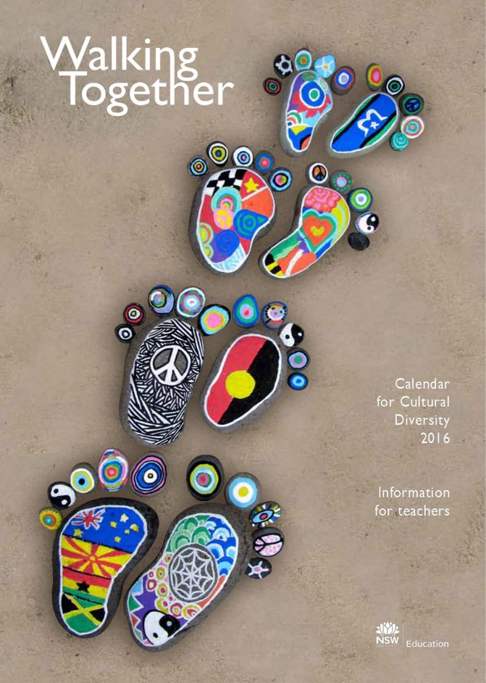
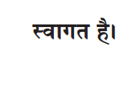
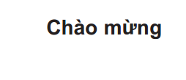
Creating a welcoming environment
What you can do:
Multilingual welcome posters
Documents translated
Click here for the Calendar for cultural diversity
Notes:
What can you do:
In the front office:
display a multilingual welcome poster to welcome parents from a variety of language backgrounds. The electronic copy of the Cultural Diversity calendar and poster is available on the DoE intranet site for schools to download and reproduce
provide multilingual, written information about your school, including school policies, support and orientation programs and multicultural initiatives, to prospective students and their families
secondary schools may wish to provide information to partner primary schools and Intensive English Centres in other languages. Written translations are especially useful for orientation meetings
print and display in the front office ‘welcome’ cards in different languages.
Q:
What are some of the cultural events that schools are encouraged to participate in and celebrate?
A:
Harmony Day celebrates Australia’s cultural diversity.
NAIDOC week.
https://education.nsw.gov.au/curriculum/multicultural-education/culture-and-diversity/calendar-for-cultural-diversity

Slide 13
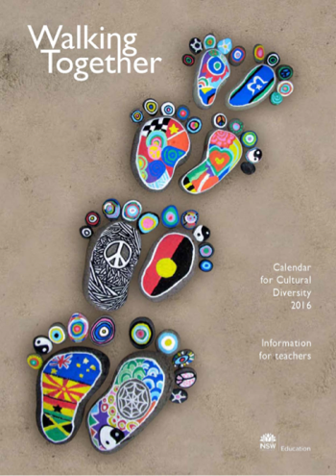
DoE multicultural education resources
Click here for Cultural inclusion
Notes:
We have mentioned the DoE Multicultural Education intranet in this session.
We have already looked at Opening the School Gate which provides school staff with a range of strategies to specifically encourage migrant and refugee parents/carers to participate in the school community.
Another resource is the Strengthening family and community engagement in student learning resource, developed to support schools to reflect on and strengthen family and community engagement, it includes a school assessment tool.
The Strengthening Community Harmony document developed in 2014 provides resources in building community harmony and recognises that it involves action at a number of levels, through: whole school policies and programs; inclusive teaching and learning programs; and collaboration with students, parents and community members.
The Department of Education intranet has many valuable resources for schools to use as guides to welcoming their parents/carers from diverse cultural and language backgrounds.
https://education.nsw.gov.au/curriculum/multicultural-education/culture-and-diversity/cultural-inclusion

Slide 14
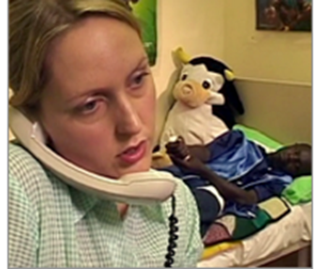
Interpreting and translations
The NSW Department of Education provides interpreting and translation services to enable parents and carers from language backgrounds other than English and parents who are Deaf or hearing impaired to communicate effectively with their child’s school or with other Public Schools NSW staff.
Click here for Interpreting and translations telephone interpreting
Notes:
‘The NSW Department of Education provides interpreting and translation services to enable parents and carers from language backgrounds other than English and parents who are Deaf or hearing impaired to communicate effectively with their child’s school or with other public schools staff’.
Schools are encouraged to use on-site or telephone interpreters to assist in communicating with parents/carers who do not speak or understand English well, who are deaf or have a hearing or speech impairment.
Telephone interpreting is generally for brief assignments such as sickness, emergencies or for school locations without access to on-site interpreters.
On-site interpreting is more appropriate for longer sessions or group meetings.
The department pays for telephone interpreting and onsite interpreting assignments which meet the guidelines set out on the Multicultural Education intranet site.
On-site interpreters must be booked in advance and the booking form can be downloaded from the Intranet site.
https://education.nsw.gov.au/curriculum/multicultural-education/interpreting-and-translations/telephone-interpreting

Slide 15
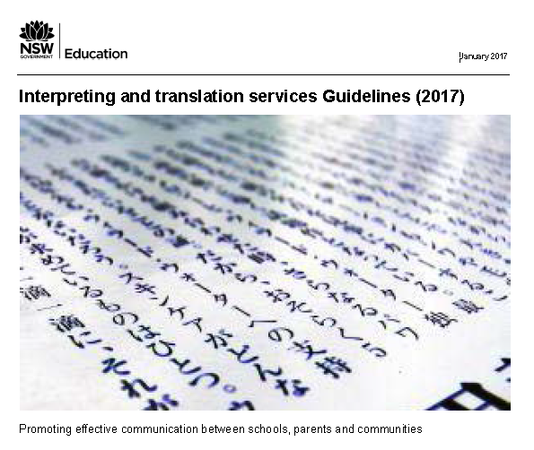
Interpreting and translations
What you can do:
Dial 13 14 50
Have relevant details ready
School details
Student language background
Parent/carer contact details
Outline the issue
Click here for Interpreting and translations telephone interpreting
Notes:
https://education.nsw.gov.au/curriculum/multicultural-education/interpreting-and-translations/telephone-interpreting
The interpreting and translation services guidelines provide schools with detailed information on the types of services available and which are appropriate for the situation.
Q:
What can you do if a student presents injured at the front office and interpretation is required to ensure they receive the correct first aid care?
A:
dial 131450
have relevant details ready
provide school details
provide student language background
provide parent/carer contact details
provide an outline of the issue so that the interpreter can talk with the parent/carers
Q:
What other scenarios can you think of where you might need to call the telephone interpreter?
A:
Student has not turned up for an excursion but family has sent a note previously indicating they would attend.

Slide 16
Interpreting and translations
https://education.nsw.gov.au/going-to-a-public-school/translated-documents
Provides a range of documents translated into over 40 languages
View alphabetical listing of documents translated
Further information 9244 5311
Click here for Translation documents website
Notes:
The department has a list on the Multicultural intranet of commonly used documents for schools translated into different languages.
You can view these documents arranged by document name - such as letters to parents including the enrolment form or view an alphabetical listing languages and the documents that have been translated into that language.
If schools need other documents translated further information is available by contacting 9244 5311, this service may incur a cost to the school, translations required for schools will only be funded for urgent matters regarding student welfare, however, schools may choose to fund their own translations for other publications such as school newsletters.
You can check if your proposed translation meets the guidelines for funding or receive advice on what costs could be incurred and the contacts for suppliers and preparation of documents for translation.
More information is available on the translations page of the Multicultural Education Intranet.
https://education.nsw.gov.au/going-to-a-public-school/translated-documents

Slide 17
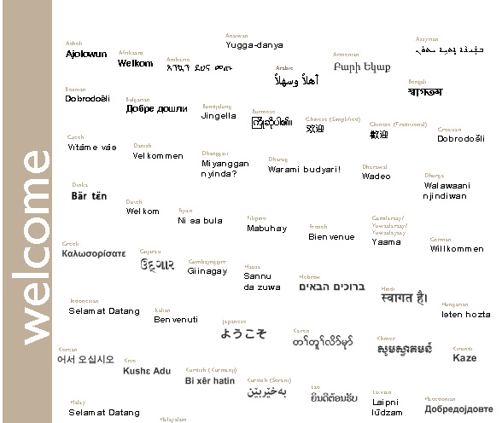
activity
Welcome to our school
Notes:
Activity
Print the Language and Visa report from ERN. This report will provide information about students languages, background etc.
Save as a CSV file and then sort into language backgrounds.
Review the data from the ERN report and make observations about the diverse cultural backgrounds at your school
Q:
What are the top 5 languages spoken at your school?
Q:
Now that you are aware of this, what are some of the ways you could make families feel more welcome at your school?
Activity (5 minutes)
In groups find out how to verbally say “hello” or “welcome” in the top 5 languages in your school.
How? Ask a person from that background or google it.

Slide 18
Reflecting on this session – cultural diversity
Has this session given you an understanding of:
the challenges and barriers faced by people of diverse language and cultural backgrounds
delivery of service to customers from diverse language and cultural backgrounds
how to make adjustments to your communication styles?
Notes:
Ask participants to reflect on what they have learned in this session
Has this session given you an understanding of:
the challenges and barriers faced by people of diverse language and cultural backgrounds
delivery of service to customers from diverse language and cultural backgrounds
how to make adjustments to your communication styles?
Ask participants to reflect individually and then share with the person next to them

Slide 19
Esa relationship modules
Click here for the Professional learning website
1.1 Oral communication |  |  | 1.2 Written communication | 1.3 Building relationships | 1.4 Teamwork
Face-to-face communication |  |  | Communication guidelines | Students as customers | Keeping staff informed
1. Quality communication |  |  | 1. DoE style guide | 1. Supporting students | 1. Keeping staff informed
2. Create a positive image |  |  | 2. Written communication | 2. Student wellbeing
3. Develop a customer service statement |  |  | Digital content - email | Connecting with customers
Telephone communication |  |  | 1. DoE email policy and procedures | 1. Cultural diversity | 1.5 Promoting the school and its vision
1. Telephone communication |  |  | 2. Storing school emails | 2. Aboriginal & Torres Strait Islander customers | School plan and school culture
2. Telephone communication procedures |  |  | 3. Structuring emails | 3. Welcoming customers with disability | 1. School plan and school culture
Key to modules table |  |  | Digital content - website | 4. Customer complaints – role of SAS staff
Framework focus area | Name of module | Name of session | 1. Keeping your website current | Customer feedback
 |  |  | 2. School website team | 1. Customer feedback
Notes:
This module is one of a series of developed resources to support the Excellence in school administration customer relationships framework.
These are all located on the DoE Professional learning website, School Administrative and Support webpage which can be accessed via the portal, Inside the department A-Z.

Slide 20
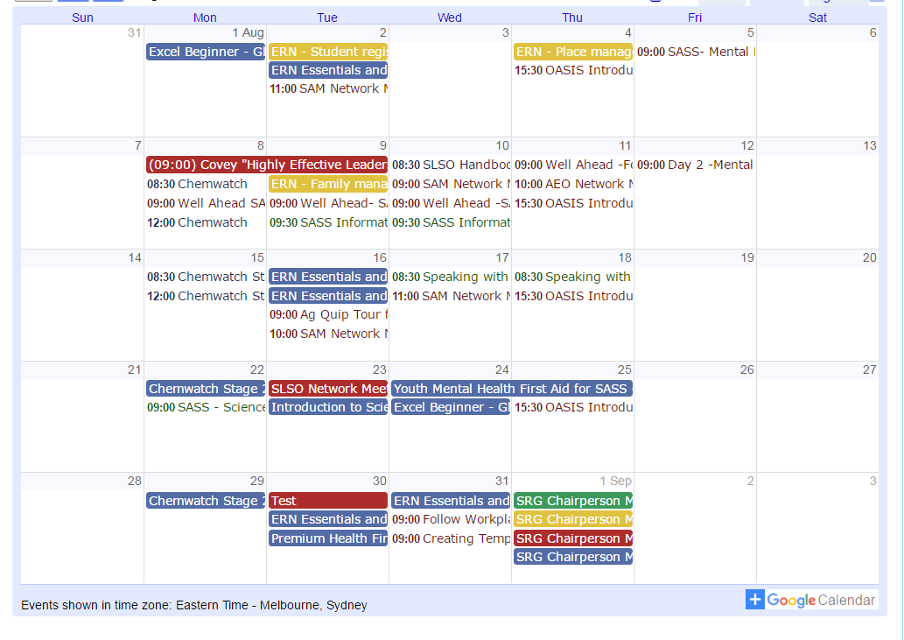
Professional development
SAS staff Reference Group (SRG)
Professional learning calendar
Thank you
for participating in this session
Notes:
The SAS staff Reference Groups (SRGs) schedule professional learning that caters for all categories of non-teaching staff in schools across the state. Please refer to the professional learning calendar for events that may assist to build your skills.
The calendar and SRG committee contact details are available for all SAS staff and can be found on the School Administrative and Support Staff webpage on the DoE Professional Learning website which can be accessed via the portal, Inside the department A-Z.
Thank you for participating in this session.

