Slide 1
Excellence in School Administration framework – Relationships
Sessions in this module
DoE email policy and procedures
Storing school emails
Structuring emails
Aspect: Communicate effectively focus: 1.2 written communication
Module: 1.2(b) Digital Content - Email
Notes:
Note to presenter
Before commencing this module please read the separate Presenter notes which outline all preparation required to successfully present each session.
Welcome to the first session on Digital Content - Email module supporting the Written Communication focus area of the Excellence in School Administration Framework.
This module is one of a series of modules which have been developed to support the implementation of the Framework and contains notes for the presenter and identifies resources for the participants.

Slide 2
Structure of the module
Purpose
This module is one of a series of modules which have been developed to support the implementation of the Excellence in School Administration Framework
This module contains 3 sessions and has a total delivery time of 2 hours 15 minutes. Resources for this module include:
PowerPoint presentation session
Session 1 – DoE email policy and procedures – 55 minutes
Session 2 – Storing school emails – 45 minutes
Session 3 – Structuring emails – 35 minutes
presenter notes with pre-reading and guidelines to successfully deliver sessions
handouts and activities
Notes:
Presenter to give an overview as per slide

Slide 3
delivery
Audience
Key audience is the front office administration staff, however it is a useful resource for all non-teaching staff in schools.
This module can be completed in the following manner:
presentation style – facilitator follows notes/slides and works through activities in a group setting
independently – individual follows slides, notes and works through learning tasks and activities
To ensure the delivery meets the needs of your audience presenter should consider the following:
for internal presentations (to own staff) prior to presenting the session assess your knowledge of each participant’s experience in this topic, adjust notes and resources where necessary
for external presentations at the commencement of the session ask participants to introduce themselves and briefly explain their reasons for attending, adjust notes and resources where necessary
Notes:
Presenter to give an overview as per slide

Slide 4
Outcome of the module – digital content - email
At the completion of this module, participants should be able to:
describe the characteristics of well structured, easy to follow written communication and apply these to produce writing in the following forms:
general correspondence
permission notes and newsletters
digital content and email
Notes:
At the completion of this module you should be able to describe the characteristics of well structured, easy to follow written communication and apply these to produce writing in the following forms:
general correspondence
permission notes and newsletters
digital content and email

Slide 5
Outcome of this session – DoE email policy and procedures
At the completion of this session, participants should:
be aware of policy and protocols when using the DoE email system
understand how to apply policy and protocols when dealing with school emails
Notes:
At the completion of this session you should:
be aware of policy and protocols when using the DoE email system
understand how to apply policy and protocols when dealing with school emails

Slide 6
Department policy
The Department of Education is committed to a workplace that provides dignity and respect. This includes the use of information and communication technologies such as email.
Click here for the Code of conduct policy
Click here for the Communication devices and associated services policy
Click here for the Records management website
Notes:
Email is an integral part of the communication strategy of the Department of Education. A significant amount of information that may have previously existed in hard copy now often only exists as part of an email message.
The Communication Devices & Associated Services Policy states:
that employees must be efficient, economical and ethical in their use and management of public resources. Departmental communication devices and associated services, including telephones, mobile phones, computers, tablet devices, personal digital assistants, facsimiles, Internet, Intranet, email and broadband data services are public resources provided for official purposes, and all employees have a responsibility to ensure their proper and secure use.
In this session we will be looking at the Code of Conduct in relation to using the department’s email systems, and the department records management program.
https://education.nsw.gov.au/policy-library/policies/communication-devices-and-associated-services-policy
https://education.nsw.gov.au/policy-library/policies/code-of-conduct-policy
https://education.nsw.gov.au/business-services/records-management/corporate-records-management/help-cards-and-e-learning

Slide 7
Department email protocols
Code of Conduct
4. Respect for people
4.4 you must not use information and communication technologies, such as email, mobile phones, text or instant messaging and websites to engage in behaviour that could reasonably be considered to have a negative impact on another person, cause them harm, or make them feel unsafe.
Click here for the Code of conduct policy
Notes:
Point 4 of the Code of Conduct is about respect and states you must not use information and communication technologies, such as email, mobile phones, text or instant messaging and websites to engage in behaviour that could reasonably be considered to have a negative impact on another person, cause them harm, or make them feel unsafe.
Q: What would you do if a threatening or derogatory email was sent to the school?
A: Follow procedures and report to the principal
https://education.nsw.gov.au/policy-library/policies/code-of-conduct-policy

Slide 8
Department email protocols
Code of Conduct
16. Signatures
Email and hard copy - as an employee, you are accountable for any email or hard copy documents that you sign. Therefore, you should carefully read all documents you are asked to sign.
16.1 Do not sign incorrect information
16.2 Sign your own name
16.3 Own authority
16.4 Keep password secure
Click here for the 2014 Code of Conduct approved by Minister 1 July 2014
Notes:
Point 16 of the Code of Conduct is in relation to signatures and the proper use of them including email and hard copy signatures and states:
16.1. you must not sign a document or an email, which you know is not true and correct
16.2. you must only sign your own name and must never permit or encourage anyone to sign a name other than their own. Managers and supervisors must not encourage or coerce their staff to sign a document with which the employee is not satisfied
16.3. you should only use your own name when sending emails, and should not give the impression that you have the authority of another person without their permission
16.4. you should never give another person your staff portal password and you should take care to ensure that you have ‘logged off’ fully from your computer before leaving it unattended
Q: Can anyone give an example of how this might apply with school email accounts or staff email accounts?
A:
principal asks you to send an email to a parent via the school email account and sign it on their behalf
someone logs into the school email account and sends an email with another person’s signature
you leave your email account logged in and leave your desk unattended and a student sends an inappropriate email to the principal signing your name (this is a real case!)
Click here for the 2014 Code of Conduct approved by Minister 1 July 2014

Slide 9
Department email protocols
Code of Conduct
20. Record keeping
A record serves an essential administrative legal and historical purpose.
Records may be class rolls, student assessment records, emails
Click here for the 2014 Code of Conduct approved by Minister 1 July 2014
Notes:
Point 20 of the Code deals with record keeping and states a record serves an essential administrative legal and historical purpose. Records may be class rolls, student assessment records, emails etc.
Fundamental to carrying out daily functions is the need for schools to manage all communications and information resources such as emails produced and received in the day-to-day business of the school.
All non-teaching staff in schools have an administrative component to their role which requires them to keep accurate records.
Q: Can anyone think of an example where this relates to their role?
A:
student assessment records
permission notes
invoices, statements, forms
Some emails need to be kept.
Q: Can you think of emails that fall into this category?
A:
attendance emails
supplier quotes
Let’s look at why effectively managing these emails is of benefit to the school.
Click here for the 2014 Code of Conduct approved by Minister 1 July 2014

Slide 10
Why manage email?
All business email messages created using departmental systems are NSW State records and must be managed in accordance with the State Records Act 1998. They are also subject to related legislation such as the Information (Public Access) Act 2009 (NSW) (GIPA Act) and the Privacy and Personal Information Act 1998. Courts have accepted email as a legitimate source of evidence and it is therefore subject to legal processes such as subpoena.
Click here for Records management for schools
Notes:
According to the Department of Education records management program, email messages are records in fact and in law, and, like records in other formats, are subject to legislation and other legal processes.
This means they are legal documents that can be requested to be produced in court.
Some examples would be student attendance cases and accident cases involving students.
The procedures for managing school records are located on Business services > Records management website, to help you manage and retain your records, including emails.
We will look at these in more detail in the next few slides.
Click here for Records management for schools

Slide 11
Department email protocols
Code of Conduct
20.1 Record Keeping
20.1 All employees have a responsibility:
to create and maintain full, accurate and honest records of their activities, decisions and other business transactions, and
to capture or store records in the Department’s records systems in line with the Department of Education records management program and the State Records Act 1998
Click here for the 2014 Code of Conduct approved by Minister 1 July 2014
Notes:
The final area of the Code that relates to emails is point 20.1 which states that all employees have a responsibility to:
1. create and maintain full, accurate and honest records of their activities, decisions and other business transactions, and
2. capture or store records in the department’s records systems in line with the Department of Education records management program and the State Records Act 1998 , mentioned on the previous slide.
Q: In summary, what can you tell me about your responsibilities in relation to emails and the Code of Conduct?
A:
all information must be factual
must use your own name on emails
keep your password secure
store emails for future reference
do not use email to harass or cause harm
In the next slide we will look at how to keep accurate records when using emails according to the department records management program.
Click here for the 2014 Code of Conduct approved by Minister 1 July 2014

Slide 12
Department email protocols
Records management
Effective management
of emails ensures:
all information resources are valuable assets
faster, cheaper provision of accurate information
better quality advice to decision-makers
decreased storage costs
compliance with policy
Click here for records management help cards and eLearning
Notes:
According to the records management program the effective management of emails can provide a wide range of benefits to your school. These benefits include:
all information resources are valuable assets that are shareable and re-usable
faster, cheaper provision of accurate information
better quality advice to school executive and decision-makers in your school
decreased storage costs
compliance with department and government policies on storage and retention of records
When using any department email system either the school email account or staff email account, you are the responsible person for managing these emails.
https://education.nsw.gov.au/business-services/records-management/corporate-records-management/help-cards-and-e-learning

Slide 13
Types of emails
Short term value email
Personal email
Business email
Notes:
Emails received or sent via the department email accounts are divided into 3 categories:
business email – email which relates to the business of the school which must be retained to provide a record and not be altered in any way
short-term value email – email which is used to facilitate school business, but is of a trivial nature or of such short-term value that it does not support or contribute to the business functions of the department or school and can be deleted
personal email – email which is of a personal nature and which has no relevance to the business of the department or school and can be deleted
Let’s look at examples of the different categories.

Slide 14
Types of emails
Business emails –not to be deleted
Seeking approval
Course of action
Pre-decision discussion
Notes:
Business emails are not to be deleted.
These are some examples:
a communication between staff seeking approval, for example, a professional learning request to the principal
a direction for an important course of action, for example, asking if a letter or permission note is ready to be sent out to parents
a discussion between staff where a decision is being formulated
Q: Can you suggest other examples of business emails?
Go to the next slide for answers

Slide 15
Types of emails
Not to be deleted
Business emails
professional learning request
staff permission
information to parents or minutes
other business correspondence
letter to be parent or
permission note
supplier quote/refund, camp contract
records of conversations
Notes:
A:
record of the essential business for example asking for a credit/refund from a supplier
information distributed by email (as attachments) for example original copies of minutes, letters to parents, contracts such as camp contracts
record of conversations (file notes)
other business correspondence received from outside or inside the department
Q: What about state office emails –Document Number (DN’s) funding allocations etc.? Do you think they come under business emails?
A: Yes
So did you know you are not allowed to delete these emails? How then do we store these securely?
We will look at storage options for emails in the next session.

Slide 16
Types of emails
Short term emails – can be deleted
Delete
Delete
Delete
Notices of meetings
Minutes
Reports
Notes:
Examples of short term value emails and these can be deleted:
notices of meetings – the attachment is the record that is kept
copies of minutes
copies of reports or newsletters
Q: Should you keep a record that the email (e.g. notice of meetings) was sent? Why would you do this?
A: Someone may complain that they didn’t attend the meeting because they were not invited. Copies of minutes, again someone may complain that they didn’t receive the email.
Q: What are other examples of short term value emails?
Go to the next slide for answers

Slide 17
Types of emails
Short term emails – can be deleted
Delete
Delete
Delete
Notices of meetings
Minutes
Reports
Delete
Delete
Delete
Staff movements
Advertising material
“cc” or “bcc”
Notes:
A:
staff movements – variations to routine where staff are at professional learning events, excursions, leave
advertising material and any other publicly available material
internal work-related email received by “carbon copy” (CC) or “blind carbon copy” (BCC)
Remember short-term value email can be deleted, let’s now look at personal emails.
Q: What are other examples of personal emails?
Stay on this slide until examples have been given then go to next slide

Slide 18
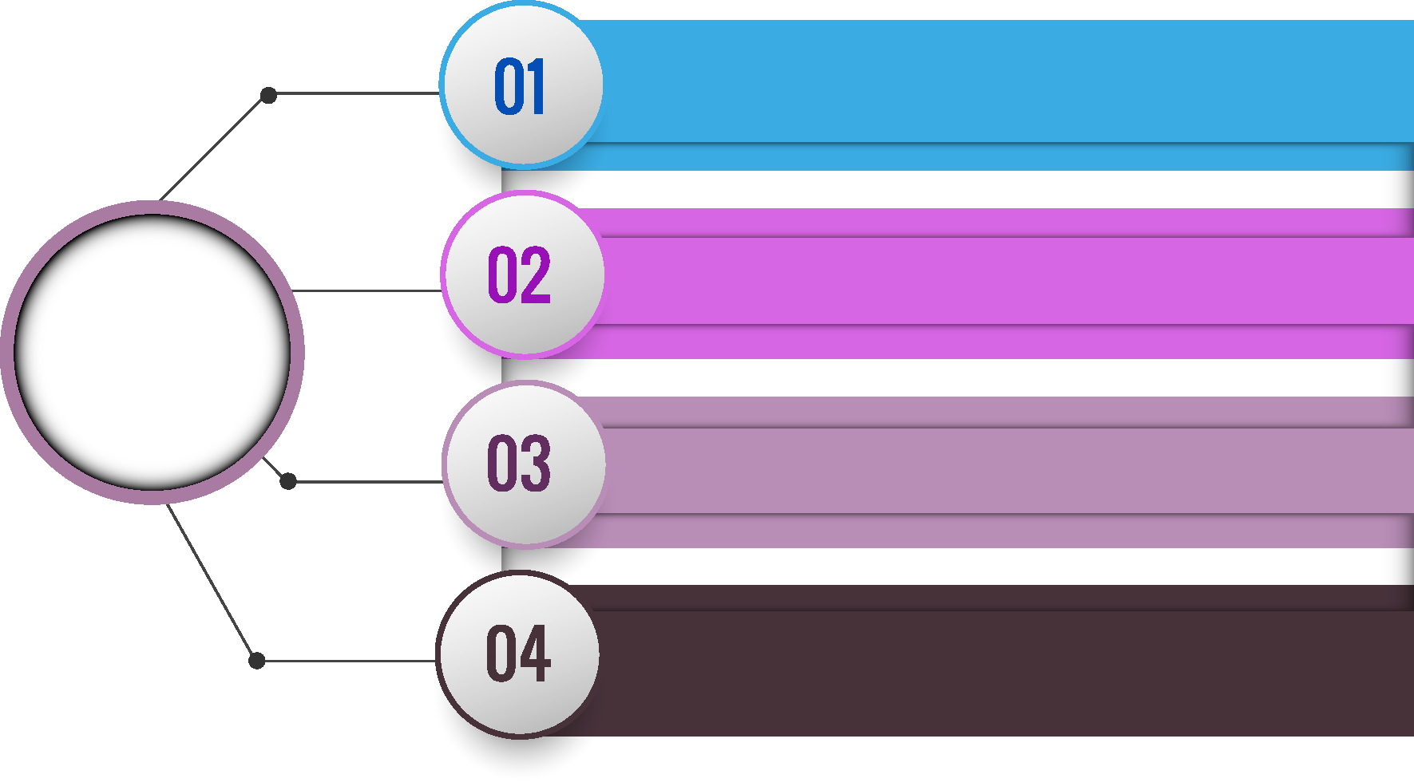
Types of emails
Let’s do lunch
Personal/family arrangements
Personal emails
Jokes
Unsolicited information or newsletters (ie. not related to staff work responsibilities)
can be deleted
Notes:
A:
let’s do lunch
personal/family arrangements
jokes
unsolicited information or newsletters (ie not related to staff work responsibilities)
Q: Can personal emails be deleted?
A: Yes as soon as you are finished with them as they are of no value to the school or department.
In the next session we will look at the options for storing business emails.

Slide 19
Reflecting on this session – DoE email policy and procedures
Has this session given you an understanding of:
policy and protocols when using the DoE email system
understand how to apply policy and protocols when dealing with school emails?
Notes:
Ask participants to reflect on what they have learned in this session
Has this session given you an understanding of:
policy and protocols when using the DoE email system
applications for use, when dealing with school emails
Ask participants to reflect individually and then share with the person next to them

Slide 20
Esa relationship modules
Click here for the Professional learning website
1.1 Oral communication |  |  | 1.2 Written communication | 1.3 Building relationships | 1.4 Teamwork
Face-to-face communication |  |  | Communication guidelines | Students as customers | Keeping staff informed
1. Quality communication |  |  | 1. DoE style guide | 1. Supporting students | 1. Keeping staff informed
2. Create a positive image |  |  | 2. Written communication | 2. Student wellbeing
3. Develop a customer service statement |  |  | Digital content - email | Connecting with customers
Telephone communication |  |  | 1. DoE email policy and procedures | 1. Cultural diversity | 1.5 Promoting the school and its vision
1. Telephone communication |  |  | 2. Storing school emails | 2. Aboriginal & Torres Strait Islander customers | School plan and school culture
2. Telephone communication procedures |  |  | 3. Structuring emails | 3. Welcoming customers with disability | 1. School plan and school culture
Key to modules table |  |  | Digital content - website | 4. Customer complaints – role of SAS staff
Framework focus area | Name of module | Name of session | 1. Keeping your website current | Customer feedback
 |  |  | 2. School website team | 1. Customer feedback
Notes:
This module is one of a series of developed resources to support the Excellence in school administration customer relationships framework.
These are all located on the DoE Professional learning website, School Administrative and Support webpage which can be accessed via the portal, Inside the department A-Z.
Click here for the Professional learning website

Slide 21
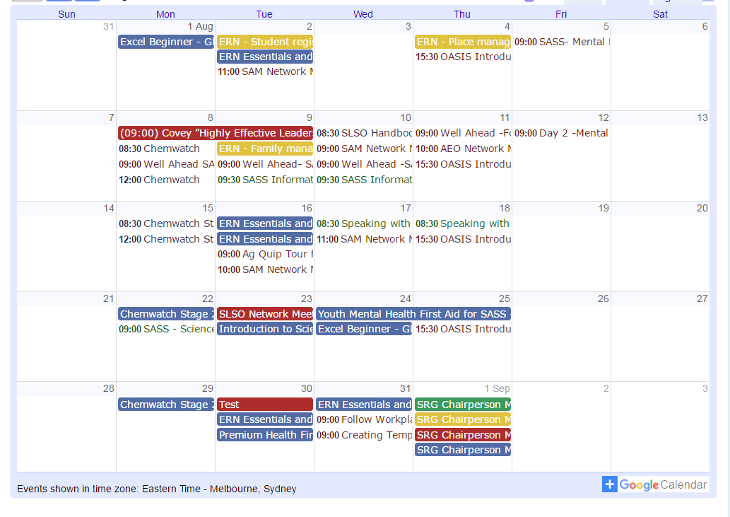
Professional development
SAS staff Reference Group (SRG)
Professional learning calendar
Thank you
for participating in this session
Notes:
The SAS staff Reference Groups (SRGs) schedule professional learning that caters for all categories of non-teaching staff in schools across the state. Please refer to the professional learning calendar for events that may assist to build your skills.
The calendar and SRG committee contact details are available for all SAS staff and can be found on the School Administrative and Support Staff webpage on the DoE Professional Learning website which can be accessed via the portal, Inside the department A-Z.
Thank you for participating in this session.

