Slide 1
The Art of Character Development
WITH JONATHAN TEO & ANTHONY GRIMA
The WALT DISNEY COMPANY Australia
WEEK 3

Slide 2
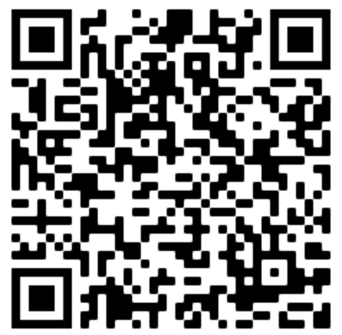
Zoom -Tool for our webinar
Primary Link
same zoom link for all Primary workshops.
does not allow participants to use their camera or their microphone.
chat function will be enabled for students to actively participate and students will be prompted when to do so.
Q&A open for questions and responses as well as the raise hand feature.
If QR code does not respond, the ZOOM room number is: 68038145880
If asked for a password, use : password1

Slide 3
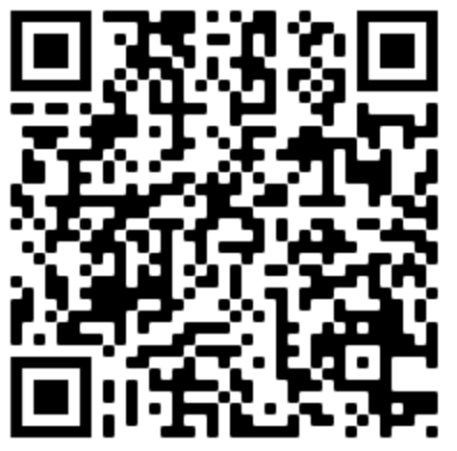
Zoom - Tool for our webinar
Secondary Link
same zoom link for all Secondary workshops.
does not allow participants to use their camera or their microphone.
chat function available for students to actively participate
Q&A open for questions and responses as well as the raise hand feature.
If QR code does not respond, the ZOOM room number is: 67925115681
If asked for a password, use : password1

Slide 4
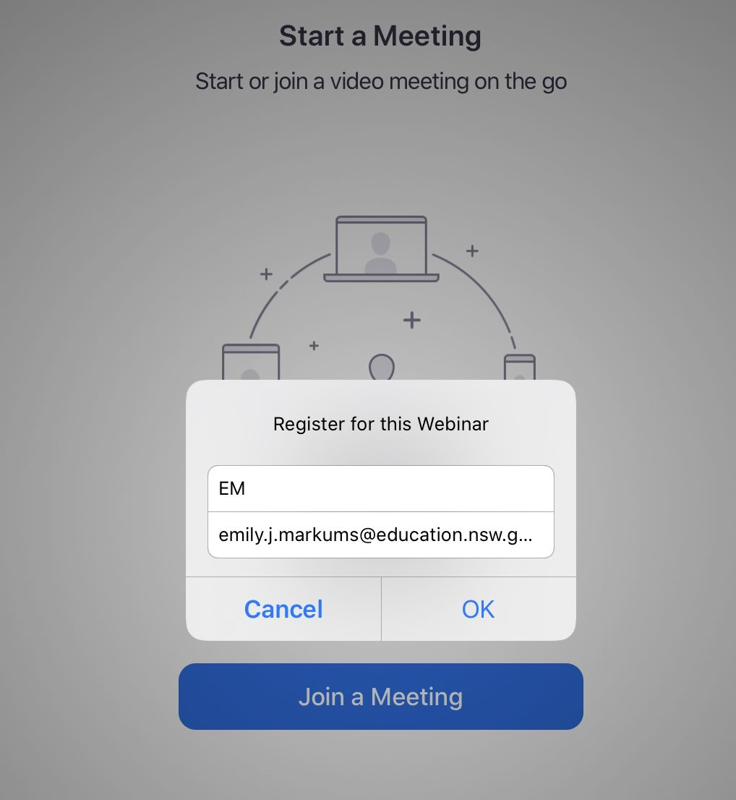
Registering in Zoom
Cyber Security Warning
To register for this webinar :
Individual students
Please use only your first name (e.g. Emily) or your initials (e.g. EM) not your full name(s).
Class group
Please put down the year group and school (e.g. 3JCondo).

Slide 5
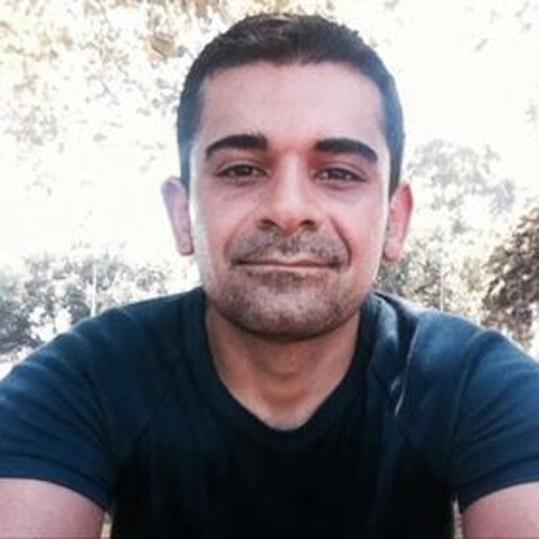
Profile Anthony Grima Designer MARVEL & LUCASFILM The Walt Disney Company Australia
Anthony is a Melbourne based Graphic Designer who specialises in branding and content creation for kids. He is currently lead designer for Marvel and Lucasfilm at the Walt Disney Company in Australia.
He has worked with businesses such as Jetstar Airways, Nintendo Australia, Penguin Books and the AFL to create brands and initiatives with the focus on engaging kids.

Slide 6
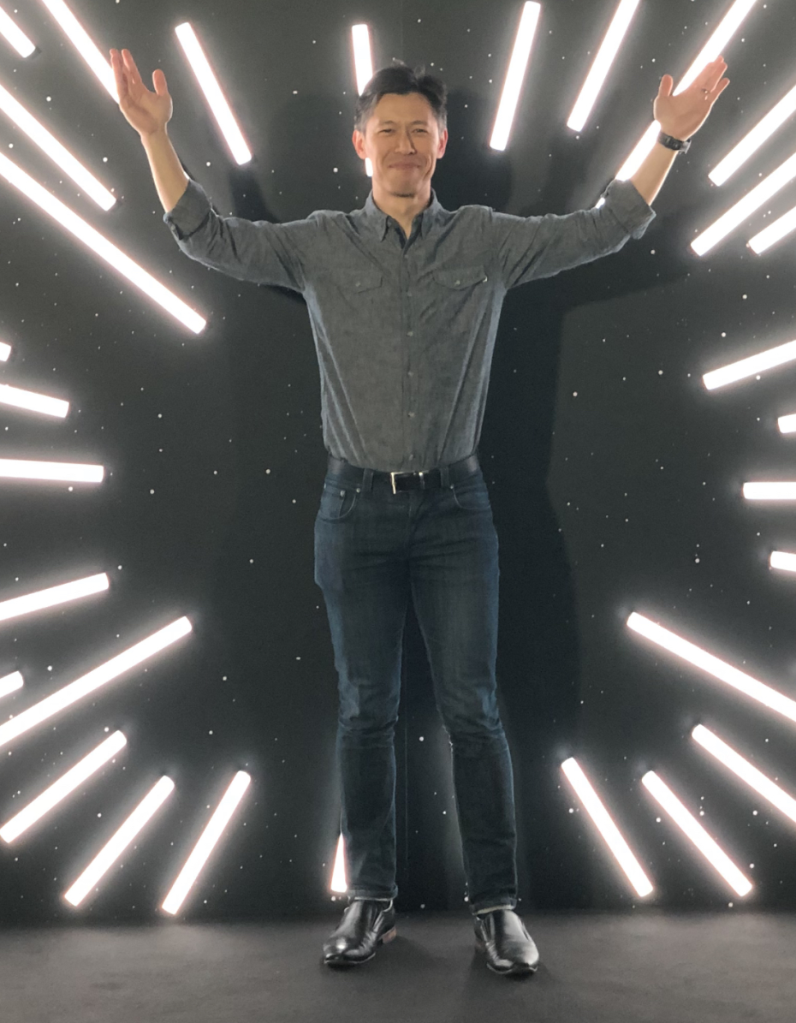
Profile Jonathan Teo Senior Manager, Lifecycle Marketing – DISNEY+
Jonathan Teo has been working in the .com landscape for over 17 years, with companies like Yahoo, eBay, InMobi and currently at The Walt Disney Company. During his career he has had the opportunity to take on various roles like operations, creative production, sales and marketing. He has a passion for analytics, technology and innovation, of which he has invented two patents for eBay. JT is currently in-charge of lifecycle marketing for Disney Streaming Services with The Walt Disney Company in Australia and New Zealand.

Slide 7
CHARACTER CREATION BRIEF
In the template provided, develop a character that exists in an imaginary world of your choosing. In addition to the look of the character and storyworld, think about some of the other factors that make a character unique.
If you don't feel comfortable illustrating your character, you can use found images to help you describe your character also!
1) Storyworld:
What does the world look like, is it pre-historic, current day, futuristic or imaginary?
2) Character Design:
What does your character look like? How are they unique? What's their personality? Do they have any special gadgets or clothing?
3) How does your character exist in this world? What's their motivation and story? Do they fight for something? What is your character up against?

Slide 8
Introducing...
Story World:
Character Design:
How does your character exist in this world?

Slide 9
Story World
Different worlds that you could use as background information to create your superhero
The more intricately and intimately you know your story’s world, the richer your writing will be.
Busy city street with tall brick buildings covered in graffiti
Underwater world with coral blooms and deep dark trenches
Over the rainbow where plants talk and unicorns strut
Mountain forest with tall trees, soft grass and a fog that never lifts
Outer space where there is no gravity and it is icy cold and day and night cycles last 6 months
Your school and classroom with some slight changes
Country lane that’s hot, dusty and trees are sparse with barbed fences on either side
The potions room in a magical castle full of shelves containing bottles of unidentifiable items

Slide 10
Superhero Design
What does your Superhero look like on the outside?
What does your Superhero do to show their personality?
Tag Name
How does your Superhero change, or what lesson does your Superhero learn?
What does your Superhero say to show their personality?

Slide 11
How does your Superhero exist in this world?
Super Hero Driving Force?
What's their motivation and story?
​
Do they fight for something?
What is your character up against?

Slide 12
Syllabus Outcomes
Stage 2 and 4
Literacy Stage 2
Literacy Stage 4
Drama Stage 2
Drama Stage 4
EN2-2A plans, composes and reviews a range of texts that are more demanding in terms of topic, audience and language
EN2-3A uses effective handwriting and publishes texts using digital technologies
EN2-8B identifies and compares different kinds of texts when reading and viewing and shows an understanding of purpose, audience and subject matter
EN2-10C thinks imaginatively, creatively and interpretively about information, ideas and texts when responding to and composing texts
EN2-11D responds to and composes a range of texts that express viewpoints of the world similar to and different from their own
EN2-12E recognises and uses an increasing range of strategies to reflect on their own and others’ learning
EN4-1A responds to and composes texts for understanding, interpretation, critical analysis, imaginative expression and pleasure
EN4-2A effectively uses a widening range of processes, skills, strategies and knowledge for responding to and composing texts in different media and technologies
EN4-4B makes effective language choices to creatively shape meaning with accuracy, clarity and coherence
EN4-5C thinks imaginatively, creatively, interpretively and critically about information, ideas and arguments to respond to and compose texts
EN4-6C identifies and explains connections between and among texts
EN4-7D demonstrates understanding of how texts can express aspects of their broadening world and their relationships within it
EN4-9E uses, reflects on and assesses their individual and collaborative skills for learning
DRA S2.1 Takes on and sustains roles in a variety of drama forms to express meaning in a wide range of imagined situations
DRA S2.2 Builds the action of the drama by using the elements of drama, movement and voice skills
DRA S2.3 Sequences the action of the drama to create meaning for an audience
DRA S2.4 Responds to, and interprets drama experiences and performances
4.1.3 devises and enacts drama using scripted and unscripted material
4.3.1 identifies and describes elements of drama, dramatic forms, performance styles, techniques and conventions in drama
4.3.3 describes the contribution of individuals and groups in drama using relevant drama terminology.

Slide 13
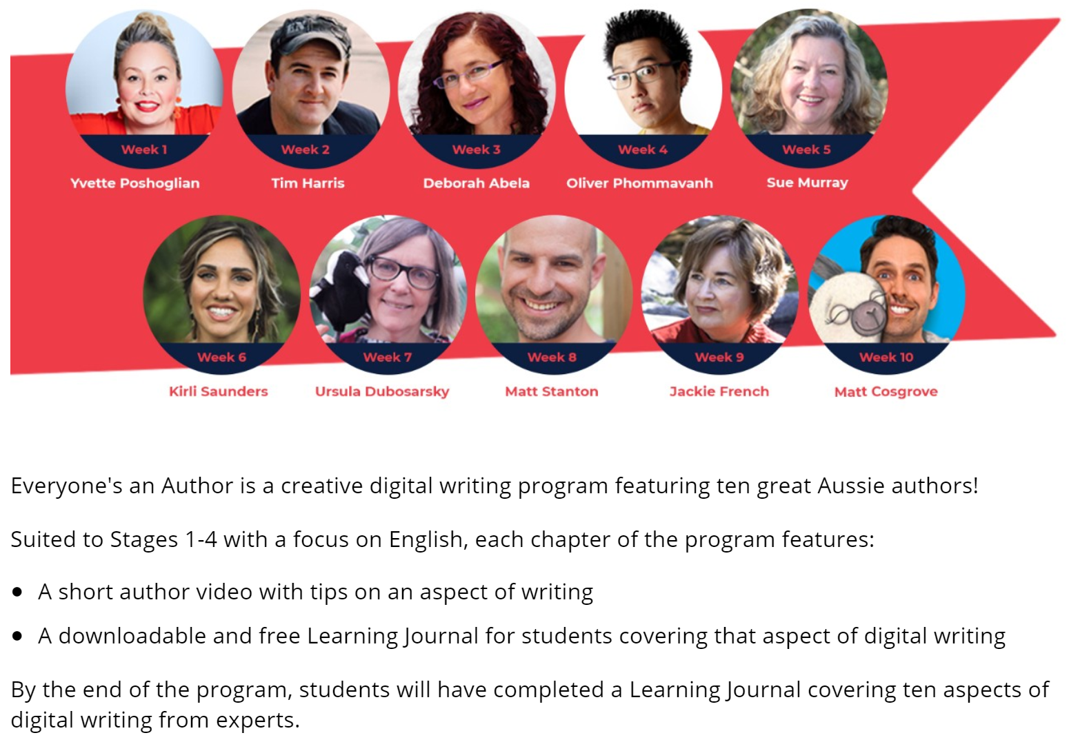
Where to go from here?
Everyone’s an Author
https://t4l.schools.nsw.gov.au/news/2020/4/everyone-s-an-author.html

Slide 14
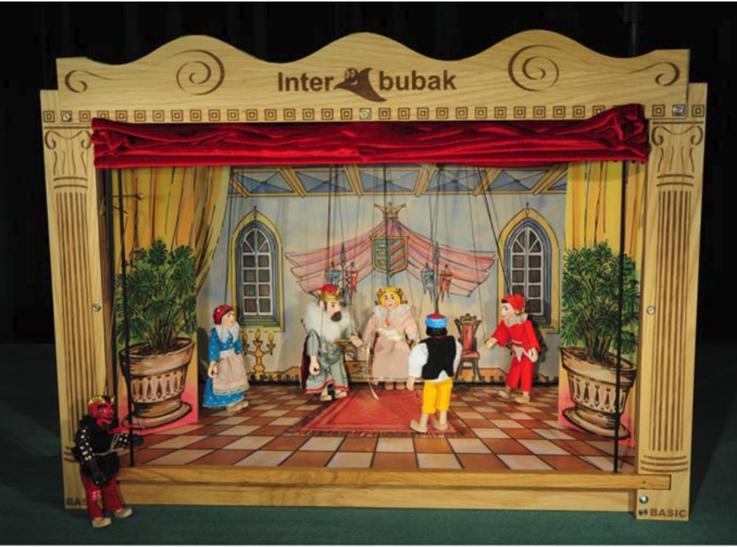
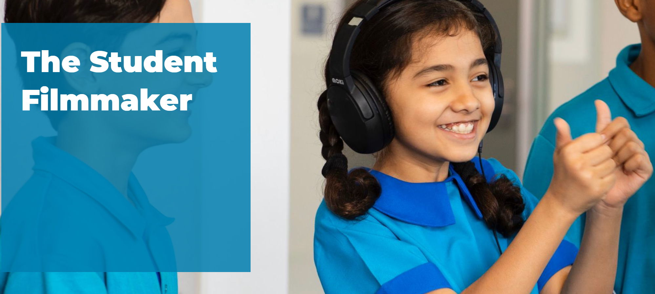
Digital ideas to continue students learning
Where to go from here?
The student film maker course
Found HERE on the learning library
Film the story using iPads/iPhone using greenscreen and simple costumes
Retell story using Claymation/ stop go animation with playdough
Record a puppet character performance with the superhero as the main character using 360 video and photos.

Slide 15
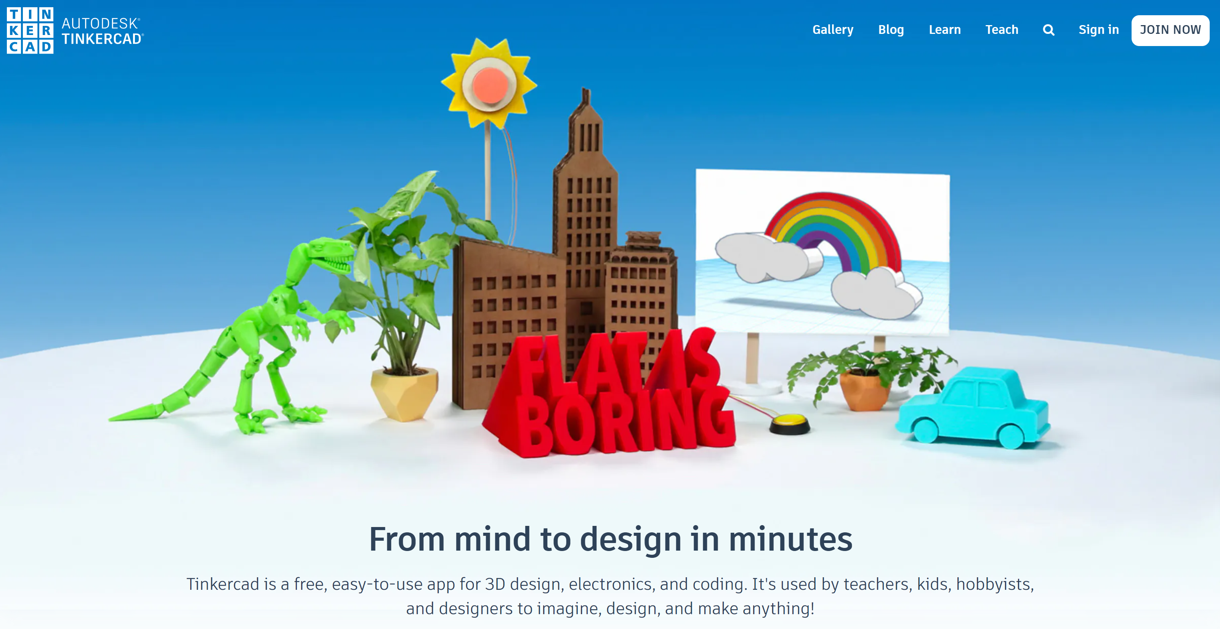
Digital ideas to continue students learning
Where to go from here?
Create the character in Tinker cad and 3D print
Recreate the story in 2D using Tynker to set the scene and code characters to interact
Create the character in 3D paint then use AR to place character into the classroom and take photos
Create the character digitally then use Cospaces to retell the story in 3D

