Slide 1
Excellence in School Administration framework – Relationships
Aspect: Consistency and vision in planning
Focus: 1.5 Promoting the school and its vision
Module: (a) School Plan and School Culture
Sessions in this module
School Plan and School Culture
Notes:
Note to presenter
Before commencing this module please read the separate Presenter notes which outline all preparation required to successfully present each session
Welcome to the School Plan and School Culture module supporting the Promoting the school and its vision focus area of the Excellence in School Administration Framework.
This module is one of a series of modules which have been developed to support the implementation of the Framework and contains notes for the presenter and identifies resources for the participants.

Slide 2
Structure of the module
This module contains 1 session and has a total delivery time of 1 hour and 10 minutes. Resources for this module include:
PowerPoint presentation session
presenter notes with pre-reading and guidelines to successfully deliver sessions
handouts and activities.
Purpose
This module is one of a series of modules which have been developed to support the implementation of the Excellence in School Administration Framework
Notes:
Presenter to give an overview as per slide

Slide 3
Delivery
This module can be completed in the following manner:
presentation style – facilitator follows notes/slides and works through activities in a group setting
independently – individual follows slides, notes and works through learning tasks and activities.
To ensure the delivery meets the needs of your audience presenter should consider the following:
for internal presentations (to own staff) prior to presenting the session assess your knowledge of each participant’s experience in this topic, adjust notes and resources where necessary
for external presentations at the commencement of the session ask participants to introduce themselves and briefly explain their reasons for attending, adjust notes and resources where necessary.
Audience
Key audience is the front office administration staff, however it is a useful resource for all non-teaching staff in schools.
Notes:
Presenter to give an overview as per slide

Slide 4
Outcome of the module – School Plan and School Culture
At the completion of this module, participants should be able to:
understand that the school plan is the document which translates the school vision into a series of coordinated actions
work collaboratively with colleagues to support the implementation of the plan in their workplace.
Notes:
At the completion of this module you should be able to:
understand that the school plan is the document which translates the school vision into a series of coordinated actions
work collaboratively with colleagues to support the implementation of the plan in their workplace.

Slide 5
Outcome of this session – School Plan and School Culture
At the completion of this session, participants should understand:
how the school plan is developed in consultation with stakeholders
that the school plan prioritises our school goals
how the school plan promotes the school and its vision.
Notes:
At the completion of this session you should understand:
how the school plan is developed in consultation with stakeholders
that the school plan prioritises our school goals
how the school plan promotes the school and its vision

Slide 6
The school plan
The School Excellence policy is supported by the School Excellence implementation guidelines - school planning. The guidelines have been developed to provide advice and support to schools as they implement the policy for the 2018-2020 planning cycle.
School Excellence implementation guidelines - school planning (PDF 527 KB)
Notes:
The School Excellence policy is supported by the School excellence implementation guidelines - school planning PDF. The guidelines have been developed to provide advice and support to schools as they implement the policy for the 2018-2020 planning cycle.
The school planning and reporting approach gives NSW public schools greater authority to meet the needs of their communities, to improve the quality of teaching in schools and outcomes for all students. It is highly strategic, focusing on key areas for improvement determined by the school in consultation with its community. This is to ensure a profound difference to the ongoing growth and development of the school.
School excellence implementation guidelines - school planning PDF https://policies.education.nsw.gov.au/policy-library/associated-documents/School-excellence-implementation-guidelines-school-planning.pdf
(PDF 527 KB)
QUESTION: Looking at this slide – in what ways do you think the school plan is relevant to SAS staff?

Slide 7
School planning 2018-2020
School Excellence policy amendment – video
School Excellence website
Notes:
We are going to watch a video created by the department, for School Excellence policy amendment.
Published on Aug 23, 2017 (This is the most current video available as at 18/7/2019. The link to the School Excellence website enables you to check if the video is subsequently updated)
Murat Dizdar, Deputy Secretary, School Operations and Performance, NSW Department of Education introduces changes to the School Excellence policy ahead of the next school planning cycle. School excellence is at the core of all work across NSW Public Schools, focusing on continuous school improvement. It encompasses all areas of school planning, self-assessment, annual reporting and external validation. The amended policy strengthens and provides clarity around the roles and responsibilities of principals and directors, Public Schools NSW. The strengthened requirements give clear direction for schools in planning, self-assessment, annual reporting and external validation.
Consider as you watch the video how non-teaching staff are connected to the school plan.
Click on School Planning picture to start video or use link below
https://www.youtube.com/watch?v=5KXhrRNXMtk
School excellence webpage
https://education.nsw.gov.au/teaching-and-learning/school-excellence-and-accountability/school-excellence

Slide 8
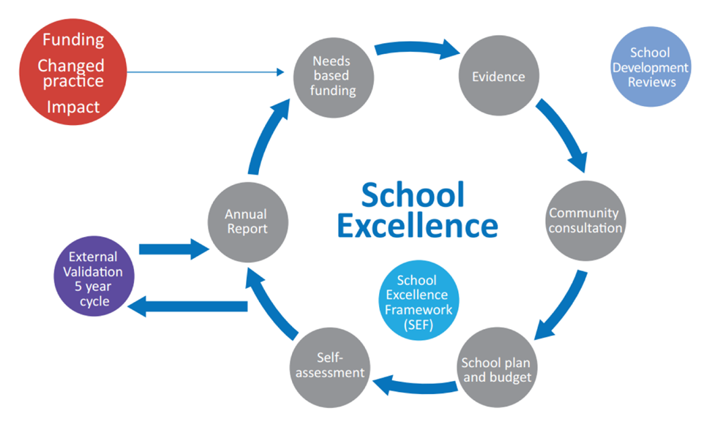
School excellence implementation guidelines - school planning
Notes:
The School Excellence policy requires schools to develop a three-year school plan in consultation with their community
Schools develop a comprehensive three-year school plan connected to a budget and student outcomes, in consultation with the school community and an annual report. The school plan should clearly reflect a school’s priorities for improvement in line with the School Excellence Framework. Each school plan should include a commitment to improvements in literacy and numeracy, as the pivotal learning for all students.

Slide 9
School plan
Notes:
In this session, we will discuss our school plan, what priorities have been identified for the school in the plan and what the SAS staff role is in the school planning process and in implementing the school plan.
Q: Where would you find a copy of a school’s plan?
A: All schools have a school plan published on their school website in the About our School > School planning and reporting
section

Slide 10
Consultation, preparation and developing the school plan
The principal leads development of the school plan in collaboration with:
students
teaching staff
non-teaching staff
parents/carers and the wider school community
Notes:
The principal collaboratively leads the development of our school plan with all members of the school community which includes:
students
teaching staff
non-teaching staff
parents/carers and the wider community
Where appropriate, this consultation also includes local Aboriginal elders and the Aboriginal Education Consultative Group Inc. (AECG) or local land council representatives.
https://education.nsw.gov.au/teaching-and-learning/school-excellence-and-accountability/school-planning/school-planning-frequently-asked-questions

Slide 11
Why is consultation important?
Strong partnerships between a school, its staff, parents/carers and community make a positive contribution to student learning
Broad community involvement in developing the school plan will lead to increased engagement by the school community
Consultation, preparation and developing the school plan
Notes:
Why consult?
Through consultation with the school community, the plan and its impact are strengthened.
Strong partnerships between a school, its staff, parents/carers and community make a positive contribution to student learning.
Broad community involvement in developing the school plan will lead to increased engagement by the school community.
Below is the link to the web page ‘Consultation, preparation and developing the school plan’
https://education.nsw.gov.au/teaching-and-learning/school-excellence-and-accountability/school-planning/school-planning-frequently-asked-questions
https://education.nsw.gov.au/teaching-and-learning/school-excellence-and-accountability/school-planning/school-planning-frequently-asked-questions/consultation--preparation-and-developing-the-school-plan

Slide 12
Role of the school administrative manager in the school planning process
Notes:
The SAM has a role to play in the school planning process.
The SAM contributes to the school planning process with advice on long term financial planning and explicit information on administrative practices to promote the school’s functions and ongoing improvement.
SAMs participate in discussions about milestones and budgets and impact on administrative practices in their school. The SAM plays a key role in helping the SAS staff team translate the school plan into a series of coordinated actions.
The SAM will work collaboratively to inform, plan, and support the implementation of the plan and its actions in the school.

Slide 13
Should SAS staff be involved in the Development of the school plan?
Consultation occurs with the school community including students, teaching and non-teaching staff, parents/carers, and community partners
All staff should be involved in the initial consultation stage
School planning, implementation guidelines (PDF 527 KB)
Notes:
Should all SAS staff be involved?
All staff should be involved in the initial consultation stage.
Consultation occurs with the school community including students, teaching and non-teaching staff, parents/carers and community partners.
https://policies.education.nsw.gov.au/policy-library/associated-documents/School-excellence-implementation-guidelines-school-planning.pdf

Slide 14
How should SAS staff be involved in the school plan and its implementation?
All staff should understand the school vision,
this is our common purpose and assists us to understand how we can contribute
Notes:
All staff should understand the school vision, it is our common purpose.
Activity (5 minutes)
Look at your school plan. Find the ‘School Vision Statement’.

Slide 15
What is a school vision statement?
A school vision statement is short and precise, describing a school’s high level goals for the future, its shared values and philosophy. It is a statement about student learning and achievement that is based on the department’s priorities.
Notes:
A school vision statement is short and precise, describing a school’s
high level goals for the future
its shared values and
philosophy.
It is a statement about student learning and achievement that is based on the department’s priorities.
Activity (5 minutes)
Look at your school plan. Read and discuss with the person next to you, the school vision statement and what it means to you.
Q: What are the key messages in the vision statement?
Q: What does this mean for you and your work? (How can you support the school vision?)

Slide 16
What are strategic directions?
Strategic directions are high level statements, based on self-assessment and consultation, which encapsulate the school plan and drive improvement for the next three years and into the future to bring about transformational change.
Notes:
School strategic directions are underpinned by the three domains of
learning
teaching and
leading
of the School Excellence Framework and provide a strong indication of the priorities that engage
school community members in a common goal.
Strategic directions are evidence-informed.
They should be short, meaningful statements articulating the transformation to be achieved so that the whole school community can share in the school’s purpose.
Schools are required to develop three strategic directions. However, small schools may develop two strategic directions.
Activity (5 minutes)
Ask participants to read their school plan and discuss with the person next to them, the ‘3 strategic directions’.

Slide 17
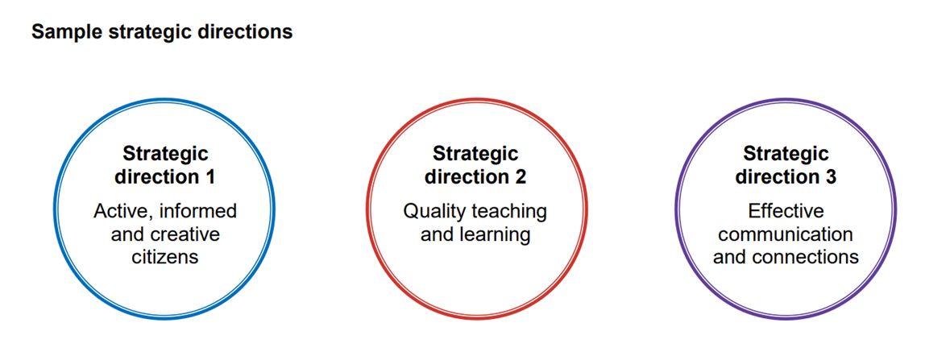
Identify the 3 strategic directions of your school plan
Sample
Notes:
Activity (5 minutes)
Ask participants to identify the 3 strategic directions of their school plan and discuss how non-teaching staff in the school can contribute to delivering one of these strategic directions.

Slide 18
How should SAS staff be involved in the implementation of the school plan?
All staff implement the school’s plan by enacting the school vision in their daily work and working towards the achievement of the strategic directions.
Notes:
The implementation and progress monitoring aspect of the school plan is for internal use to monitor and evaluate the effectiveness of implementation and to inform discussions with Directors, Public Schools NSW.
This is where activities are planned, resources allocated and the effectiveness of activities evaluated.
There are three aspects to this section of school planning:
i. identifying and mile stoning the activities for each process
ii. allocating resources
iii. monitoring and evaluating actions and impact at regular intervals.

Slide 19
So what does this mean for you?
your input into the school planning process is valued and important
when dealing with the school community, you have a role in delivering a consistent message about what we believe (vision) and what we are trying to achieve as a school (strategic directions)
Notes:
As a member of the school staff, everyone has a responsibility to work towards the achievement of the school’s strategic directions.
your input into the school planning process is valued and important
when dealing with the school community, you have a role in delivering a consistent message about what we believe (vision) and what we are trying to achieve as a school (strategic directions)
Every member of our staff, from our teachers in the classroom to the school executive, non teaching staff and students representing the school are responsible.

Slide 20
Activity
choose the strategic decision that is most relevant to your work
identify the practices that support this strategic direction
discuss in your group
Notes:
Activity (10 minutes) - Ask participants to identify the following:
Click to transition next point in slide
1. Choose the strategic direction that is most relevant to your work.
Click to transition next point in slide
2. Identify your practices that support this strategic direction.
Click to transition next point in slide
3. Discuss answers in your group.
Sample answers part 2
communicating a positive school image with teachers, students, parents/carers and the community in how we present ourselves, what we say and do
consistent practices in dealing with parent/carer enquiries e.g. phone calls
providing a welcoming environment at the front office that encourages community engagement
communicating with our community through the newsletter
engaging in professional learning
behaving in a positive, professional manner when interacting with students (ie speaking respectfully).

Slide 21
School culture
Culture is:
the personality of the school
what is valued
how people are expected to behave in your school
It’s the way we do things around here
Notes:
Culture is:
the personality of the school
what is valued
how people are expected to behave in your school
It’s the way we do things around here
The school plan sets the direction for the school. It details what is important and valued in our school. Our school’s culture is communicated from messages about what is valued and important in our school.
How we implement our school plan and what we say and do to build our school culture, are closely linked.
Activity (3 minutes)
Ask participants to discuss in groups what 3 words they would use to describe the culture of their school. Their work place?

Slide 22
What does a positive culture look like?
Notes:
We all want to work in a school with a positive culture.
Q: What does a positive school culture look and feel like?
A:
happy students
happy staff
people working together well
consultation and negotiation
tidy work areas
student work displayed
welcoming office environment
school is clean and tidy
people want to regularly visit the school
inquiries are responded to in a respectful and timely manner.
Q: What does a negative school culture look like?
A:
messy playgrounds
unwelcoming environment
staff speaking disrespectfully to students or each other

Slide 23
How can SAS staff contribute to a positive school culture?
Notes:
We all need to work together to create and maintain a positive school culture.
Activity (3 minutes)
Ask participants to discuss in groups what they think SAS staff can do to contribute to a positive school culture
Sample answers
value and demonstrate the school vision in what you say and do every day
be inclusive, listen and value the opinions of others
work collaboratively and contribute to a happy and supportive working environment
be respectful in all communication – verbal and written, email , phone and signage
take pride in achievements and in your school
support students in your daily activities
contribute to a safe and supportive working environment by modelling safe and supportive behaviours
model respect with colleagues, students and all community members
Activity (3 minutes)
Ask participants to discuss in groups what 3 things they could do to contribute to the implementation of the school plan and promote a positive school culture.
Sample answer: Do a School environment review and ask ‘Is our school office and surrounding areas positive and welcoming?’

Slide 24
Reflecting on this session – School plan and School culture
Has this session given you an understanding of:
how the school plan is developed in consultation with stakeholders
how the school plan prioritises our school goals
how the school plan promotes the school and its vision?
Notes:
Ask participants to reflect on what they have learned in this session
Has this session given you an understanding of:
how the school plan is developed in consultation with stakeholders
how the school plan prioritises our school goals
how the school plan promotes the school and its vision?
Ask participants to reflect individually and then share with the person next to them

Slide 25
ESA relationship modules
Framework focus area | Module | Session
1.1 Oral communication | a. Face-to-face communication | Quality communication Create a positive image Develop a customer service statement
1.1 Oral communication | b. Telephone communication | Telephone communication Telephone communication procedures
1.2 Written communication | a. Communication guidelines | DoE Style Guide Written communication
1.2 Written communication | b. Digital content – email | DoE email policy and procedures Storing school emails Structuring emails
1.2 Written communication | c. Digital content – website | Keeping your website current School website team
1.3 Building relationships | a. Students as customers | Supporting students Student wellbeing
1.3 Building relationships | b. Connecting with customers | Cultural diversity Aboriginal & Torres Strait Islander customers Welcoming customers with disability Customer complaints - role of SAS staff
1.3 Building relationships | c. Customer feedback | Customer feedback
1.4 Teamwork | a. Keeping staff informed | Keeping staff informed
1.5 Promoting the school and its vision | a. School plan and school culture | School plan and school culture
Professional Learning for Non-Teaching Staff (PLNTS) website
Notes:
This module is one of a series of developed resources to support the Excellence in school administration customer relationships framework.
These are all located on the DoE professional learning website, School Administrative and Support webpage which can be accessed via the portal, Inside the department A-Z.
https://education.nsw.gov.au/teaching-and-learning/professional-learning/professional-learning-for-non-teaching-staff

Slide 26
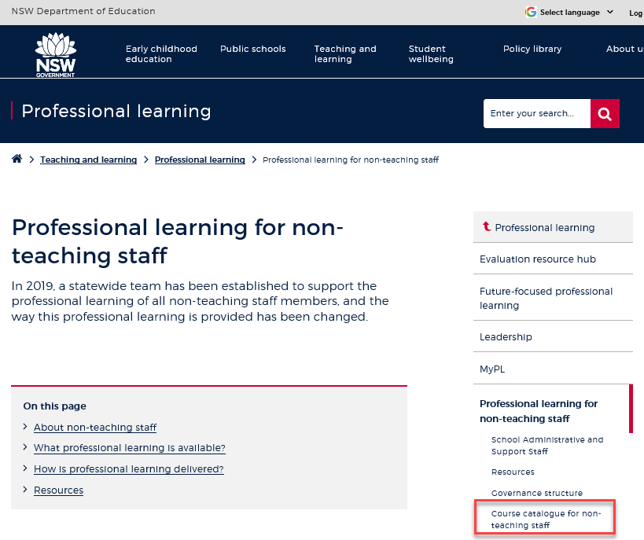
Professional learning information, resources and course catalogue for non-teaching staff
Information about professional learning for non-teaching staff including links to a course catalogue and resources, can be found on the professional learning site of the intranet.
From the Inside the department A-Z tab select:
Professional learning
Professional learning for non-teaching staff
Course catalogue
Notes:
Professional learning information, resources and course catalogue for non-teaching staff.
Professional learning for non-teaching staff
Information about professional learning for non-teaching staff including links to a course catalogue and resources, can be found on the professional learning site of the intranet.
From the Inside the department A-Z tab select:
Professional learning
Professional learning for non-teaching staff
Course catalogue
Our course catalogue has a large range of professional learning events available for non-teaching staff in your area and are a great resource to keep you up to date so you don’t miss out.
https://education.nsw.gov.au/teaching-and-learning/professional-learning/professional-learning-for-non-teaching-staff
https://education.nsw.gov.au/teaching-and-learning/professional-learning/professional-learning-for-non-teaching-staff/course-catalogue-for-non-teaching-staff

Slide 27
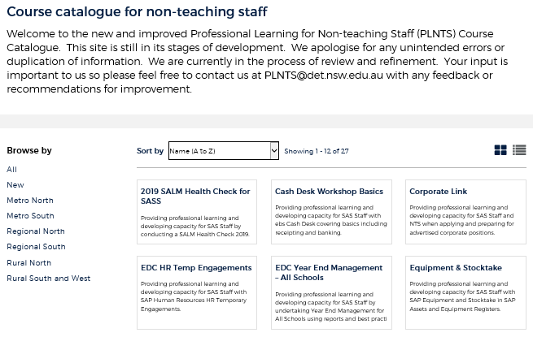
Professional learning for non-teaching staff (PLNTS) catalogue
New and improved layout and features!
Display as a grid or a list
Browse options
Click a course for details, dates, location and MyPL reference
PLNTS catalogue
Notes:
The Professional Learning for Non-Teaching Staff (PLNTS) team’s schedule of professional learning caters for all categories of non-teaching staff in schools across the state.
Please refer to the professional learning catalogue for events that build your skills.
The catalogue is easy to use to find the course you need:
you can display as a grid or as a list
you can also browse by your region or
simply focus on new courses
Once you select a course, you will see
the course details and location
the dates the course is being presented and
the MyPL reference code.
https://education.nsw.gov.au/teaching-and-learning/professional-learning/professional-learning-for-non-teaching-staff/course-catalogue-for-non-teaching-staff

