Slide 1
Excellence in School Administration Framework Administrative Practices
Aspect: Finance Focus: 2.2 Effective financial practices, financial literacy and compliance
Module: 2.2(c) Procurement
Notes:
Note to presenter
Before commencing this module please read the separate Presenter notes which outline all preparation required to successfully present this module.
Welcome to the procurement module supporting the Financial literacy and compliance focus area of the Excellence in School Administration Framework (ESA).
This module is one of a series of modules which have been developed to support the implementation of the Framework and contains notes for the presenter and identifies resources for the participants.

Slide 2
Structure of the module
Purpose
This module is one of a series of modules which have been developed to support the implementation of the Excellence in School Administration Framework
Purpose - This module is one of a series of e-learning modules which have been developed to support the implementation of the Excellence in School Administration (ESA) Framework.
Audience - Key audience is the front office administration staff, however it is a useful resource for all non-teaching staff in schools.
Delivery - This module can be completed in the following manner:
Presentation style – facilitator follows notes/slides and works through activities in a group setting
Independently – individual follows slides, notes and works through learning tasks and activities
To ensure the delivery meets the needs of your audience the presenter should consider the following:
For internal presentations (to own staff) prior to presenting the session assess your knowledge of each participant’s experience in this topic, adjust notes and resources where necessary
For external presentations at the commencement of the session ask participants to introduce themselves and briefly explain their reasons for attending, adjust notes and resources where necessary
Notes:
Slide for presenter information only

Slide 3
Outcome of the Module – Procurement
At the completion of this module participants should be able to:
understand financial terms
understand compliance obligations related to resources and recording transactions.
Notes:
At the completion of this module you should be able to:
understand financial terms
understand compliance obligations related to resources and recording transactions.

Slide 4
Procurement
Simple procurement guide
confirm funding
check for an existing contract or scheme
identify vendors/suppliers
confirm procurement delegation
raise purchase order
manage goods & services on arrival
Click here to go to the Procurement intranet page
Notes:
In the ESA administrative practices modules School Finance and Financial Terminology, participants are given an overview of the integrated administration systems that supports financial management and administrative activities in schools - SAP & SALM. The modules introduced financial terms and acronyms used in schools in relation to schools finance including procurement.
This module will discuss procurement which relates to the purchasing of goods.
Hand out procurement checklist (1 page refer to pre-reading)
The department’s guidelines vary according to
the amount of money to be spent. It is important to follow the relevant processes at all times to ensure you are compliant and gain best value when spending public money.
This simple procurement guide will help you follow the rules for all procurement purchase decisions up to $150,000 and will protect both you and your school. It intends to show you how straightforward the process can be so that you’ll have the tools to undertake policy compliant procurement on behalf of the department.
The six procurement stages are:
Confirm funding: check first that there is an allocated budget
Check for an existing contract or scheme on the Procurement website to find a list of commonly used department contracts. The website offers a range of best value solutions to meet the school needs QUESTION: If there is no contract supplier, can a non-contracted supplier be used? ANSWER: Yes, refer to DoE Schools finance website, policy handbooks and training purchasing checklist
https://education.nsw.gov.au/schools-finance/policies-handbooks
3. Identify suppliers: are the suppliers DoE contract suppliers? Non-contracted suppliers? – refer to the eLearning module mentioned in the next slide Unsolicited proposals? i.e. direct selling from suppliers - exercise extreme caution to ensure you don’t create issues in regard to price and conflicts of interest
4. Obtain procurement delegation: how much can the person requiring the goods sign for? Is their delegation appropriate? Delegation levels are found in the Finance in School Handbook (FISH) in the finance framework. https://education.nsw.gov.au/schools-finance/policies-handbooks QUESTION: Do you know what your finance delegation is as a School Administrative Manager (SAM)? ANSWER: $5,000 QUESTION: Does a SAO/GA/SLSO have a delegation level? ANSWER: Not under procurement, only $1000 under purchasing card (PCard) with principal’s prior approval. PCards are Visa credit cards that can be issued to approved departmental staff to undertake a broad range of business related purchasing/payments directly with suppliers at the point of sale, online or over the phone.
5. Process the purchase following school procedures. Check with the SAM/principal to see what school procedures should be followed for obtaining approval and processing this purchase order.
6. On receipt of purchased goods and services follow department guidelines and policies on confirming goods in SAP to facilitate payment, and deliver goods to appropriate staff.

Slide 5
e-learning module
An easy-to-follow
e-learning module providing a guide for small amount purchases up to the value of $150,000.
Click here to go to the Low to medium spend buying program intranet page
Notes:
The Low to medium spend buying e-learning module on the DoE Procurement website guides the participant through the procedures for small amount purchases and buying up to the value of $150,000.
The online program outlines the steps and policies that should be followed to protect both you and your workplace when purchasing goods and services up to the value of $150,000 (GST inclusive).
Completing this e-learning module through the DoE corporate professional learning website results in a more efficient procurement process across the department as it provides the rules of purchasing goods and services.
https://education.nsw.gov.au/procurement
https://education.nsw.gov.au/procurement/how-we-can-help/building-procurement-capabilities/online-low-to-medium-spend-buying-program
https://corporate.learn.det.nsw.edu.au/login/index.php

Slide 6
assets
School ASSETS
Are defined as
fixed
assets
$10,000 or more
(ex GST)
intangibles over $50,000 (ex GST)
Click here for Fixed Assets & Equipment online training – in the Asset Management drop down section
Notes:
he term assets in DoE schools includes the following:
fixed assets such as buildings
any items costing $10,000 GST exclusive or more
and intangibles such as computer software with a value over $50,000 GST exclusive.
Assets are items that are financially reported by the department and intended for long term use.
Some examples of assets are covered outdoor learning areas (COLA), a school bus or a communication network installed in the school valued at over $50,000.
QUESTION: Can anyone provide more examples of items that schools purchase that would fit in the category of assets?
ANSWER: Ride-on lawnmower, safe, computer lab software/hardware, kiln, purchase of ovens for an industrial kitchen
With schools input and approvals, assets must be recorded in an asset register which is updated and monitored through EDConnect Asset Accounting team in SAP who report the figures in the financial statement for the department.
Provision should be made through the budget for the replacement of assets normally against a 3 year cycle, taking into account the age, condition and state of the asset.
Before completing any task(s) in relation to assets and equipment it is recommended that staff complete online training located on the EDConnect intranet as discussed in slide 9 of this module.
https://education.nsw.gov.au/inside-the-department/edconnect/facilities-assets-and-equipment

Slide 7
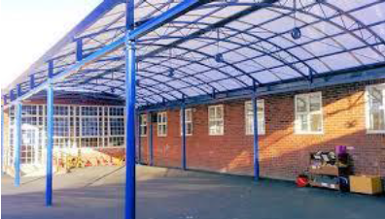
Asset management
Asset management is managing projects in schools such as:
building a COLA
purchasing land
setting up a computer lab
Hiring out facilities
Click here to go to the Asset Management intranet page in EDConnect
Notes:
All requests for the assets mentioned in the previous slide must be approved through normal budget approval processes.
Assets that require asset management are projects in a school, funded by the school, P&C or other external sources for example purchases of land, licence agreement, canteen or hire of facilities agreements, once appropriate approval has been received from the Asset Management Unit (AMU) .
Each school has a local asset management unit that will support them or help manage the project dependent on the size.
Asset management has an Asset Management System (AMS). It is a computer system that supports the management of school property assets.
The AMS is a database of asset related information linked to maps and plans of all DoE schools. It supports the processes of planning, acquisition, development, maintenance, utilisation and disposal of property assets.
Contact details for your local asset management unit can be found on the DoE Asset management website which provides schools with resources and information on assets and managing large assets within schools.
Note: The principal is responsible for the management of assets in schools.
https://education.nsw.gov.au/inside-the-department/edconnect/facilities-assets-and-equipment

Slide 8
equipment
School equipment
is defined as
at risk
attractive
portable
subject to stocktake
less than $10,000
(ex GST)
Click here for Fixed Assets & Equipment online training – in the Asset Management drop down section
Notes:
Equipment is a product or service that is valued at below $10,000 (ex GST) but deemed as an at risk item or are attractive/portable items. Equipment is subject to an annual stocktake.
QUESTION: Can you provide any examples of items that schools purchase that would fit in the category of equipment?
ANSWER: laptops, iPads, musical instruments, TVs, tools, cameras.
Details of all assets referred to in slide 6, and equipment items, whether purchased from school funds or received as a donation, must be recorded upon confirmation of receipt by the school.
Schools must check that all equipment has been recorded before distributing for use in the school.
It is the sole responsibility of the school to regularly maintain and update their equipment to ensure maximum benefit to the school.
Provision should be made through the budget for the replacement of equipment and teaching resources, taking into account the age, condition and state of currently used equipment.
Schools must also establish and maintain a loans register for equipment distributed to faculties or borrowed by staff.

Slide 9
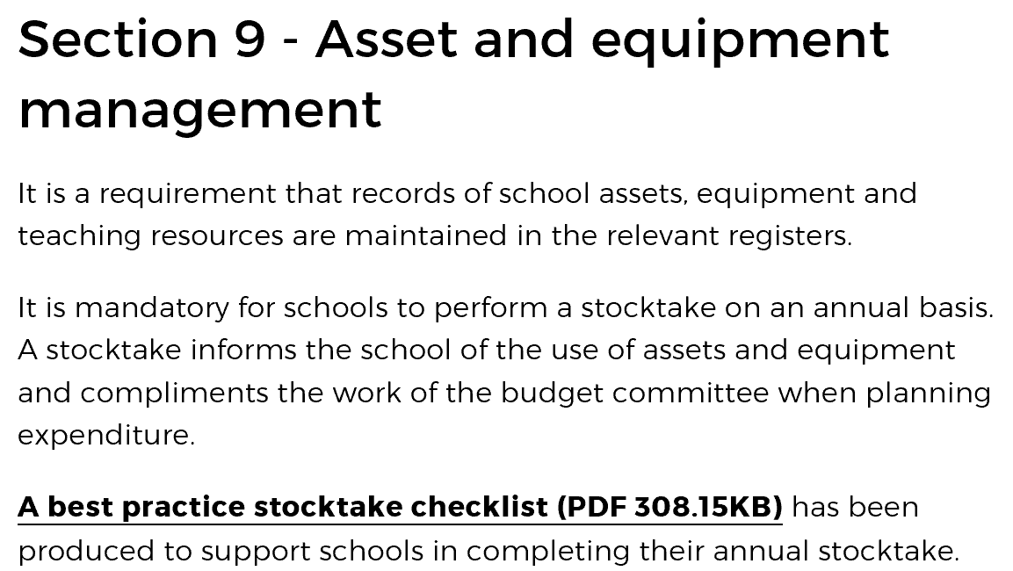
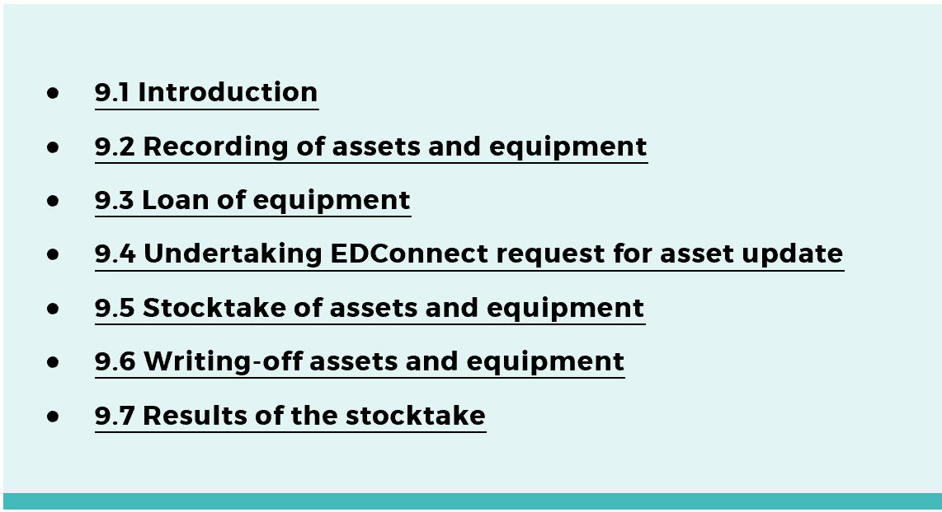
Recording of assets and equipment - SAP
Click here to go to the Finance in Schools Handbook (FISH) – Section 9.
Click here to go to the Facilities, assets and equipment intranet page in EDConnect
Notes:
Details of all accountable assets and equipment items, whether purchased from school funds or received as a donation, must be recorded when received at the school in SAP.
It is a department requirement that records of school assets, equipment and teaching resources are maintained in the relevant registers at school.
It is mandatory for schools to perform a stocktake on an annual basis. A stocktake informs the school of the use of assets and equipment and compliments the work of the budget committee when planning expenditure.
Whether an asset or equipment item is either purchased or donated, the Asset & Equipment Master Maintenance form found in SAP must be completed by the school.
It is recommended that staff complete the online Fixed Assets and Equipment training course and other additional support materials located on the EDConnect intranet page as this provides an understanding of assets and equipment in SAP.
https://education.nsw.gov.au/inside-the-department/edconnect/facilities-assets-and-equipment
The Finance in schools handbook (FISH) chapter 9 refers to the management of assets and equipment in schools.
https://education.nsw.gov.au/schools-finance/policies-handbooks/finance-in-schools-handbook#Section8

Slide 10
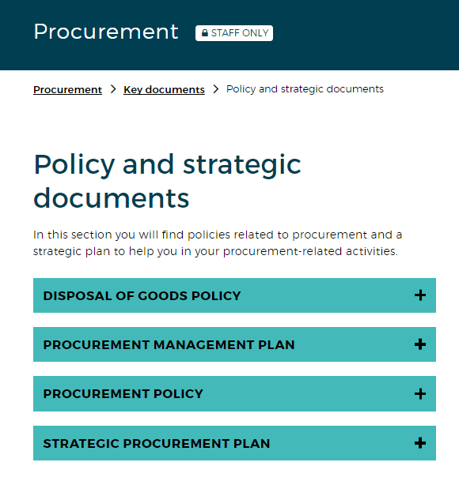
Disposing of assets and equipment
Click here to view the Procurement Policy and Strategic Documents
Notes:
Schools will from time to time be faced with the need to dispose of accountable assets and equipment that are surplus to requirements, beyond economical repair, or need to be updated to keep pace with technological change.
Disposing of assets and equipment is considered a procurement activity and the PWP 002 (procurement delegations) outlines the method for disposing of assets and equipment in accordance with procedures described in the Procurement policy.
Any items that contain memory or data, such as computer equipment or imaging devices must be securely wiped before transferring or relinquishing ownership, or being sent to be dumped or recycled.
The Procurement website is the source of information relating to the policy on the disposal of goods in schools.
https://education.nsw.gov.au/procurement/key-document/policy-and-strategic-documents
Schools can contact the Contract Managers in the Information Technology and Procurement Solutions directorates for assistance by logging a call online or by phone to the ICT service desk at EDConnect.
EDConnect has replaced the individual contact and helplines for IT, SAP finance, Student management and wellbeing, Human Resources and Business services and procurement.
Further information on disposal procedures for assets and equipment can be found in the FISH section 9.6.
https://education.nsw.gov.au/schools-finance/policies-handbooks/finance-in-schools-handbook#Section8

Slide 11
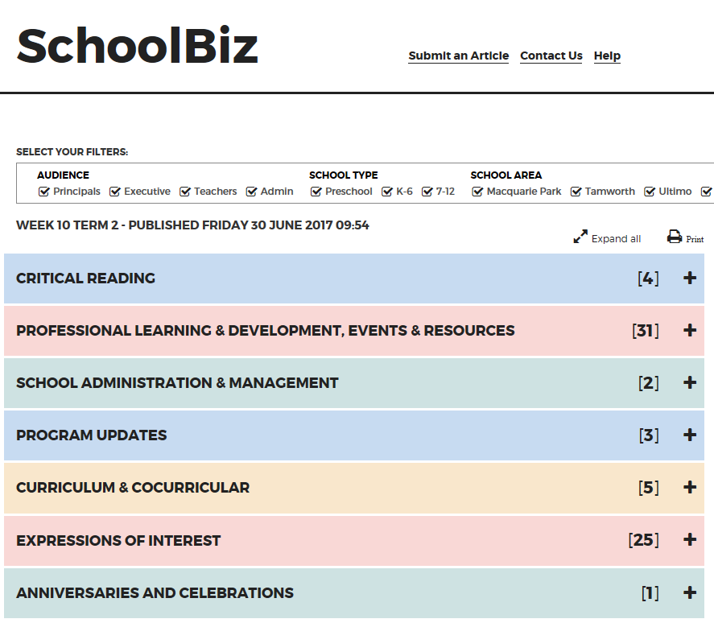
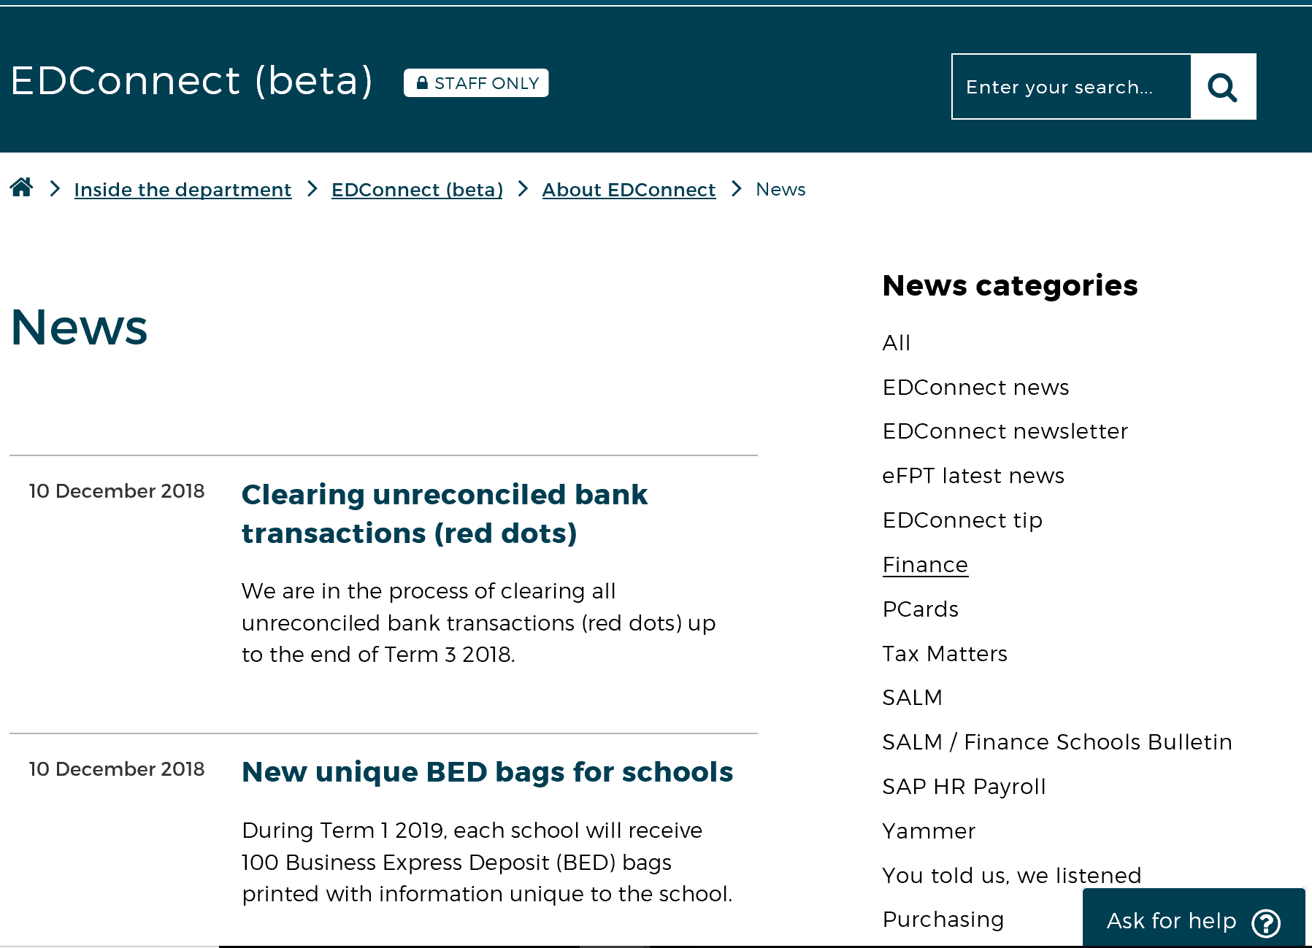
Regular updates – policy and guidelines
Click here for SchoolBiz
Click here for Schools Finance News
Click here for EDConnect Newsletters and Bulletins
Notes:
Department policy and guidelines in relation to finance and procurement are regularly updated.
It is important as a DoE staff member that you are aware and comply with the policy and guidelines. You must remain aware of any changes that could impact on your role.
Please refer to online resources at all times for the most up to date information.
SchoolBiz is the online weekly newsletter delivered to all department employee staff email every Friday but can also be accessed via the staff portal.
The Schools Finance News on the Schools finance website is published each term in week 1 and provides information and updates in all areas of finance.
The EDConnect Newsletter page provides links to several newsletters, new articles and bulletins.
Select the links on the slide to demonstrate the resources
https://beta.dec.nsw.gov.au/schoolbiz
https://education.nsw.gov.au/schools-finance/newsletter
https://education.nsw.gov.au/inside-the-department/edconnect/about-us/news/edconnect-newsletter/edconnect-newsletters

Slide 12
Websites referred to in this module
Click here for Asset management
Click here for Procurement
Click here for the EDConnect website
Click here for Professional learning login
Click here for Schools finance
Click here for SchoolBiz
Notes:
In this module we have discussed or demonstrated resources from the following department websites:
Asset management
Procurement
EDConnect
Professional learning login
Schools finance
SchoolBiz
These websites can all be located through your staff portal, inside the department A-Z.
https://education.nsw.gov.au/inside-the-department/edconnect/facilities-assets-and-equipment
https://education.nsw.gov.au/procurement
https://corporate.learn.det.nsw.edu.au/login/index.php
https://education.nsw.gov.au/schools-finance
https://beta.dec.nsw.gov.au/schoolbiz

Slide 13
Reflecting on this module – Procurement
Has this module given you an understanding of:
financial terms
compliance obligations related to resources and recording transactions?
Notes:
Ask participants to reflect on what they have learned in this module
Has this module given you an understanding of:
financial terms
compliance obligations related to resources and recording transactions?
Ask participants to reflect individually and then share with the person next to them

Slide 14
Esa administrative practices modules
2.1 Applying DoE policies and processes | 2.2 Financial literacy and compliance | 2.3 Achieving team objectives | 2.4 Supporting change | 2.5 Systems improvement
Policy and Procedures in Administrative Practices | School Finance | Team Objectives | Change in the Workplace | Technology and Systems
Risk management in the Workplace | Financial Terminology
 | Procurement
Click here to go to the Professional Learning for School Administrative and Support Staff intranet page
Notes:
This module is one of a series of developed resources to support the ESA Customer relationships framework.
These are all located on the DoE Professional learning intranet page, School Administrative and Support section which can be accessed via the portal, Inside the department A-Z.

Slide 15
Professional development
SAS staff Reference Group (SRG)
Professional learning calendar
Thank you for your participation
Click here to go to the professional learning calendars for SAS staff.
Notes:
The SAS staff Reference Groups (SRGs) schedule professional learning that caters for all categories of non-teaching staff in schools across the state. Please refer to the professional learning calendar for events that may assist to build your skills.
The calendar and SRG committee contact details are available for all SAS staff and can be found on the School Administrative and Support Staff section on the DoE Professional Learning intranet page which can be accessed via the portal, Inside the department A-Z.
Thank you for participating in this session.

