Slide 1
Excellence in School Administration framework – Administrative Practices
Aspect: Plan, Prioritise and Deliver Results
Focus: 2.3 Achieving Team Objectives
Module: (a) Team objectives
Session in this module
Team objectives
Notes:
Note to presenter
Before commencing this module please read the separate Presenter Notes which outline all preparation required to successfully present this module.
Welcome to the Team Objectives module supporting the Achieving Team Objectives focus area of the Excellence in School Administration (ESA) Framework.
This module is one of a series of modules which have been developed to support the implementation of the Framework and contains notes for the presenter and identifies resources for the participants.

Slide 2
Structure of the module
This module contains 1 session and has a total delivery time of 40 minutes. Resources for this module include:
PowerPoint presentation session
Session 1 – Team Objectives – 40 minutes
presenter notes with pre-reading and guidelines to successfully deliver sessions
handouts and activities.
Purpose
This module is one of a series of modules which have been developed to support the implementation of the Excellence in School Administration Framework
Notes:
Presenter to give an overview as per slide

Slide 3
Delivery
This module can be completed in the following manner:
presentation style – facilitator follows notes/slides and works through activities in a group setting
independently – individual follows slides, notes and works through learning tasks and activities.
To ensure the delivery meets the needs of your audience presenter should consider the following:
for internal presentations (to own staff) prior to presenting the session assess your knowledge of each participant’s experience in this topic, adjust notes and resources where necessary
for external presentations at the commencement of the session ask participants to introduce themselves and briefly explain their reasons for attending, adjust notes and resources where necessary.
Audience
Key audience is the front office administration staff, however it is a useful resource for all non-teaching staff in schools.
Notes:
Presenter to give an overview as per slide

Slide 4
Outcome of this module – team objectives
At the completion of this module, participants should be able to:
understand and contribute to team objectives
prioritise allocated tasks
respond flexibly to changing circumstances.
Notes:
At the completion of this module you should be able to:
understand and contribute to team objectives
prioritise allocated tasks
respond flexibly to changing circumstances.

Slide 5
What is a team?
A team is a group of people who come together to achieve a common goal
Notes:
A team is a group of people working together with skills and strengths that complement and balance one another to:
complete a task
solve a problem
or explore changes in the current school practices to improve operations.
Working as a team can provide key opportunities for individuals as well as the school to improve procedures and performance.

Slide 6
What teams could be in schools?
finance
welfare
Health & Safety
administration
executive
Remember - a team can be as small as two people
Notes:
There are many different teams within a school.
School administrative and support (SAS) staff could belong to any of the teams shown here.
School learning support officers (SLSOs) could belong to the learning and support team or welfare team
School administrative officers (SAOs) could belong to the technology team because they have an interest in technology and learning
School administrative managers (SAMs) and SAOs belong to the administration team
SAMs could be involved in the executive team and the finance team
QUESTION: What other teams do you belong to or are there in schools?
ANSWER: Health & Safety (H&S) committee, SAS team, technology

Slide 7
Teams need
clear objectives
defined roles
open and clear communication
Notes:
To be an effective team, members need to have a common purpose and direction. Good teamwork doesn’t just happen. Effort is needed to help groups of individuals work together as a team.
For instance
who should lead the group?
will everyone be motivated to meet the team's objectives?
and how can people balance the needs of the team with responsibilities in their day-to-day role?
The following points provide strategies to assist teams in building a common purpose:
Teams should have clear goals and objectives set and communicated to all team members to make sure that everyone understands and can identify with them. The principal and/or team leader must establish ground rules and that will work to bring the team together. For example what the goal of the team is, when the team should meet, how long meetings should go for and how long the team needs to operate.
Having defined roles ensures that team members understand their role within the team and how their contribution will help the team meet the objectives. Team members can also take on different roles within the team as their skills and knowledge levels increase.
Open and clear communication is vital to a team’s effectiveness. Communication should be clear, concise, respectful and transparent.
Strong team communication helps to build relationships and ensure the sharing of new ideas. Ways to achieve this are:
face-to-face meetings with agendas and minutes distributed to each member
group emails using ‘reply all’
conference calls
VC and Adobe connect sessions when all team members aren’t or cannot be in the same place for the meeting and sharing documents using technology.

Slide 8
Teams require
effective decision making
effective leadership
collaboration
coordination
cooperation
Notes:
Effective leaders will
build trust within the team and between team members
inspire and motivate team members to be active participants
encourage and support independent thinking
seek feedback from the team
recognise skills of team members and utilise these strengths to achieve team objectives
Anyone in the team can take on the role of leader and use it as an opportunity to learn the knowledge, expertise and necessary skills in leading effective teams.
Often groups of people can make better decisions than one person on their own. An effective team will
promote collaborative decision-making through the opportunity for feedback, resulting in a sense of ownership by the whole team
have ownership of the final product by providing input and feedback.
Cooperation, collaboration & coordination are three key aspects of teamwork but are very different.
cooperation is required from all team members as individuals in sharing their skills, knowledge and relevant information to support the team goals
Cooperation involves the understanding that there may be more than one viewpoint or way to do something
collaboration is when individuals work together to review, create or resolve problems through shared knowledge
coordination is when individuals share information and resources in a timely way so that others can achieve their part in the team’s goals
one member of the team may play a key role in drawing information together in a way which enables decision-making or action.

Slide 9
Effective meetings
Effective meetings increase motivation and strengthen teamwork
stay simple
encourage feedback
stay on track
action items
Notes:
Effective meetings increase motivation and strengthen teamwork.
For information on conducting effective meetings refer to the ESA Framework Customer Relationships module 1.4a Keeping Staff Informed.
Things to consider when deciding on team meetings are:
stay simple – sometimes small teams just need to touch base on where they are at. A Monday morning 15 minute meeting with team members to give a quick update on progress, tasks or just sharing information is just as effective as a structured meeting with an agenda and minutes. Meetings should be scheduled at a time that suits the team. Remember to use technology to ensure these catch-up meetings are effective and accessible for everyone in the team
stay on track – have an agenda sent out prior to the meeting and identify who will present each item and for how long. Everyone should have the opportunity to add to the agenda as well. It helps stay on track
be involved and engaged in the meeting and bring something to the discussion. Take a turn as the chairperson, team leader or organiser for a meeting
ask for feedback and act on it
don’t finish any discussion in the meeting without deciding who is doing what task and how to act on it. Tie all discussions back to the team goals and keep the end result in view.

Slide 10
Prioritising allocated tasks
identify the difference between urgent and important
prioritise in order of importance
be flexible and adaptable
list all tasks
Notes:
Are you able to complete a task without any interruptions at school during your work day?
The nature of administrative work in schools includes stopping to answer the phone, attend to the front counter or answer a question from a teacher/parent/student or colleague, which can sometimes interrupt and impact on the achievement of urgent or daily tasks that need to be completed.
All school administrative and other non-teaching staff are part of the team that keeps the school functioning. It is essential that tasks allocated to these staff members are completed within a reasonable time frame in order for the school to function effectively as a team.
Prioritising daily tasks is essential to ensure adequate time is allocated for task completion.
Some strategies for prioritising your day could include:
making a list of all tasks that you have. Don’t keep it in your head or on a post-it note. Write it down and keep it with you throughout the day. It will help you to focus on what you want to achieve
grouping together everything that should be done in the day and reviewing it regularly. Allocate a specific time to complete the task if you can. Don’t avoid the hard tasks!
identifying urgent tasks which are essential to the functioning of the organisation and could have consequences if not completed on time
identifying important tasks. If you have tasks that are equally important but could possibly wait - group them together
setting realistic deadlines for these tasks and being honest in what you can achieve. Be prepared to be flexible with all the important tasks and adaptable on completion time
allow time for interruptions as mentioned before and then pick up where you were on your list. Try to avoid feeling overwhelmed by interruptions. It can be motivating to check off shorter tasks before tackling the bigger ones.
Check your list with your supervisor for some advice on tasks that could be scheduled for another time or delegated to another staff member.

Slide 11
Activity
Use the ‘TO DO LIST’
and prioritise a typical
work day.
Activity
Notes:
Hand out the blank ‘TO DO LIST’ (refer to pre-reading)
This is a simple ‘to do list’ that can be used to prioritise your day.
the priority is a rating between 1 the lowest priority to 5 the highest priority
due date is when the task is needed to be completed by – sometimes this affects the priority rating higher or lower
what is identifying the task that needs to be completed – is it dependent on another task being completed – is the other task rated higher in priority than this one?
who do you need to report to about this task – this can sometimes be helpful when you need to report that you might not make the deadline or need more information or clarification on the task
in progress means where you are up to with that task or if someone else needs to do part of the task
done - can be a tick or cross indicating at the end of the day/week that this task was completed or not completed.
Having a ‘to do list’ also gives you a tracking tool if you need to report on where you are at with your tasks.
Activity
(5 minutes)
Ask participants to prioritise a typical work day for themselves.
QUESTION: Would anyone like to share their ‘to do list’ with the group?
(3 minutes)
QUESTION: Are there other strategies which you use and can share, about how you prioritise or how your team can work collaboratively?
(2 minutes)

Slide 12
Responding flexibly
start of day – check ‘to do list’
Complete priority 1 rollover tasks to tomorrow
priority 1 started
back to priority 1
interruption
interruption
back to priority 1
Notes:
Despite the preparation of a priority and ‘to do list’, circumstances often change rapidly in a school which can mean even with your preparation you might not get to complete the tasks in the time you wanted to.
It is the nature of a school that everyone’s daily routine is interrupted.
For example a sick child comes to the office, the principal requests an urgent report on student data that the Director has requested or a teacher requires urgent editing and copying of a permission note that needs to go out on the same day to 200 students.
If you have a top priority that you know must be completed in a certain timeframe but there is a constant stream of interruptions stopping you from doing this – ask for help.
It is important to be able to respond flexibly to these situations as they arise but keep in the back of your mind the priorities in your ‘to do list’ and what you can realistically achieve when you can get back to it.
Ask a colleague if they can edit the permission note for the teacher while you complete the priority but you will do the photocopying of the note.
Ask your school administrative manager for help with the priority task as you have spent 1 hour tending to a sick child.
See your supervisor and let them know that with all the interruptions you are struggling to complete the task within the timeframe required.
Don’t give up on your ‘to do list’, rollover any tasks not completed to the next day and start again.
QUESTION: What circumstances do you think are important enough that you should interrupt your ‘to do list’ tasks for?
ANSWER:
maintenance issue that if not addressed would present a health hazard for example plumbing
emergency evacuations, lockdown, lockout
urgent repair to classroom equipment ie broken window
general student or teacher interruptions
staff off sick

Slide 13
Reflecting on this session – team objectives
Has this session given you an understanding of how to:
how to understand and contribute to team objectives
how to prioritise allocated tasks
how to respond flexibly to changing circumstances?
Notes:
Ask participants to reflect on what they have learned in this module
Has this module given you an understanding of:
how to understand and contribute to team objectives
how to prioritise allocated tasks
how to respond flexibly to changing circumstances?
Ask participants to reflect individually and then share with the person next to them

Slide 14
ESA administrative practices modules
Framework focus area | Module
2.1 Applying DoE policies and processes | Policy and Procedures in Administrative Practices Risk management in the Workplace
2.2 Financial literacy and compliance | School Finance Financial Terminology Procurement
2.3 Achieving team objectives | Team Objectives
2.4 Supporting change | Change in the Workplace
2.5 Systems improvement | Technology and Systems
Professional Learning for Non-Teaching Staff (PLNTS) website
Notes:
This module is one of a series of developed resources to support the excellence in school administration framework for administrative practices.
These are all located on the DoE professional learning website, School Administrative and Support webpage which can be accessed via the portal, through Inside the department A-Z.
https://education.nsw.gov.au/teaching-and-learning/professional-learning/professional-learning-for-non-teaching-staff

Slide 15
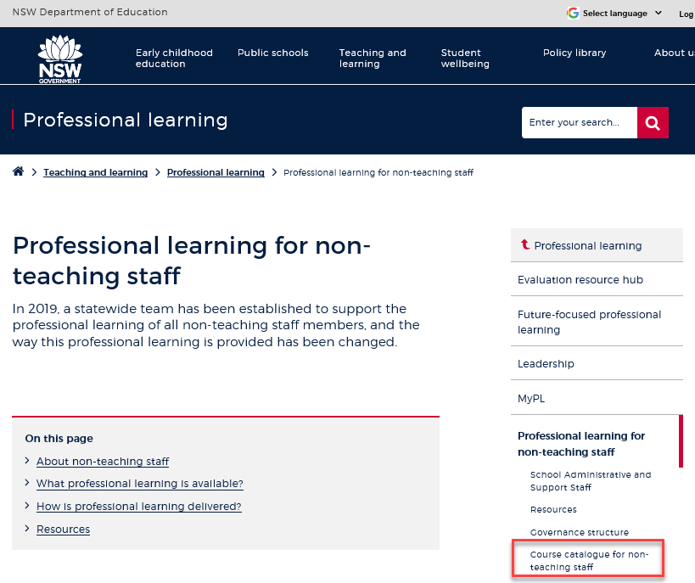
Professional learning information, resources and course catalogue for non-teaching staff
Information about professional learning for non-teaching staff including links to a course catalogue and resources, can be found on the professional learning site of the intranet.
From the Inside the department A-Z tab select:
Professional learning
Professional learning for non-teaching staff
Course catalogue
Notes:
Professional learning information, resources and course catalogue for non-teaching staff.
Professional learning for non-teaching staff
Information about professional learning for non-teaching staff including links to a course catalogue and resources, can be found on the professional learning site of the intranet.
From the Inside the department A-Z tab select:
Professional learning
Professional learning for non-teaching staff
Course catalogue
Our course catalogue has a large range of professional learning events available for non-teaching staff in your area and are a great resource to keep you up to date so you don’t miss out.
https://education.nsw.gov.au/teaching-and-learning/professional-learning/professional-learning-for-non-teaching-staff
https://education.nsw.gov.au/teaching-and-learning/professional-learning/professional-learning-for-non-teaching-staff/course-catalogue-for-non-teaching-staff

Slide 16
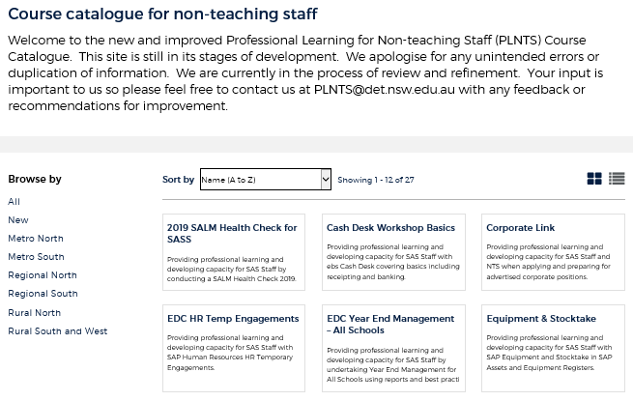
Professional learning for non-teaching staff (PLNTS) catalogue
New and improved layout and features!
Display as a grid or a list
Browse options
Click a course for details, dates, location and MyPL reference
PLNTS catalogue
Notes:
The Professional Learning for Non-Teaching Staff (PLNTS) team’s schedule of professional learning caters for all categories of non-teaching staff in schools across the state.
Please refer to the professional learning catalogue for events that build your skills.
The catalogue is easy to use to find the course you need:
you can display as a grid or as a list
you can also browse by your region or
simply focus on new courses
Once you select a course, you will see
the course details and location
the dates the course is being presented and
the MyPL reference code.
https://education.nsw.gov.au/teaching-and-learning/professional-learning/professional-learning-for-non-teaching-staff/course-catalogue-for-non-teaching-staff

