Slide 1
Excellence in School Administration framework – Relationships
Aspect: Commit to customer service
Focus: 1.3 Building relationships
Module: (c) Customer feedback
Sessions in this module
Customer feedback
Notes:
Note to presenter
Before commencing this module please read the separate Presenter Notes which outline all preparation required to successfully present each session
Welcome to the Customer Feedback module supporting the Building Relationships focus area of the Excellence in School Administration Framework.
This module is one of a series of modules which have been developed to support the implementation of the Framework and contains notes for the presenter and identifies resources for the participants.

Slide 2
Structure of the module
This module contains 1 session and has a total delivery time of 45 minutes. Resources for this module include:
PowerPoint presentation session
presenter notes with pre-reading and guidelines to successfully deliver sessions
handouts and activities.
Purpose
This module is one of a series of modules which have been developed to support the implementation of the Excellence in School Administration Framework
Notes:
Presenter to give an overview as per slide

Slide 3
Delivery
This module can be completed in the following manner:
presentation style – facilitator follows notes/slides and works through activities in a group setting
independently – individual follows slides, notes and works through learning tasks and activities.
To ensure the delivery meets the needs of your audience presenter should consider the following:
for internal presentations (to own staff) prior to presenting the session assess your knowledge of each participant’s experience in this topic, adjust notes and resources where necessary
for external presentations at the commencement of the session ask participants to introduce themselves and briefly explain their reasons for attending, adjust notes and resources where necessary.
Audience
Key audience is the front office administration staff, however it is a useful resource for all non-teaching staff in schools.
Notes:
Presenter to give an overview as per slide

Slide 4
Outcome of the module – customer feedback
At the completion of this module, participants should be able to:
describe strategies which build positive relationships with customers and apply these to develop relationships that are authentic and supportive.
Notes:
At the completion of this module, you should be able to:
describe strategies which build positive relationships with customers and apply these to develop relationships that are authentic and supportive.

Slide 5
Outcome of this session – customer feedback
At the completion of this session, participants should be able to:
understand the value of customer feedback
use feedback to improve and build customer relationships in the school
use feedback to build staff performance and skills.
Notes:
At the completion of this session, you should be able to:
understand the value of customer feedback
use feedback to improve and build customer relationships in the school
use feedback to build staff performance and skills.

Slide 6
Why is customer feedback so important?
Customer feedback provides a way to acquire ideas on how to improve customer service
Notes:
Customer feedback provides a way to acquire ideas on how to improve customer service. It should be easy for customers to give their suggestions or ideas for improvement as it builds staff understanding of customers’ expectations of service.
All school staff should act on feedback and pass on positive feedback to the relevant area or staff and always thank customers for providing their feedback.
Improving your customer experiences should be the main purpose for gathering feedback.
Q: Why should schools encourage customer feedback?
A:
customers feel their opinions are valued
when listening to your customers you are being proactive, ensuring that the school is meeting their needs
it provides a valuable insight into what customers think about the service provided by the school
customers can highlight issues that may have otherwise been missed.

Slide 7
How is customer feedback collected?
what methods work in schools?
who do you ask?
Notes:
When requesting feedback, we need to have an understanding of what we are hoping to achieve. How do we know that our service is meeting our customer’s expectations unless we ask?
We often don’t want to ask for feedback as we may assume that it will be negative. Even if the feedback is negative, it may not be of a personal nature, so it’s not always about your personal performance, it could be about processes. Sometimes feedback can streamline a process or change a school policy. We can use this feedback to assist us in our growth and improvements in our customer service. If the feedback is negative, we may not be meeting our customer’s expectations.
Think about your audience and how they could best access the customer feedback questions.
How can we collect customer feedback and what methods do you think would work best in a school setting?
Q: Can you think of any suggestions for collection of customer feedback that would work in your school?
Answers provided on next slide

Slide 8
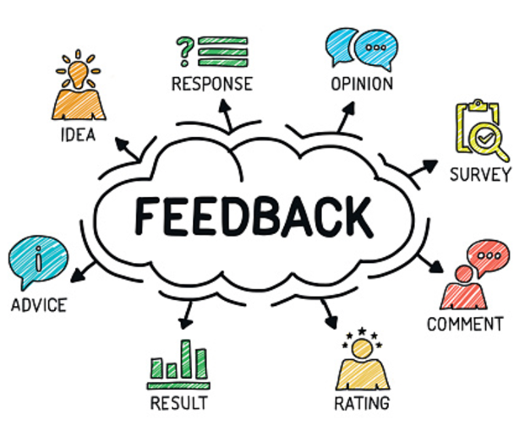
Collecting customer feedback
email
paper surveys
online surveys
customer focus groups
newsletter responses
verbal
apps
Excellence in School Service 360 Reflection Tool
Notes:
A:
Some of the suggestions are:
email
paper surveys
online surveys
customer focus groups
newsletter responses
verbal
apps
Excellence in School Customer Service 360 Reflection Tool
These are some of the options your principal may employ to get customer feedback. We will look at the Excellence in School Customer Service 360 Reflection Tool later in this session.

Slide 9
Collecting customer feedback
increased parent participation in school events = good feedback
excursion notes returned by due date = good feedback on communication
Notes:
Do school procedures provide feedback?
If your school has good communication with its community, ensures all parents/carers of the school are welcome and that their input is valued, this could result in increased parent/carer participation in school events such as graduation ceremonies or P&C representation.
These successful processes are a reflection of good communication processes that are well understood by customers.
Other examples that communication is working could be when you are not chasing up permission notes and payments on the day of an excursion, or that fee payments are reaching your anticipated level.
When processes are not working ask your customers what would work better for them? Do they have any suggestions to streamline the processes? (For example, different ways of making
payments or returning notes).
Q: How could the information or processes about payments and excursions be made easier for customers?
A:
emailing the note to parents
paper copy of the note
one-off note at the start of the year to gain permission for small already planned excursions
customised payment envelopes
permission note on school app
installation of the parent online payment system (POP)

Slide 10
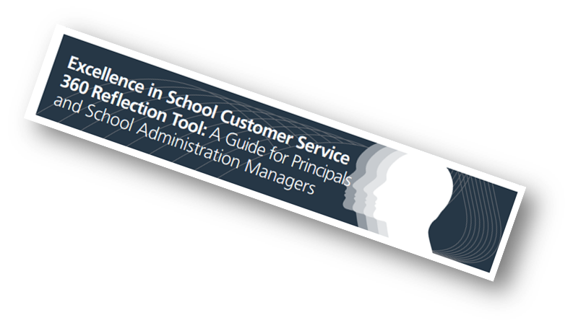
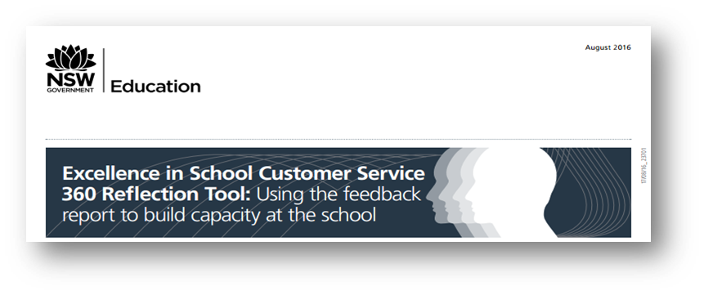
Collecting customer feedback
360 Reflection Tool
360 reflection tool
Notes:
The DoE Communication and Engagement (C&E) directorate has developed the Excellence in School Customer Service 360 Reflection Tool which is a survey tool. The tool is based on the Excellence in School Customer Service Framework which identifies staff capabilities along a continuum and provides principals and school staff with the opportunity to:
reflect on their capacity to deliver exceptional customer service and identify and explore opportunities for improvement
reflect on their capacity to effectively communicate and engage with the school community
monitor change in the behaviour and actions of groups of school staff and learn more about the school’s strengths
gather feedback on the customer service provided by the school and use it to reflect on leadership and the direction of communication and engagement at the school and plan professional learning and development opportunities.
If you don’t have a benchmark for these services and procedures, how do you know that they are working?
Hand out the Customer Service Framework (1 page) refer to pre-reading link
Give participants 3 minutes to read Framework
DoE Schools Communication and Engagement - Excellence in School Customer Service 360 Reflection Tool
https://education.nsw.gov.au/inside-the-department/communication-and-engagement/services-and-support/planning-your-communication/360-reflection-tool
Excellence in School Customer Service Framework
https://education.nsw.gov.au/content/dam/main-education/en/home/inside-the-department/communication-and-engagement/media/documents/Excellence_in_School_Customer_Service_-_Framework_FINAL_Sep_16_cwZwpaIzpz.pdf

Slide 11
Activity
Customer Service and Communication | Sometimes meets community expectations | Meets community expectations | Exceeds community expectations
Communicate effectively | Staff use positive and confident gestures, facial expressions and body language | Customers are invited to provide feedback and are viewed as partners
Commit to customer service |  |  | Relationships between the school and wider community strengthen the ability to support student learning outcomes
Work collaboratively | Staff work as supportive and cooperative team members, share information and acknowledge others' efforts
Consistency and vision in planning | Staff observe all relevant departmental polices
Notes:
Let’s look at some of the benchmarks in the 360 Reflection Tool as a way of understanding how to act on positive and negative feedback.
Select relevant activities for group discussion
Activity
Read out sample benchmark
‘Staff use positive and confident gestures, facial expressions and body language.’
Positive feedback received by the SAM: ‘I always feel welcome when I come to the office by the person at the front counter; she always has a smile for me.’
Q: How would you action that feedback?
A: Share it with the staff and use it as a benchmark for everyone
Negative feedback received by the SAM: ‘The person on the front counter always keeps me waiting when I come to the office and makes me feel like I am interrupting her with my enquiry.’
Q: How would you action that feedback?
A: Privately discuss with staff member concerned and review what is expected in greeting customers at the front counter.
Conduct professional learning for all staff on face-to-face customer service - see module 1.1(a) Face-to-Face Communication
Activity
Read out sample benchmark
‘Customers are invited to provide feedback and are viewed as partners.’
Q: In what ways could customers be invited to provide feedback or viewed as partners?
A:
online surveys
customer focus groups
newsletter responses
verbally
Activity
Read out sample benchmark
‘Relationships between the school and wider community strengthen the ability to support student learning outcomes.’
Q: What types of relationships with the school and wider community does this relate to?
A:
inviting parents/carers to be part of the celebrations at school events
inviting parents/carers to be volunteer readers at the school.
Activity
Read out sample benchmark
‘Staff work as supportive and cooperative team members, share information and acknowledge others efforts.’
Q: In what ways can staff work as supportive and cooperative team members?
A:
sharing information on processes in the front office
covering the front desk and phone during breaks
working together to get tasks done such as a big mail-out or printing and collating reports
Q: In what ways can staff be acknowledged for their work?
A:
positive feedback from customers to the principal/SAM
staff reward program that encourages staff to nominate someone who they would like to see acknowledged for good work
a simple thank you to the staff member when they have done a good job, gone beyond
Activity
Read out sample benchmark
‘Staff observe all relevant departmental polices.’
Q:
what policies should all SAS staff be aware of
why is this important
how does this relate to good customer service?
A:
Code of Conduct
dress policy
all emergency plans and policies
H&S mandatory

Slide 12
Reflecting on this session – customer feedback
Has this session given you an understanding of:
the value of customer feedback
how to use feedback to improve and build customer relationships in the school
how to use feedback to build staff performance and skills?
Notes:
Ask participants to reflect on what they have learned in this session
Has this session given you an understanding of:
the value of customer feedback
how to use feedback to improve and build customer relationships
how to use feedback to build staff performance and skills?
Ask participants to reflect individually and then share with the person next to them

Slide 13
ESA relationship modules
Framework focus area | Module | Session
1.1 Oral communication | a. Face-to-face communication | Quality communication Create a positive image Develop a customer service statement
1.1 Oral communication | b. Telephone communication | Telephone communication Telephone communication procedures
1.2 Written communication | a. Communication guides | DoE Style Guide Written communication
1.2 Written communication | b. Digital content – email | DoE email policy and procedures Storing school emails Structuring emails
1.2 Written communication | c. Digital content – website | Keeping your website current School website team
1.3 Building relationships | a. Students as customers | Supporting students Student wellbeing
1.3 Building relationships | b. Connecting with customers | Cultural diversity Aboriginal & Torres Strait Islander customers Welcoming customers with disability Customer complaints - role of SAS staff
1.3 Building relationships | c. Customer feedback | Customer feedback
1.4 Teamwork | a. Keeping staff informed | Keeping staff informed
1.5 Promoting the school and its vision | a. School plan and school culture | School plan and school culture
Professional learning non-teaching staff (PLNTS) website
Notes:
This module is one of a series of developed resources to support the Excellence in school administration customer relationships framework.
These are all located on the DoE Professional learning website, School Administrative and Support webpage which can be accessed via the portal, Inside the department A-Z.
https://education.nsw.gov.au/teaching-and-learning/professional-learning/professional-learning-for-non-teaching-staff

Slide 14
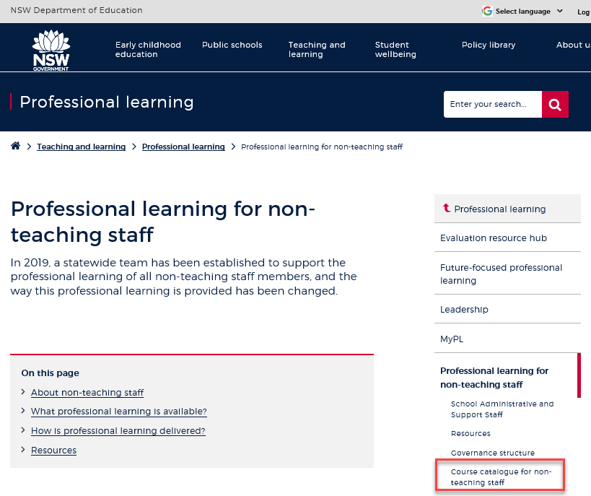
Professional learning information, resources and course catalogue for non-teaching staff
Information about professional learning for non-teaching staff including links to a course catalogue and resources, can be found on the professional learning site of the intranet.
From the Inside the department A-Z tab select:
Professional learning
Professional learning for non-teaching staff
Course catalogue
Notes:
Professional learning information, resources and course catalogue for non-teaching staff.
Professional learning for non-teaching staff
Information about professional learning for non-teaching staff including links to a course catalogue and resources, can be found on the professional learning site of the intranet.
From the Inside the department A-Z tab select:
Professional learning
Professional learning for non-teaching staff
Course catalogue
Our course catalogue has a large range of professional learning events available for non teaching staff in your area and are a great resource to keep you up to date so you don’t miss out.
https://education.nsw.gov.au/teaching-and-learning/professional-learning/professional-learning-for-non-teaching-staff
https://education.nsw.gov.au/teaching-and-learning/professional-learning/professional-learning-for-non-teaching-staff/course-catalogue-for-non-teaching-staff

Slide 15
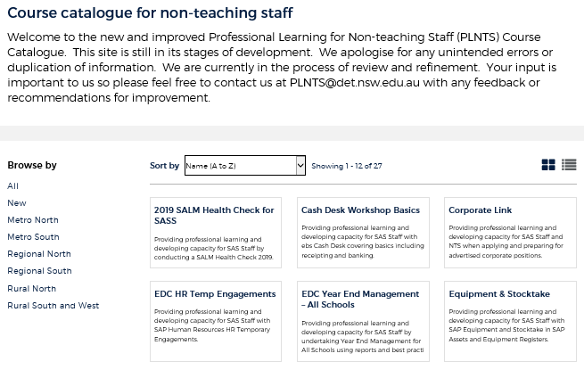
Professional learning non-teaching staff (PLNTS) catalogue
New and improved layout and features!
Display as a grid or a list
Browse options
Click a course for details, dates, location and MyPL reference
PLNTS catalogue
Notes:
The Professional Learning non-teaching staff (PLNTS) team’s schedule of professional learning caters for all categories of non-teaching staff in schools across the state.
Please refer to the professional learning catalogue for events that build your skills.
The catalogue is easy to use to find the course you need:
you can display as a grid or as a list
you can also browse by your region or
simply focus on new courses
Once you select a course, you will see
the course details and location
the dates the course is being presented and
the MyPL reference code.
https://education.nsw.gov.au/teaching-and-learning/professional-learning/professional-learning-for-non-teaching-staff/course-catalogue-for-non-teaching-staff

