Slide 1
Excellence in School Administration framework – Relationships
Aspect: Communicate effectively
Focus: 1.2 Written communication
Module: (b) Digital content - email
Sessions in this module
DoE email policy and procedures
Storing school emails [this session]
Structuring emails
Notes:
Note to presenter
Before commencing this module please read the separate Presenter notes which outline all preparation required to successfully present each session.
Welcome to the second session on Digital Content - Email module supporting the Written Communication focus area of the Excellence in School Administration Framework.
This module is one of a series of modules which have been developed to support the implementation of the Framework and contains notes for the presenter and identifies resources for the participants.

Slide 2
Structure of the module
This module contains 3 sessions and has a total delivery time of 2 hours 15 minutes. Resources for this module include:
PowerPoint presentation session
Session 1 – DoE email policy and procedures – 55 minutes
Session 2 – Storing school emails – 45 minutes
Session 3 – Structuring emails – 35 minutes
presenter notes with pre-reading and guidelines to successfully deliver sessions
handouts and activities.
Purpose
This module is one of a series of modules which have been developed to support the implementation of the Excellence in School Administration Framework
Notes:
Presenter to give an overview as per slide

Slide 3
Delivery
This module can be completed in the following manner:
presentation style – facilitator follows notes/slides and works through activities in a group setting
independently – individual follows slides, notes and works through learning tasks and activities.
To ensure the delivery meets the needs of your audience presenter should consider the following:
for internal presentations (to own staff) prior to presenting the session assess your knowledge of each participant’s experience in this topic, adjust notes and resources where necessary
for external presentations at the commencement of the session ask participants to introduce themselves and briefly explain their reasons for attending, adjust notes and resources where necessary.
Audience
Key audience is the front office administration staff, however it is a useful resource for all non-teaching staff in schools.
Notes:
Presenter to give an overview as per slide

Slide 4
Outcome of the module – digital content - email
At the completion of this module, participants should be able to:
describe the characteristics of well structured, easy to follow written communication and apply these to produce writing in the following forms:
general correspondence
permission notes and newsletters
digital content and email.
Notes:
At the completion of this module you should be able to describe the characteristics of well structured, easy to follow written communication and apply these to produce writing in the following forms:
general correspondence
permission notes and newsletters
digital content and email

Slide 5
Outcome of this session – storing school emails
At the completion of this session, participants should be able to:
understand their responsibility concerning the storage of emails
demonstrate their ability to correctly store and file department business emails.
Notes:
At the completion of this session you should be able to:
understand your responsibility concerning the storage of emails
demonstrate your ability to correctly store and file department business emails

Slide 6
Types of emails
Business email
Short term value email
Personal email
Record management - Help cards and eLearning
Notes:
In the previous session we looked at emails received or sent via the department email accounts which are divided into 3 categories:
business email – email which relates to the business of the school which must be retained to provide a record and not be altered in any way
short-term value email – email which is used to facilitate school business, but is of a trivial nature or of such short-term value that it does not support or contribute to the business functions of the department or school and can be deleted
personal email – email which is of a personal nature and which has no relevance to the business of the department or school and can be deleted
In this session we will discuss simple and practical options for storing the business emails, in-keeping with the Department of Education records management program.
Record management - Help cards and eLearning
https://education.nsw.gov.au/inside-the-department/edconnect/corporate-operations/compliance-records-and-audit/records-management/corporate-records-management/help-cards

Slide 7
Storage of business emails
Storage of business emails
What does it relate to?
What files should it be stored in?
Paper vs online
Notes:
It is highly likely that emails kept in most email systems will be unreadable in as little as 7 years due to technological changes. The Department of Education records management program details the length of time school records such as student records must be kept and in this case the timeline is 7 years with others only being 1 to 2 years or less. So how do we store emails for 7 years?
It is important that every school has standard procedures for keeping emails as a record. An important component of managing emails is classification. We classify emails by asking the following questions:
what does it relate to
in which file should it be stored
Emails should be filed so that they relate to other documents (paper or electronic) on the same activity or event, when this is done correctly a complete picture of the events related to a particular activity, student or business project is built.
Whether stored online or printed, these are things to consider in your school procedures.
Q: What do you see as the benefit to having standard procedures in schools for storage of emails?
A:
new staff are aware of procedures, easy to find all information relating to activity
student files are accurate and up to date if required for legal reason
Record management - Help cards and eLearning
https://education.nsw.gov.au/inside-the-department/edconnect/corporate-operations/compliance-records-and-audit/records-management/corporate-records-management/help-cards

Slide 8
Storage of business emails
Printed emails
Advantages
Can be deleted, saving space online
Cannot be altered after printing
Permanent record
Not affected by technology changes.
Disadvantages
Increase in printing and paper costs
Less confidential
Can get lost.
Record management - Help cards and eLearning
Notes:
Q: Can you print business emails?
A:Yes, all emails can be printed but some don’t need to be printed.
Q: What are the disadvantages to printing emails?
A:
substantial increase in printing and paper costs, so it would not be feasible to print all the business emails
less confidential as anyone can read them
printed copies can get lost
However there are some benefits to printing business emails:
once printed the email can be deleted from the inbox releasing more storage space in the email system
once printed the email content cannot be altered in any way, thereby providing a permanent record of the activity
printed emails are not affected by technological changes such as email systems crashing, new versions and new computers
Record management - Help cards and eLearning
https://education.nsw.gov.au/inside-the-department/edconnect/corporate-operations/compliance-records-and-audit/records-management/corporate-records-management/help-cards

Slide 9
Storage of business emails
Stored online emails
Advantages
Disadvantages
no printing costs
inbox space issues
confidential to email receiver
content can be altered
easily accessible when required
can get deleted or lost
include others in email trail
subject to technology changes
Record management - Help cards and eLearning
Notes:
What about saving the emails online?
All emails can be stored online. Let’s look at the advantages and disadvantages of online storage.
Click to transition points on slide
The advantages are:
no printing costs
confidential to email receiver
easily accessible when required
can include others in the email trail by forwarding or cc’ing a person into it rather than copying the email
Click to transition points on slide
The disadvantages are:
inbox space issues
content can be altered
can get deleted or lost
subject to technology changes.
Q:
Can you think of any other advantages or disadvantages?
Record management - Help cards and eLearning
https://education.nsw.gov.au/inside-the-department/edconnect/corporate-operations/compliance-records-and-audit/records-management/corporate-records-management/help-cards

Slide 10
Storage of business emails
Stored business emails
Online email folder
Create new folder in “inbox”
Finance – subfolder ‘year’
Department notifications -subfolder ‘year’
Hardcopy folder
Student record card
Finance management reports
Principal secure filing
Notes:
When considering the storage of emails you must take into consideration the long term storage options.
For example: if the sick note is sent by email then it can be:
saved then uploaded against the student in ebs which will remain in the students documents until they turn 25 years of age as an electronic copy. The electronic document can be opened, printed or emailed at a later date if required
printed and stored in the student record card (7 years storage) and then deleted from the inbox
If it is relevant to only store it online, good practice is to, action the email - forward it to the relevant person. If it is a business email, store it in the relevant inbox folder. If it is not a business email it can be deleted.
You can also create a subfolder within the inbox labelled, for example, finance and then another subfolder in the finance folder with the relevant year for example, 2017.
Emails can then be transferred to these subfolders releasing room in the school email inbox.
The next slide shows an example of an inbox and subfolders.

Slide 11
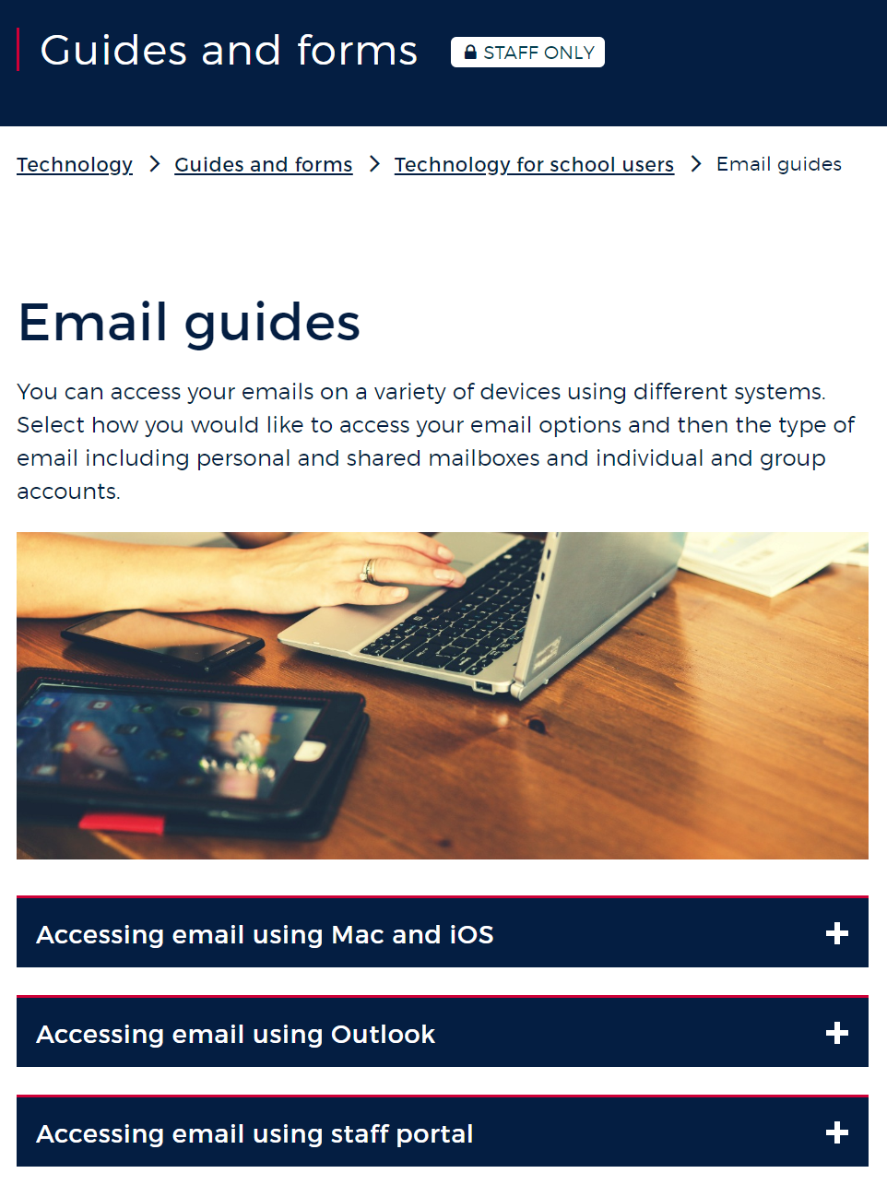
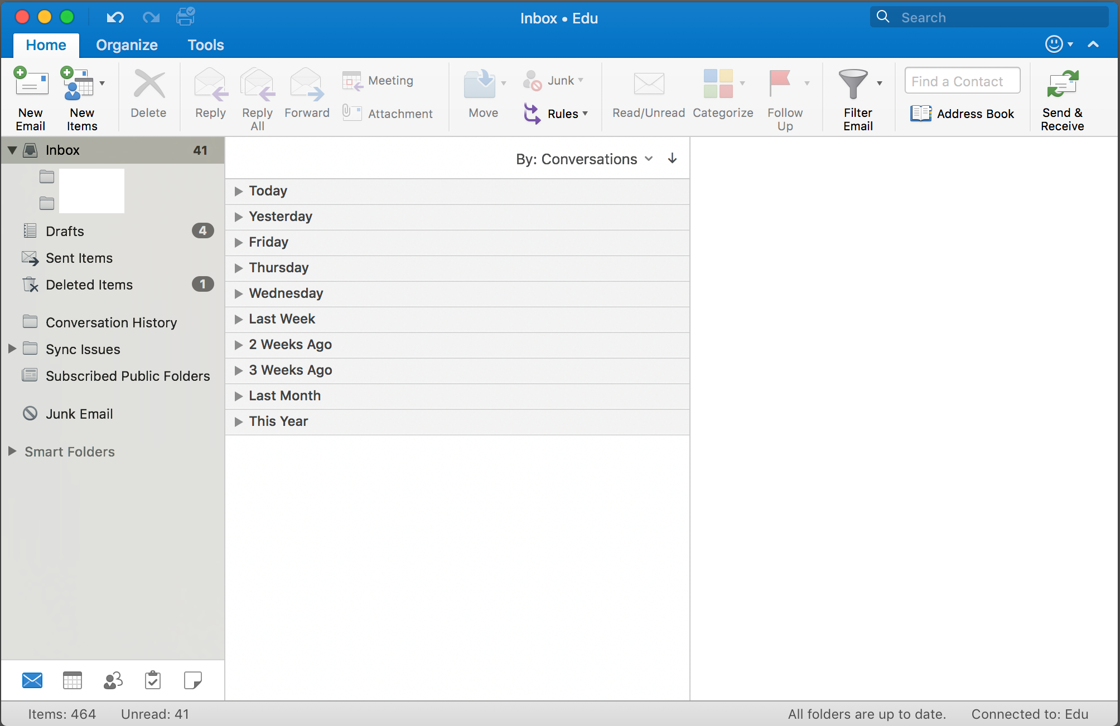
Inbox and subfolder
Email guides and forms for school users
Notes:
Subfolders can be created in the email inbox for different storage requirements.
For example:
inbox, finance, year
inbox, professional learning, SAS, Teacher
inbox, meeting minutes, year
Q: Can you suggest other folders for storage?
A:
archive
invoices
For resources and further information on how to best use your emails from your Portal page, go to A to Z, Information Technology, Guides and forms, Email guides about how to create sub folders and how to use emails, calendars etc.
Click here for Email guides and forms for school users
https://education.nsw.gov.au/technology/guides-and-forms/technology-for-school-users/email-guides

Slide 12
Storage of emails
Activity – storage of emails
Which emails should be kept?
Should they be printed or stored online?
Where should they be stored
Notes:
Let’s look at which emails should be printed and where to store them?
Activity (10 minutes)
Hand out from Presenter Notes - Storage of emails activity sheet
Work through the first example on the sheet to familiarise participants with the activity and then ask participants to work through the sheet in pairs.
Using the questions on this slide work through the types of emails on the handout.
Stay on this slide until participants are finished
Q: Would anyone like to share with the room what they wrote on the sheet?

Slide 13
Storing emails
Storing emails |  | Type of email |  |  | Print email |  | Storage | Location
 | Business (go to print column) | Short term value (go to print column) | Personal (delete) | Yes (go to storage location) | No (delete when finished) | No (go to storage location) | Online folder | Paper record
Supplier quote
Permission note
Sick note
Department notification (DN)
Copy of student enrolment form
Mum inviting you to lunch
Cranky parent letter
Funding notification/grants
Confidential staff issues
Community member positive feedback email
Enrolment enquiry
Invite for principal to attend local high/primary school event
Guest reply to end of year presentation day ceremony invitation
Notes:
Discuss the options that were chosen
Do participants agree with this?
Did they follow policy in the storage and retention of the email?
There is an answer sheet in the presenter notes.

Slide 14
Reflecting on this session – storing school emails
Has this session given you an understanding of:
your responsibility concerning the storage of emails
how to correctly store and file department business emails?
Notes:
Ask participants to reflect on what they have learned in this session
Has this session given you an understanding of:
your responsibility concerning the storage of emails
how to correctly store and file department business emails?
Ask participant's to reflect individually and then share with the person next to them

Slide 15
ESA relationship modules
Framework focus area | Module | Session
1.1 Oral communication | a. Face-to-face communication | Quality communication Create a positive image Develop a customer service statement
1.1 Oral communication | b. Telephone communication | Telephone communication Telephone communication procedures
1.2 Written communication | a. Communication guidelines | DoE Style Guide Written communication
1.2 Written communication | b. Digital content – email | DoE email policy and procedures Storing school emails Structuring emails
1.2 Written communication | c. Digital content – website | Keeping your website current School website team
1.3 Building relationships | a. Students as customers | Supporting students Student wellbeing
1.3 Building relationships | b. Connecting with customers | Cultural diversity Aboriginal & Torres Strait Islander customers Welcoming customers with disability Customer complaints - role of SAS staff
1.3 Building relationships | c. Customer feedback | Customer feedback
1.4 Teamwork | a. Keeping staff informed | Keeping staff informed
1.5 Promoting the school and its vision | a. School plan and school culture | School plan and school culture
Professional Learning for Non-Teaching Staff (PLNTS) website
Notes:
This module is one of a series of developed resources to support the Excellence in school administration customer relationships framework.
These are all located on the DoE professional learning website, School Administrative and Support webpage which can be accessed via the portal, Inside the department A-Z.
https://education.nsw.gov.au/teaching-and-learning/professional-learning/professional-learning-for-non-teaching-staff

Slide 16
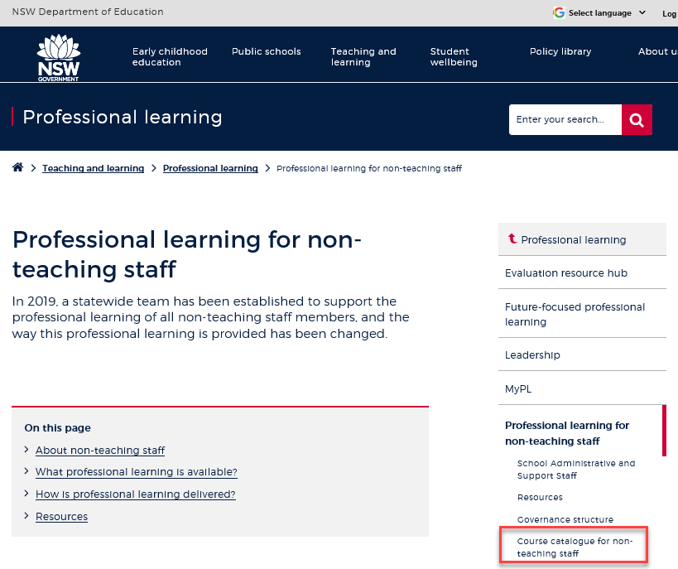
Professional learning information, resources and course catalogue for non-teaching staff
Information about professional learning for non-teaching staff including links to a course catalogue and resources, can be found on the professional learning site of the intranet.
From the Inside the department A-Z tab select:
Professional learning
Professional learning for non-teaching staff
Course catalogue
Notes:
Professional learning information, resources and course catalogue for non-teaching staff.
Professional learning for non-teaching staff
Information about professional learning for non-teaching staff including links to a course catalogue and resources, can be found on the professional learning site of the intranet.
From the Inside the department A-Z tab select:
Professional learning
Professional learning for non-teaching staff
Course catalogue
Our course catalogue has a large range of professional learning events available for non-teaching staff in your area and are a great resource to keep you up to date so you don’t miss out.
https://education.nsw.gov.au/teaching-and-learning/professional-learning/professional-learning-for-non-teaching-staff
https://education.nsw.gov.au/teaching-and-learning/professional-learning/professional-learning-for-non-teaching-staff/course-catalogue-for-non-teaching-staff

Slide 17
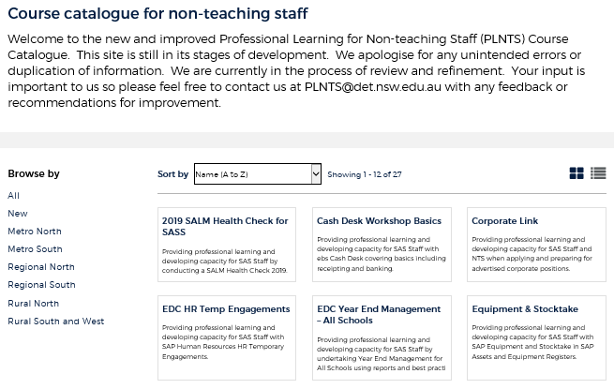
Professional learning for non-teaching staff (PLNTS) catalogue
New and improved layout and features!
Display as a grid or a list
Browse options
Click a course for details, dates, location and MyPL reference
PLNTS catalogue
Notes:
The Professional Learning for Non-Teaching Staff (PLNTS) team’s schedule of professional learning caters for all categories of non-teaching staff in schools across the state.
Please refer to the professional learning catalogue for events that build your skills.
The catalogue is easy to use to find the course you need:
you can display as a grid or as a list
you can also browse by your region or
simply focus on new courses
Once you select a course, you will see
the course details and location
the dates the course is being presented and
the MyPL reference code.
https://education.nsw.gov.au/teaching-and-learning/professional-learning/professional-learning-for-non-teaching-staff/course-catalogue-for-non-teaching-staff

