Slide 1
Nationally Consistent Collection of Data on School Students with Disability (NCCD)
School Presentation

Slide 2
What are my school’s obligations under the legislation?

Slide 6
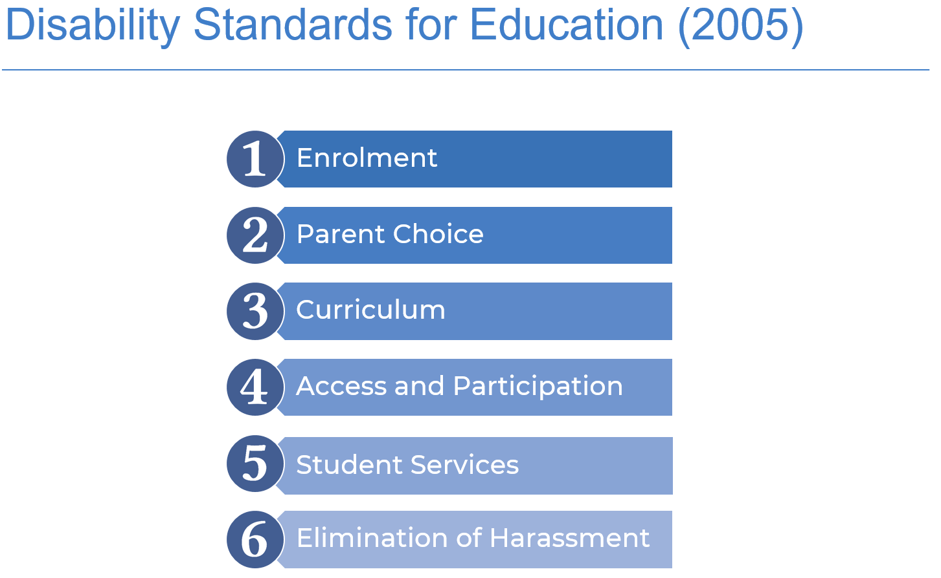

Slide 10
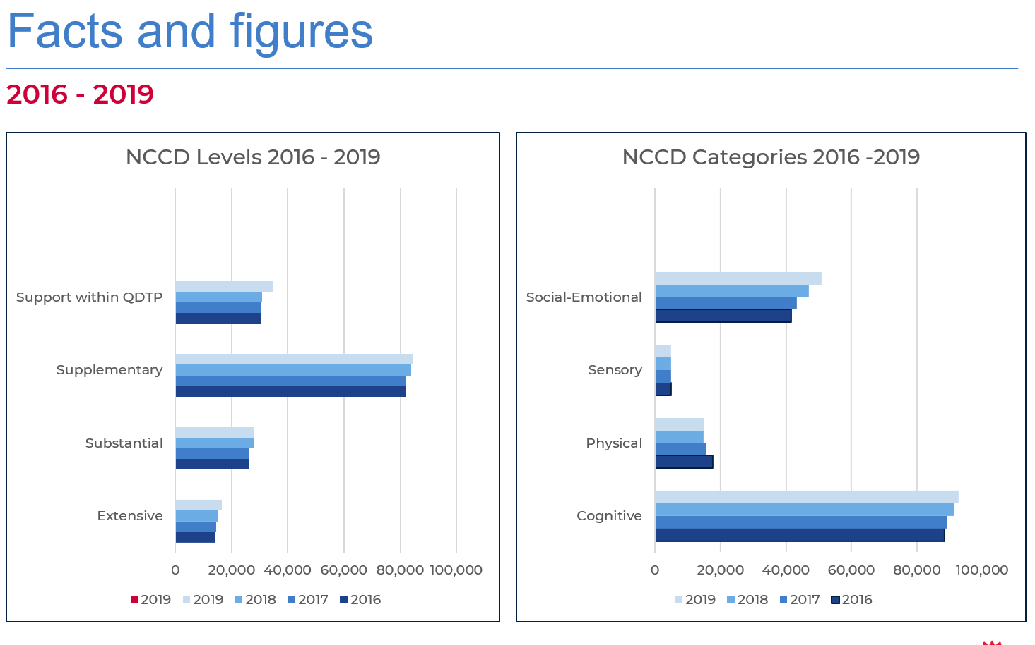

Slide 11
What is the NCCD Model?

Slide 16
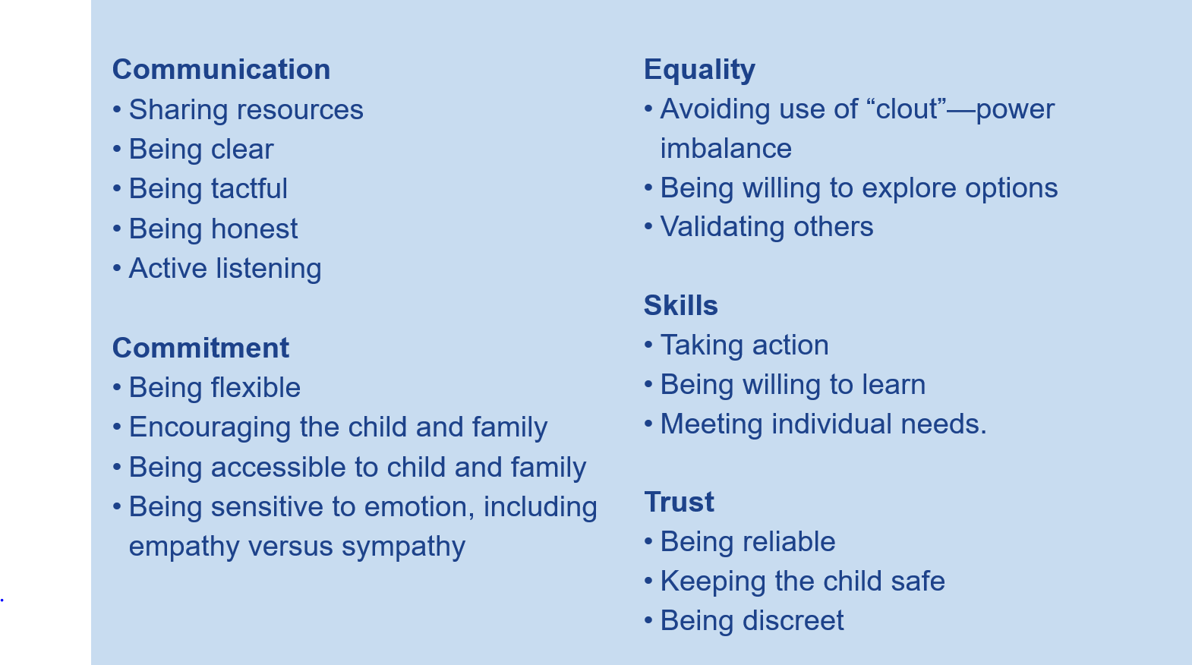

Slide 30
System Demonstration
ERN – Disability Adjustment Website
Online Data Collection Website

Slide 31
Evaluation and Close

Slide 32
Resources
Department of Education
Disability and Learning website
National
National NCCD professional learning portal
Australian Government’s Department of Education website
NSW Education Standards Authority
Collaborative Curriculum Planning
Adjustments
Assessment and Reporting
Programming

