Slide 1
Defence Drone Racing Team
Drone Learning Collection
STEMaSESH
WITH
Lieutenant Colonel Keirin Joyce CSC
Gunner Lewis Day
Private Mackenzie Togo
Flying Officer Jake Dell-O’Sullivan

Slide 2
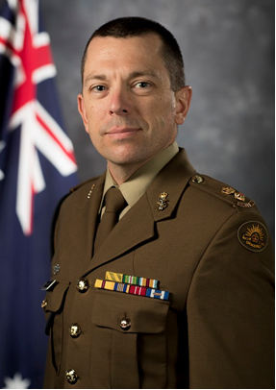
Profile: Lieutenant Colonel Keirin Joyce, CSC
Career blurb: LTCOL Joyce is an Australian Defence Force Academy graduate with an Honours Bachelor of Aeronautical Engineering. LTCOL Joyce has spent the last 14 years in support of the ADF Unmanned Aerial Systems (UAS) capability including deployment to Iraq and Afghanistan. LTCOL Joyce is a Chartered Professional Engineer, holds a Masters in Aviation Management (specialising in Human Factors), a Masters of Aerospace Engineering, a Masters in Military and Defence Studies, a Graduate Diploma in Secondary Education (Mathematics) and he is currently researching part time as a Doctorate of Philosophy student through ADFA. For the last three years, LTCOL Joyce was the Australian Army UAS Sub-Program Manager responsible for all Australian Army UAS activities, including Army Drone Racing, and this year is the Royal Australian Air Force Remotely Piloted Aircraft Systems (RPAS) Sub-Program Manager.

Slide 3
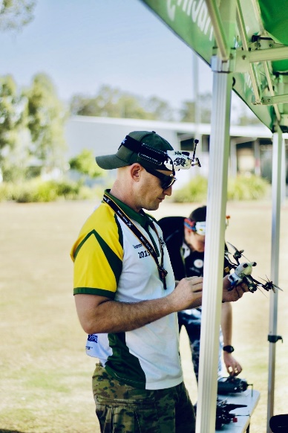
Profile: Gunner Lewis Day
Gunner Lewis Day is an Unmanned Aerial Systems (UAS) Operator, currently posted to the 20th Regiment, Royal Australian Artillery (RAA) in Brisbane.
Growing up in Regional NSW, Lewis finished is Higher School Certificate in 2006, spending 2007 in Europe travelling before studying Criminal Justice at Charles Sturt University in Bathurst, NSW.
Enlisting in the Australia Army in 2013 as Military Police member, Lewis soon realised that another military role was better suited to his personal interests and career goals, transferring to RAA in 2018 to begin his training as a UAS Operator.
Lewis has always had a passion for anything remote controlled, be it cars, planes, trains and so on. So, this career path was almost a natural progression of that, being able to operate large scale unmanned aircraft within the military.
In his spare time, Lewis enjoys competitive First-Person View (FPV) Drone Racing, music and e-sport.

Slide 4
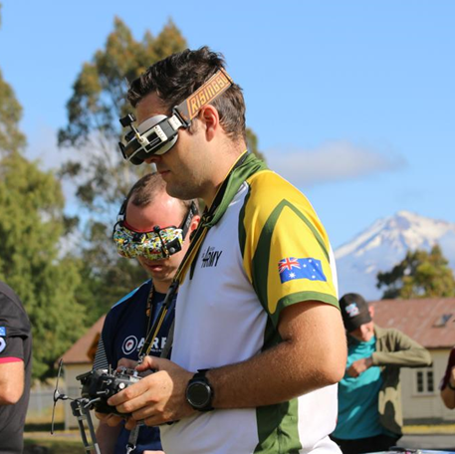
Profile: Private Mackenzie Togo
Private Mackenzie Togo is an Army Reservist currently posted to Army Headquarters and is the current Army Drone Racing Team Captain and Army Drone Racing Association Vice President.
Living in Northern NSW, Mackenzie enlisted in the Army Reserves in the infantry in mid-2015 and completed his High Schooler Certificate in 2015.
Mackenzie works full time as an indigenous education worker at a secondary college in Northern NSW, supporting Aboriginal and Torres Strait Islander students with their studies and future career options.
Mackenzie enjoys 3D design, 3D printing, working on MicroElectronics and competitive First-Person View (FPV) Drone Racing.

Slide 5
Drone Challenges
Activities that you can continue with after watching STEMaSESH
.

Slide 6
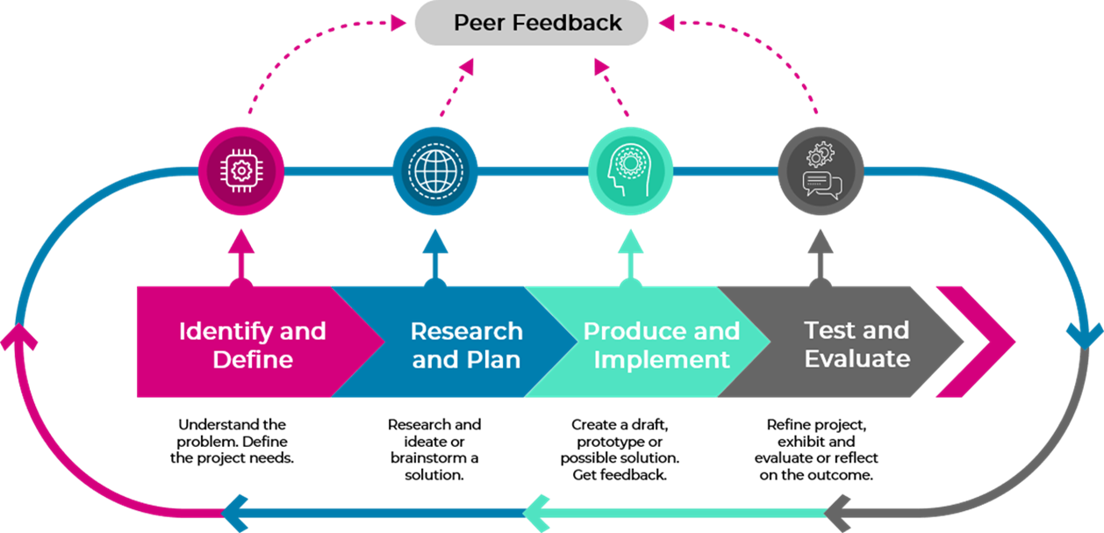

Slide 7

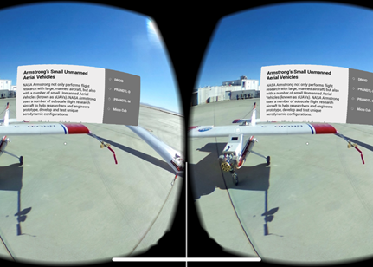
Virtual Tour about Drones
Google Tour Creator
Create a virtual tour on drones with Google Tour Creator.
Plan tour by drafting a storyboard outlining scenes and points of interest that will be included in each scene.
Write a list of short descriptive paragraphs that can be added as details to each point of interest.
Use the 360 camera to take a series of photos and videos or access the school's collection of 360s.
A series of photos will be needed for the points of interest, aim to include a minimum of 3 and maximum of 6 in each scene.
Once completed, share your virtual tour with your classmates in Google Expeditions.

Slide 8

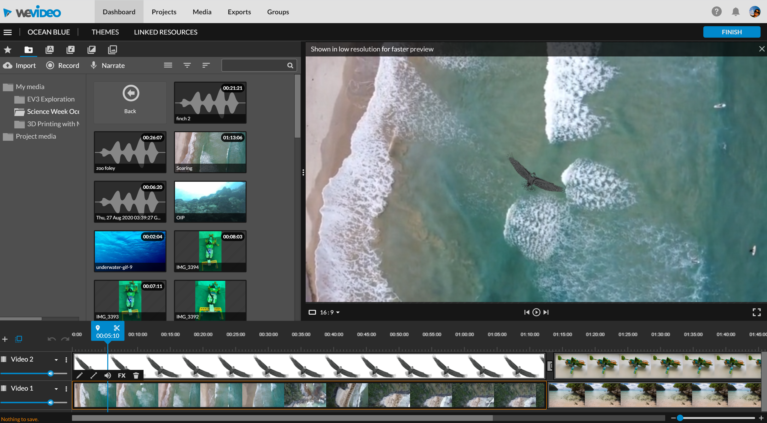
Create a Documentary or News Report about Drones
WeVideo
Brainstorm what your documentary or news report will cover about drones (e.g. racing, rescues, farming, deliveries, rules, career profiles, etc).
After researching drones construct a documentary or news report script.
Film with iPads or iPhones.
What features of WeVideo can you use in timeline or story mode e.g. a greenscreen, audio, transitions, titles etc. when editing your footage.
Share your finished product with your classmates.

Slide 9
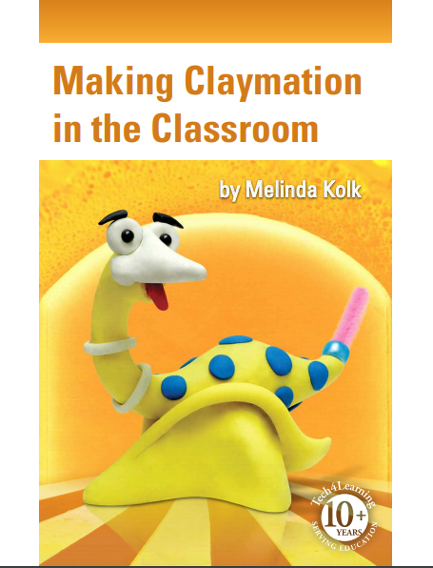
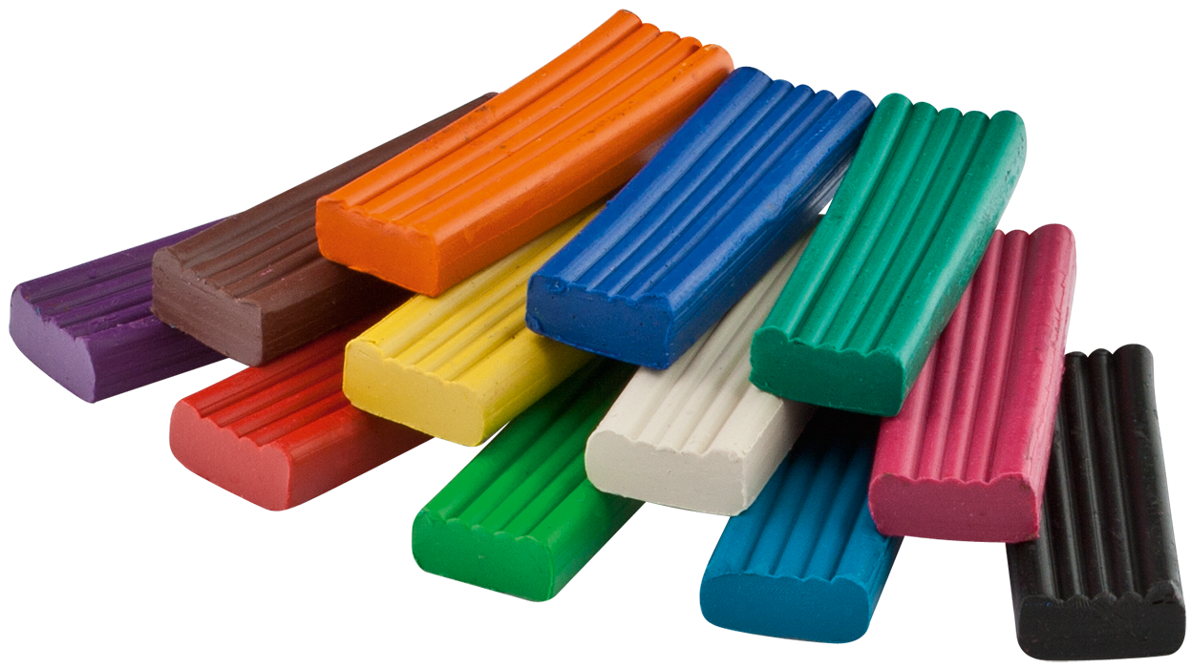
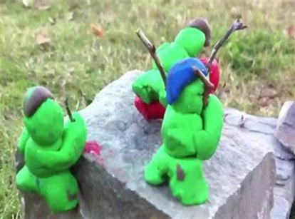
Drone Rescue Claymation
Claymation/Stop Go Motion Animation
Retell a story about a drone being used in a rescue.
Use Clay or LEGO to construct simple characters and objects for your animations.
Plan how you intend to morph characters or objects frame by frame.
Design and draw backdrops, or use a green screen effect and chroma key to place characters in a scene.
Use an iPad or iPhone to film your Claymation.
Notes:
https://www.tech4learning.com/files/Making_Claymation_in_the_Classroom.pdf

Slide 10

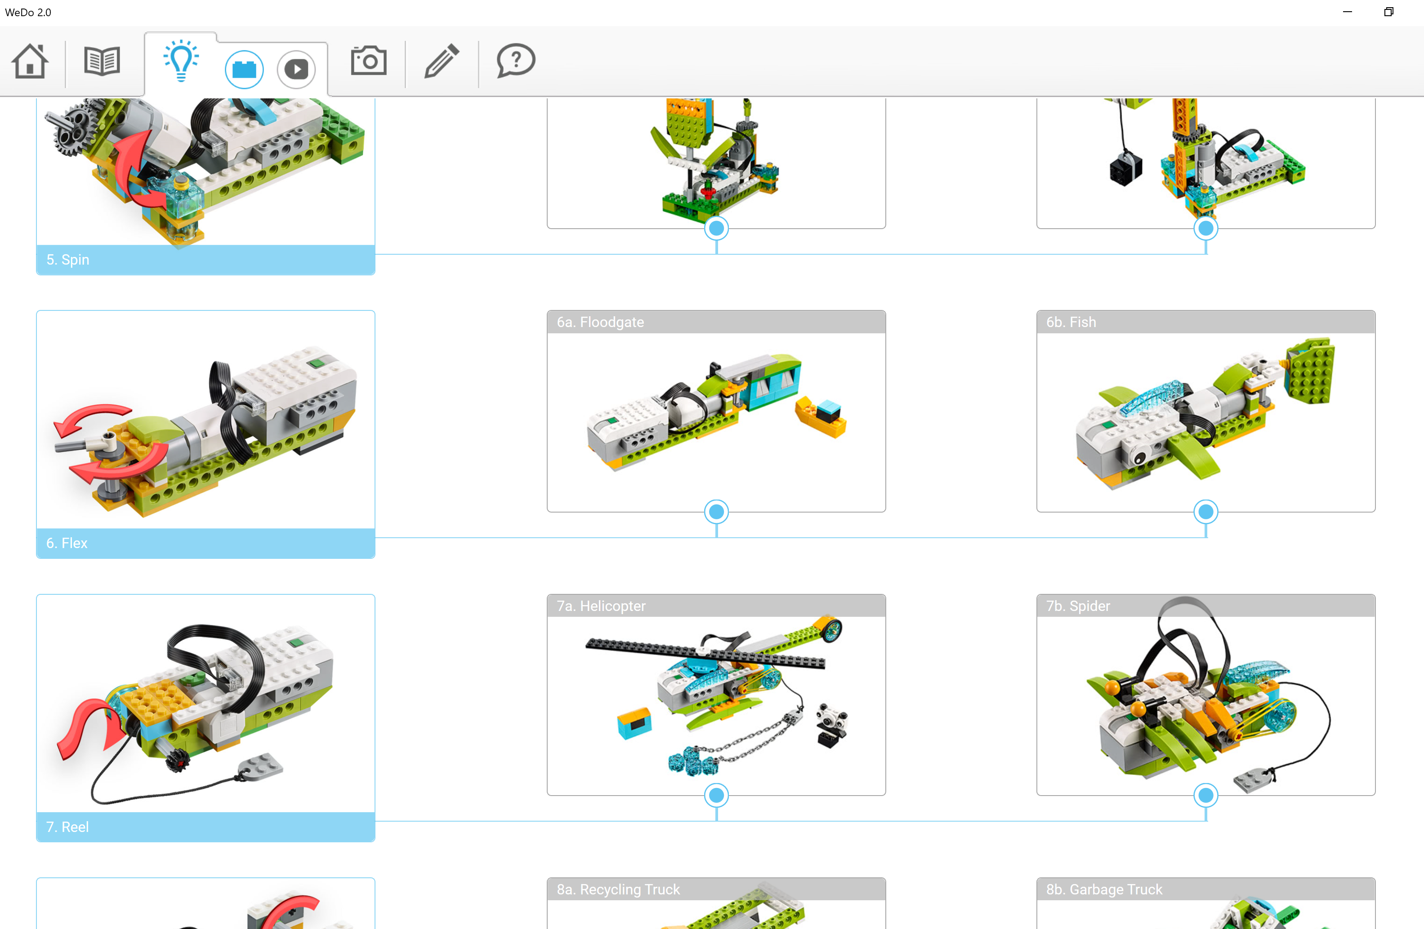
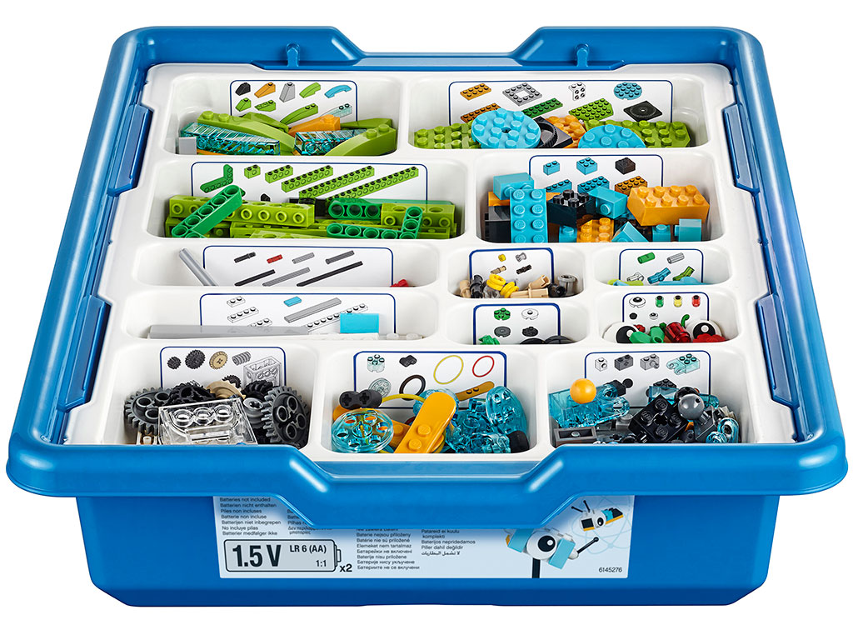
Design and Build a new style of Drone
WeDo Lego Education
Research drones and its uses.
Your challenge is to design a drone or improve an existing model using WeDo Lego Education.
Draw and label parts of your drone, before building it.
Be sure to program, test and modify your drone.
Share your finished drone with your classmates.

Slide 11

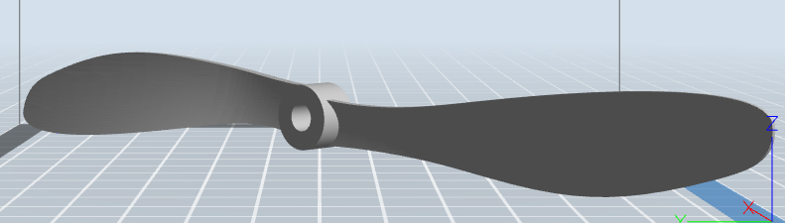
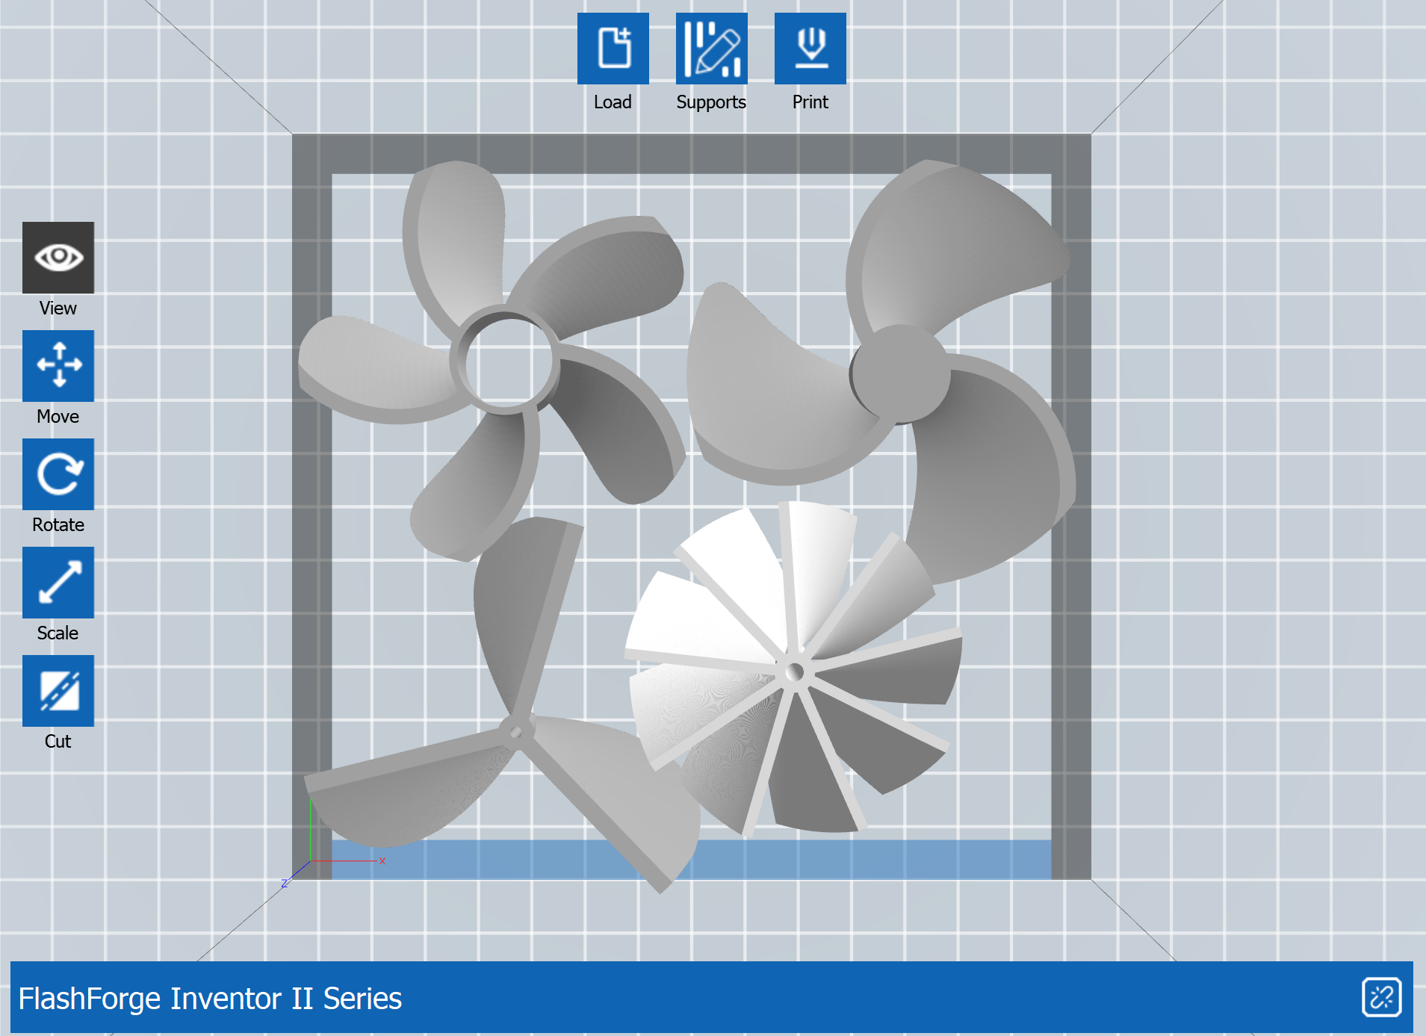
Modelling flight
3D Modelling with Tinkercad
Create models in Tinker cad of propeller blades ,3D print and test.
Creating a digital portfolio of blades created, reasoning behind the shape data collected and test results.
Test the following variables for force :
  The shape
  Angle
  Length
  Surface area
  Number of blades
  Weight
  Axis the propeller is facing when printing
Testing can be as simple as observing the force of the air moving through the propeller when spun.
Remembering validity and reliability while testing
Will the class be collecting qualitative or quantitative data

Slide 12

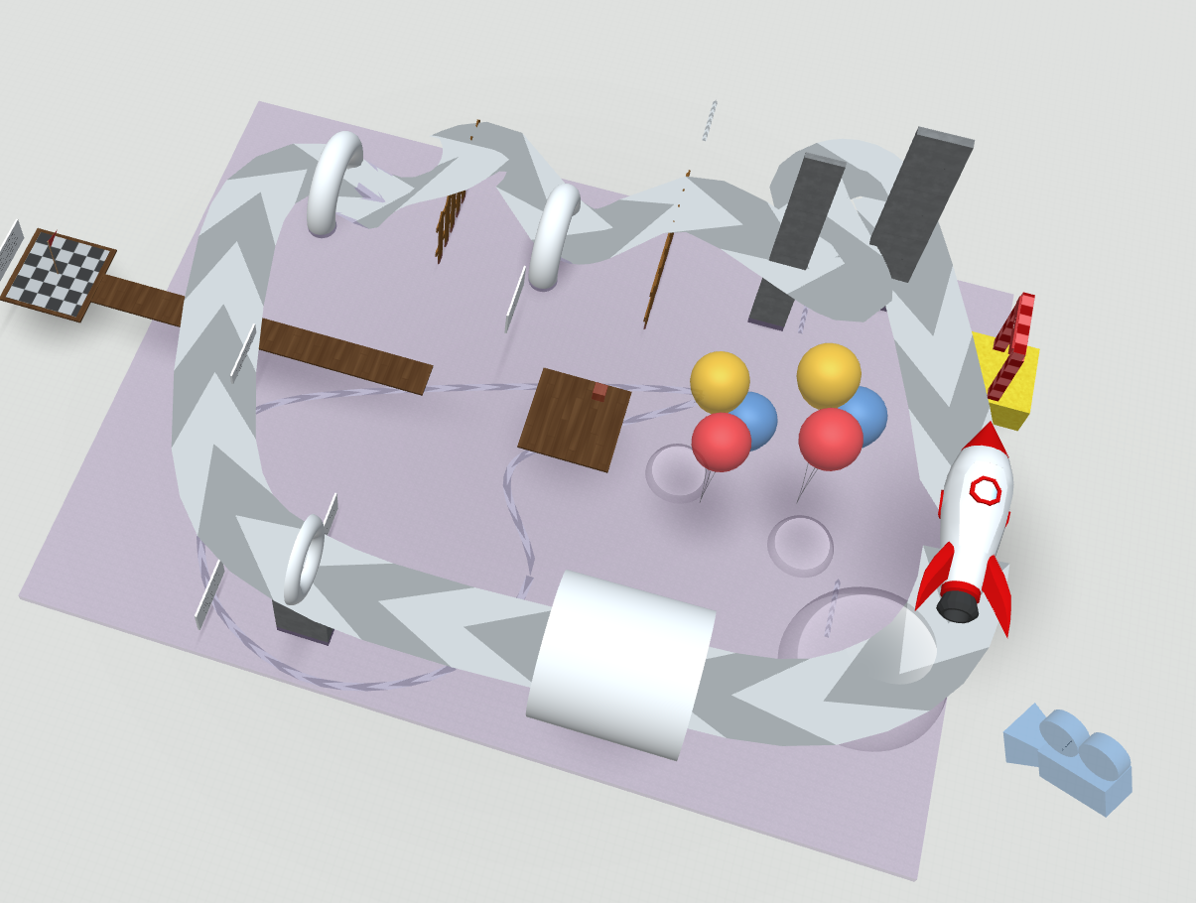
Simulated Drone Training Ground
Cospaces
1. Use Cospaces EDU to create a virtual drone training ground containing obstacles to fly through. Download a drone and use the path tool to travel through the course.
Template Parkour
3. If the school has a drone, complete the model to scale then build the course and test.
4. Use drone footage of your area to create a linked tour like Indooroopilli https://edu.cospaces.io/QBU-ZLX
NB: If using drones in schools please make sure that you read and comply with the Equipment Safety in Schools Advice

Slide 13
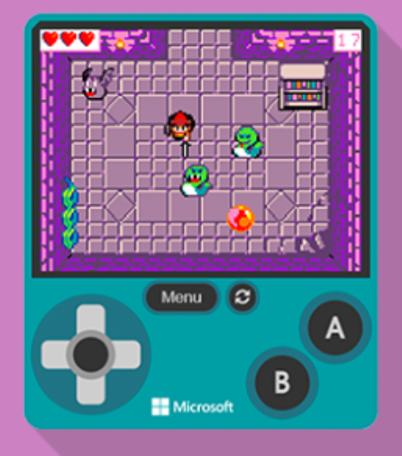
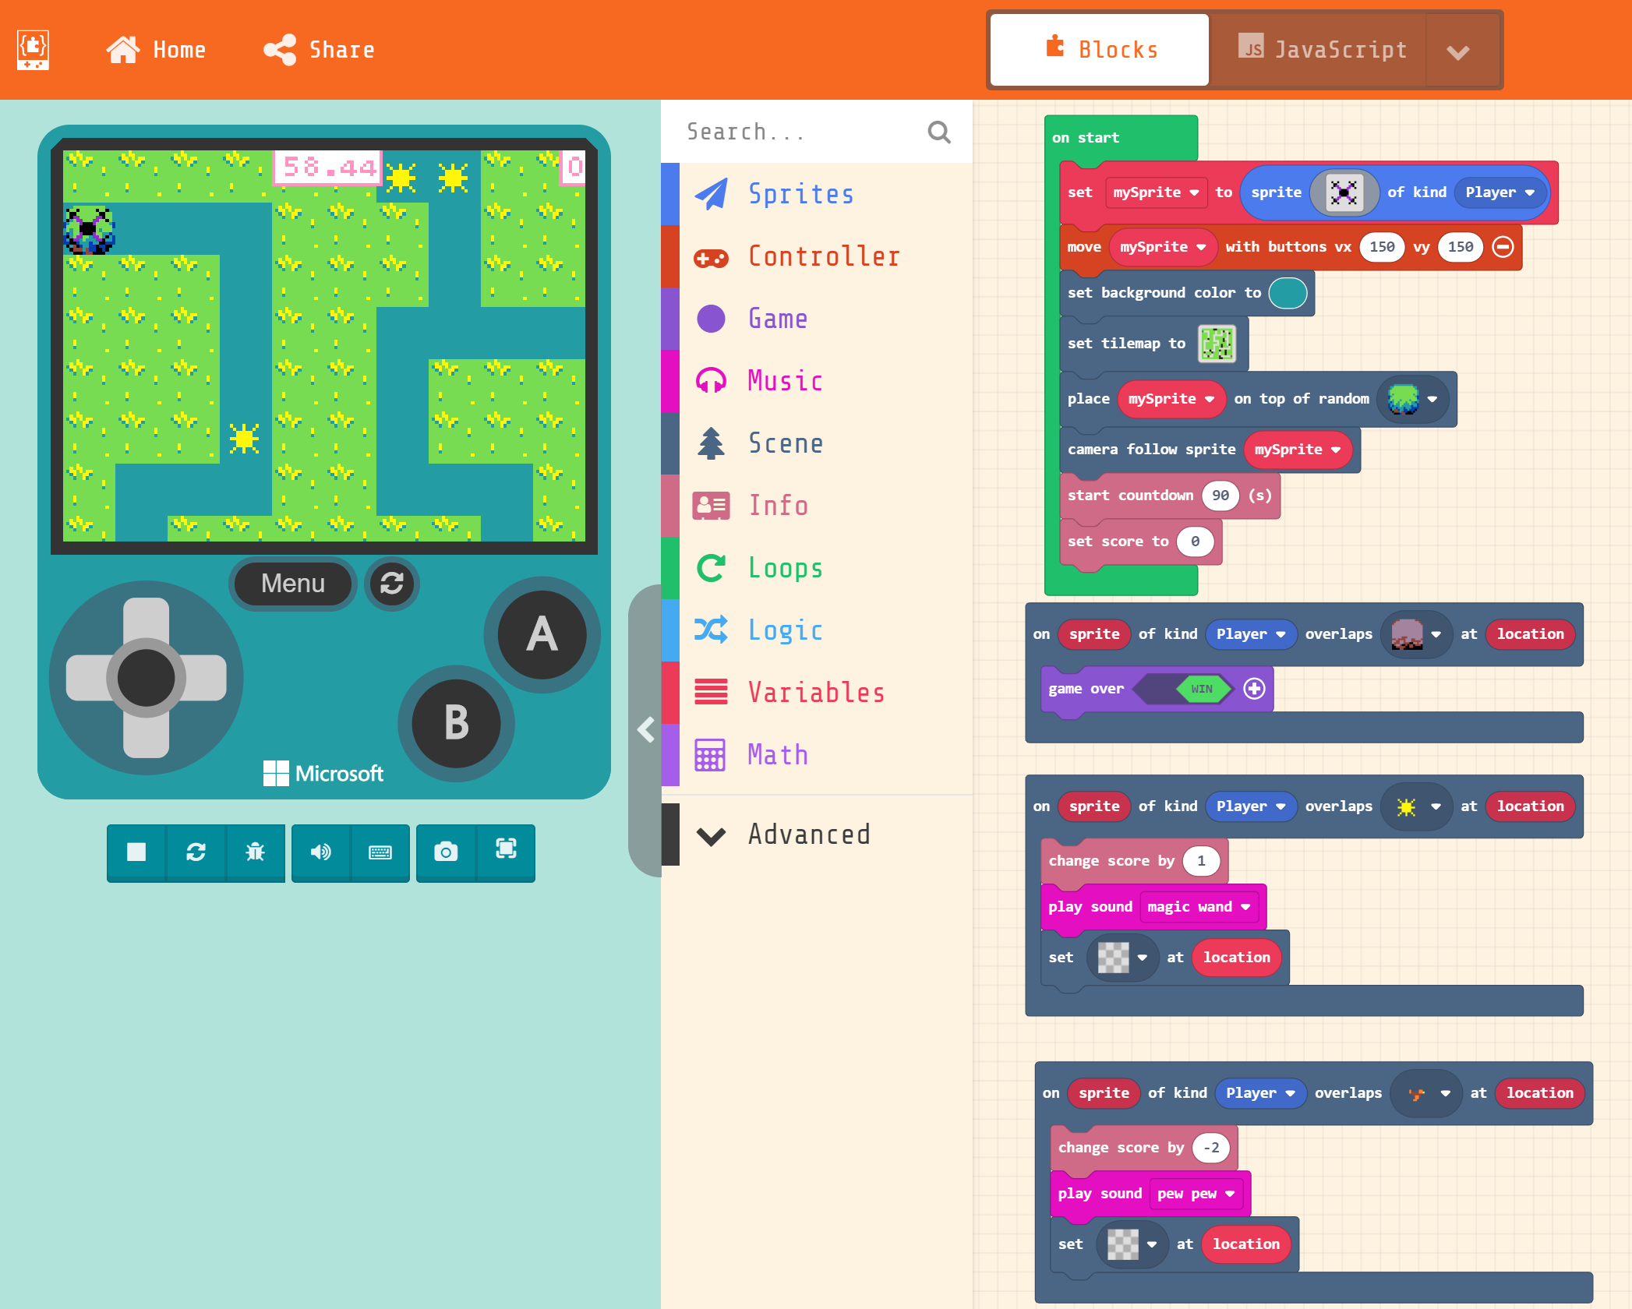
Flight Simulator – Video Game
Make Code Arcade
Create a flight simulator using block based or java script coding
Need step by step- Follow the Wonder Woman example provided by make code.
  Modifying the code to include drones/rescue/birds to interfere with flight
Example https://makecode.com/_Aiz564gj18PM

Slide 14

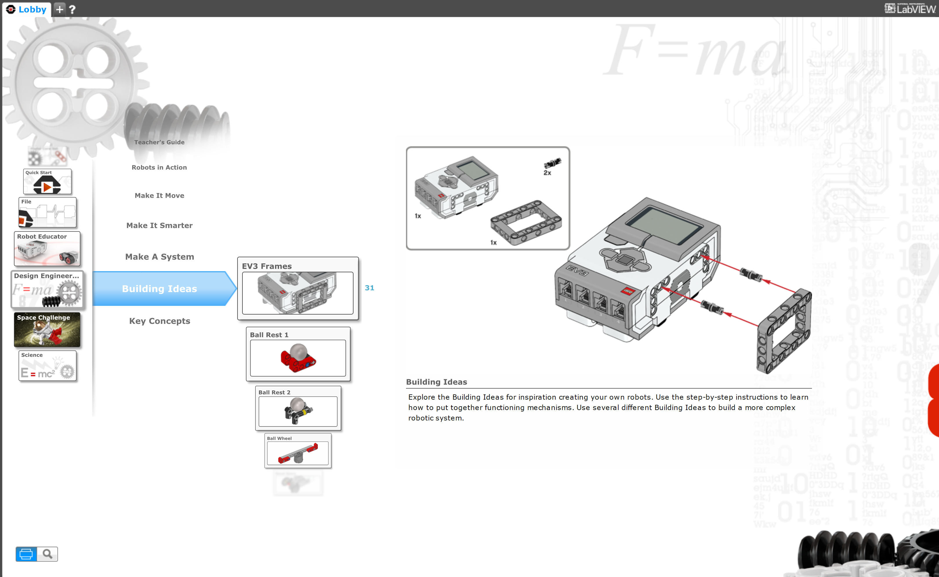
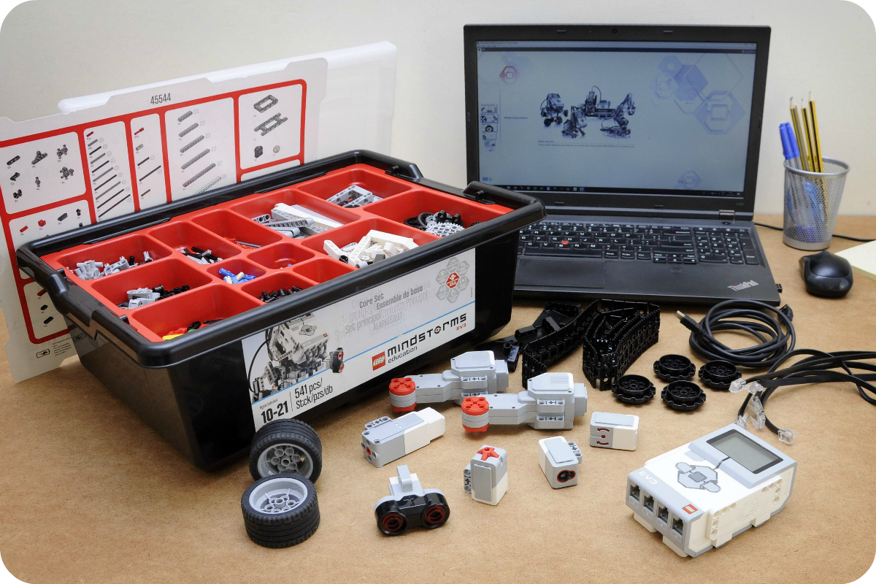
Create Drone Attachments
Lego Mindstorms Education - EV3
Can you design an attachment for your drone to pick up an object such as a grappling hook, net, rope mounted claw, bucket.
Once you have built your attachment be sure to program and test it.
Share your completed design with your class
Can your classmates offer any valuable ideas to modify and improve your attachment?

Slide 15
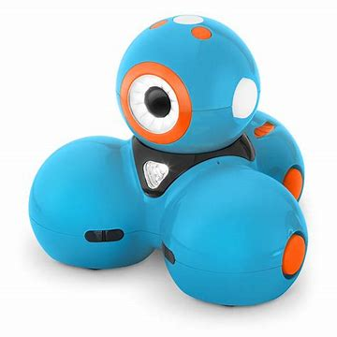
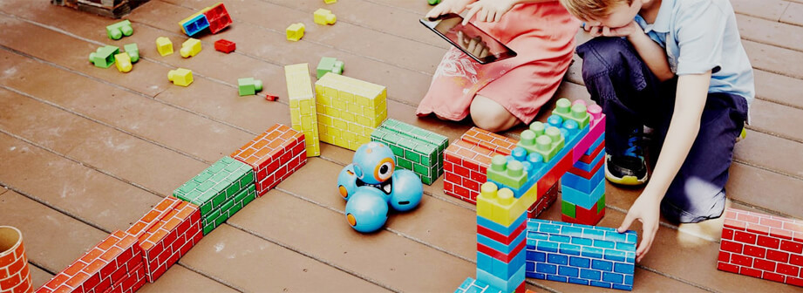
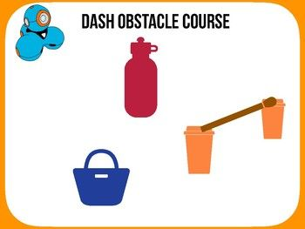
Create a drone racing obstacle course
Dash Wonder
Driving a drone is like driving a robot. Can you design an obstacle course for Dash to tackle?
Once you have designed a course and built it, program Dash to navigate around, through and under obstacles.
Have classmates attempt to navigate your maze in the fastest time.
Have classmates rate your obstacle course and give you feedback.

Slide 16
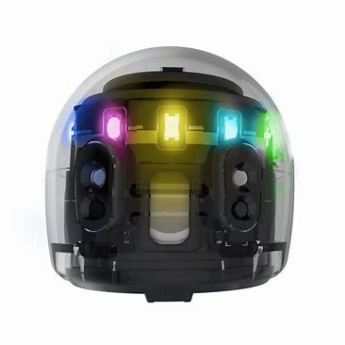
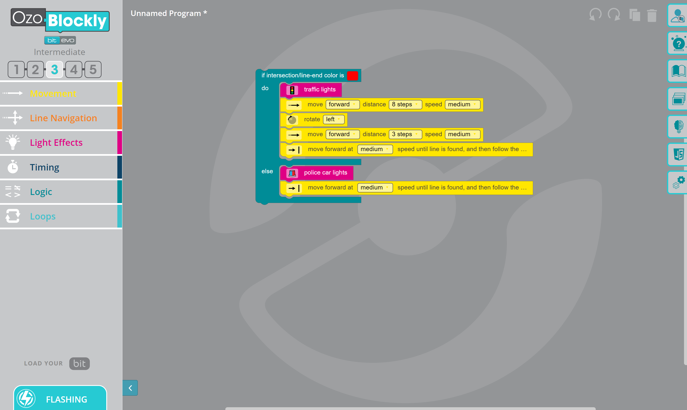
Storyboarding career paths
OZOBOT
Storyboard a career path of one of our guest speakers and how they got into drone racing.
See if you can add code to your storyboard using the markers and watch Ozobot navigate the career path.
Are you up for a challenge? Use OzoBlockly to code your Ozobot to navigate the career path.

Slide 17

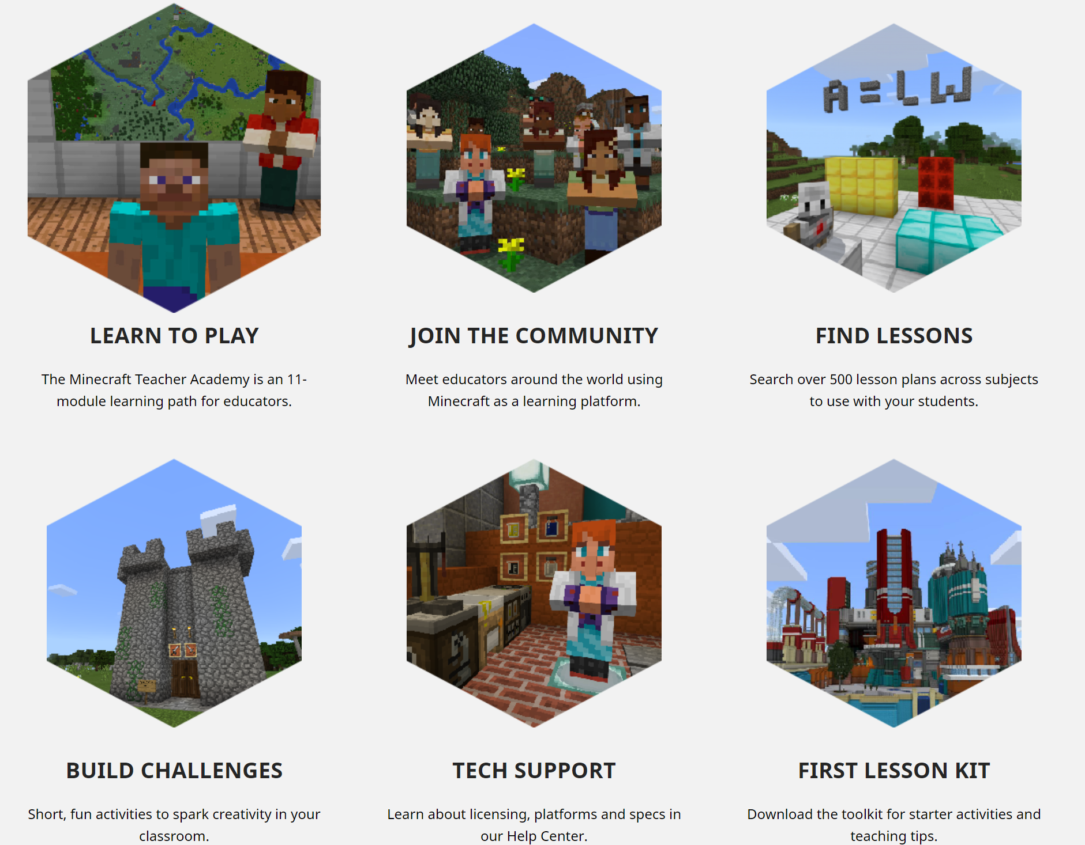
Simulating a Drone/3D modelling
Minecraft
Design a drone and simulate/code the parts of the drone, how they work together to enable the drone to fly.
Create a drone and use to create through code. The drone could be used to create buildings, deliver goods or complete challenges.

Slide 18


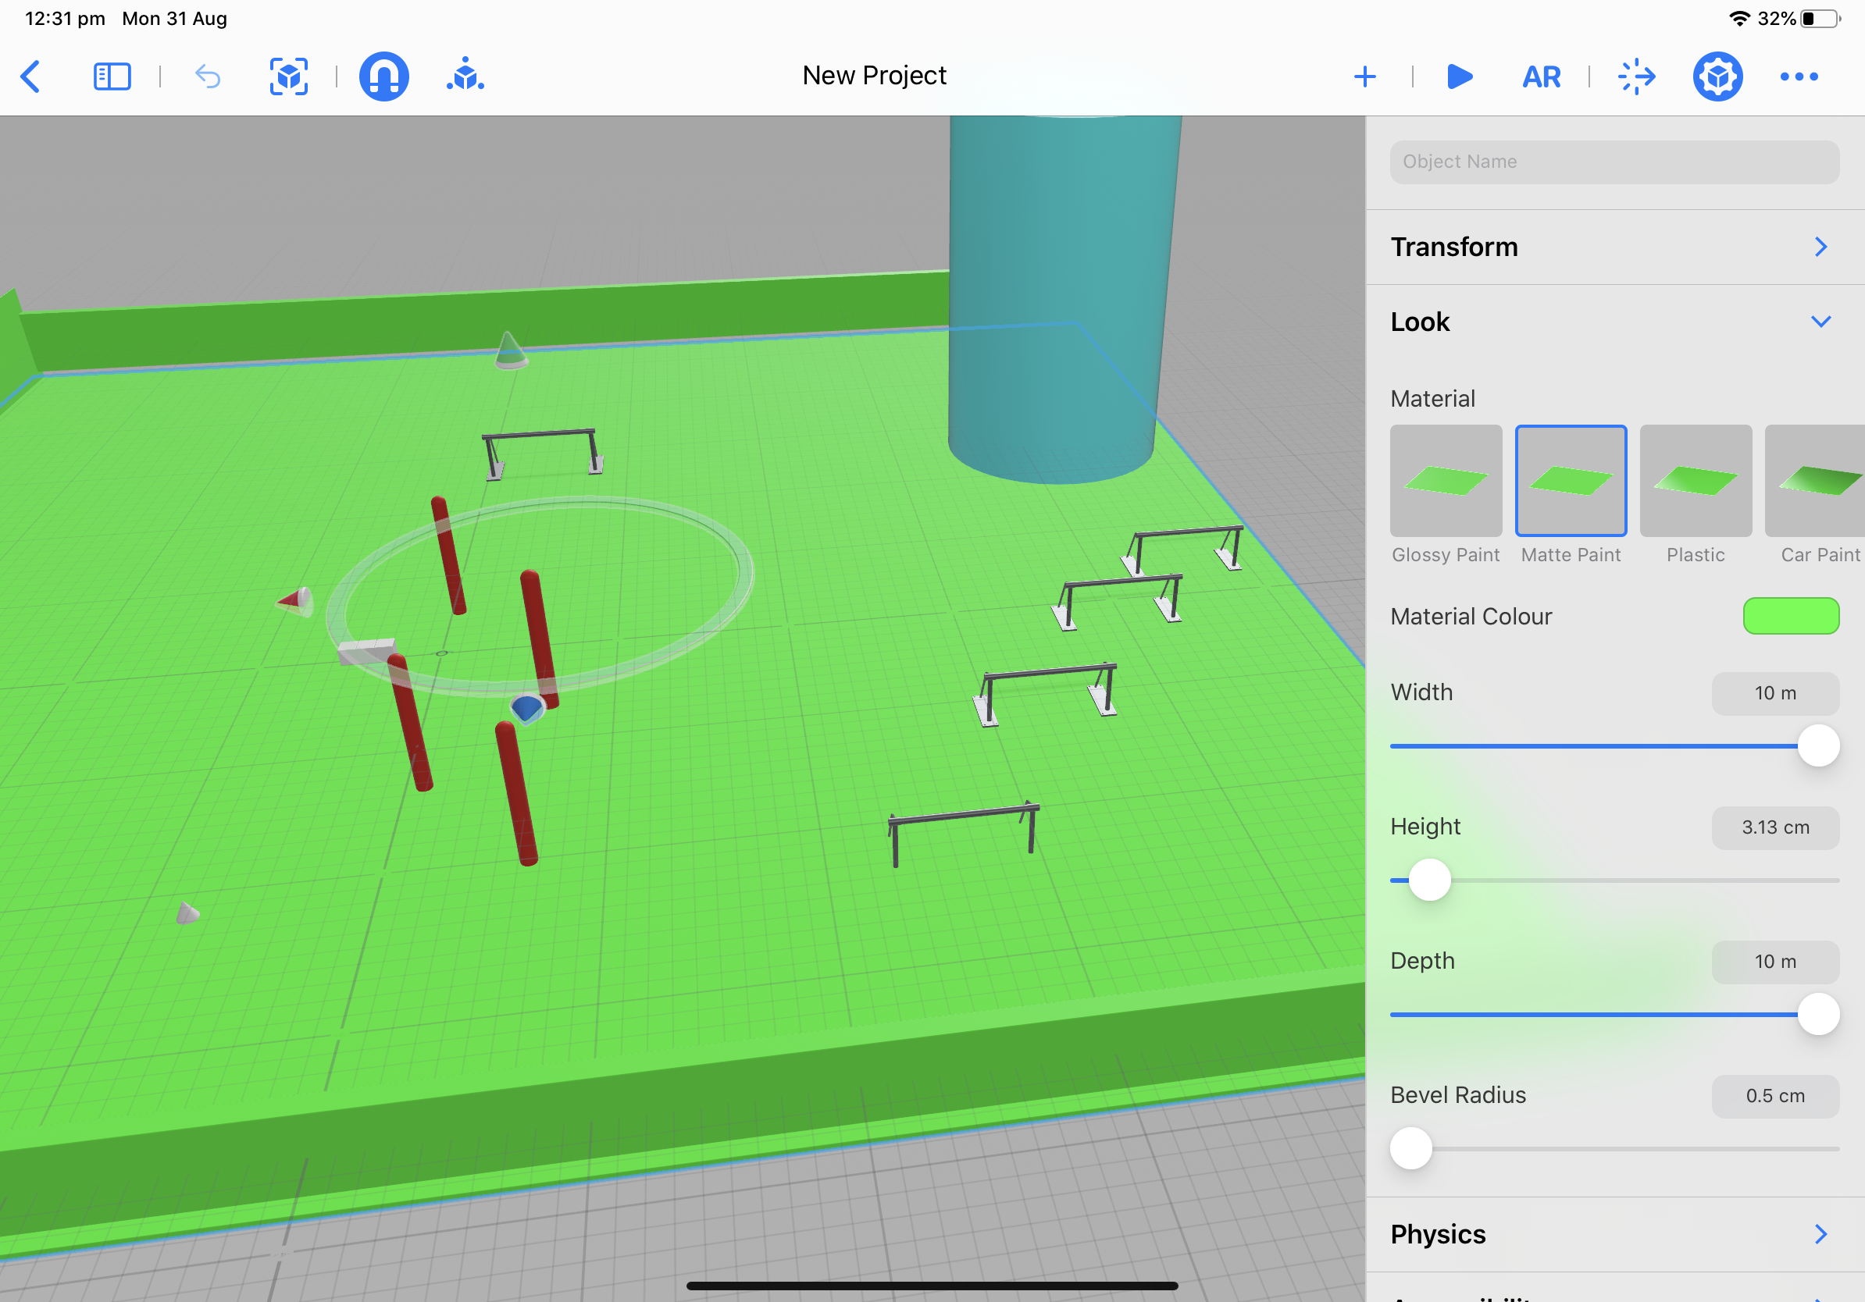
Digital story time into the future: Drone battle in 2050……….
iMovie- Comic Filter
Create a drone field using reality composer, place green blocks around the outside of the scene so that greenscreen/backgrounds can be added later.
Record the flight and movement from different angles
Place into iMovie and use the comic filter over the recording
Add music and other special effects.

Slide 19
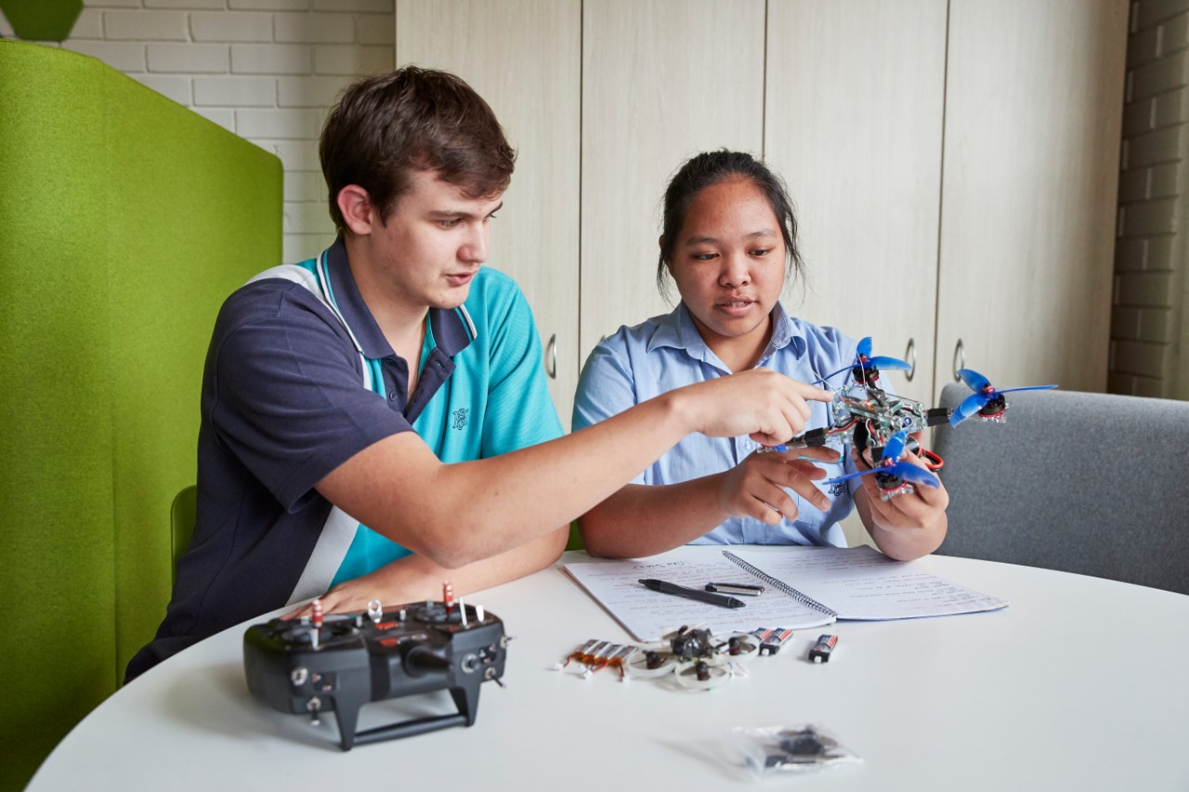
Please Note:
If using drones in schools please make sure that you read and comply with the Equipment Safety in Schools Advice

Slide 20

Be a T4L all star
Building a community of practice
When you complete any of these activities, or one you have designed yourself using the video as inspiration, please share your efforts and let us celebrate with you.
Via Email:
  Kath Lollback KATHERINE.LOLLBACK@det.nsw.edu.au
  Tanya Riach tanya.riach@det.nsw.edu.au
Via Social Media
  Stem.T4L facebook
  Yammer
  #T4Lallstar, #stem.T4L, #stemasesh
When you share your work, this helps to build a community of practice by inspiring others. We like to hear and see:
  Success stories
  Photos of student portfolios and/or worksheets
  Student samples of video, coding and other creations

